Slide 1
Unit 5
Chapter 6 Zumdahl
Thermochemistry

Slide 2
Thermochemistry
The study of energy released or absorbed (heat) during
chemical and physical processes.
We also talk about work (which extends our study into
thermodynamics a bit!)
Examples
How does burning gasoline “drive” a car?
How does melting ice cool your drink?

Slide 3
Capacity to do work or transfer energy (heat)
Mechanical Energy: Total PE and KE of system
Potential energy – energy due to position/forces; stored energy
Kinetic energy – energy due to motion
Associated with object “as a whole” (macroscopic)
Example: a ball thrown up in the air
PE due to position (gravity/height above ground)
KE due to motion (1/2 m v²)

Slide 4
Total KE and PE of the molecules of an object/system
Potential Energy
energy stored in chemicals as a result of their composition/bonds
Kinetic Energy
thermal energy (“heat”)
related to motion of particles (atoms/molecules)
Example: A mixture of gasoline and oxygen
PE due to chemical reaction “potential”
KE due to motion of the molecules

Slide 5
System: The part of the Universe under study
Surroundings: The rest of the universe with which the system can exchange energy or matter
Open System (e.g. beaker)
Energy and matter can both flow between system and surroundings
Closed System (e.g. stoppered flask)
Energy can flow, but no material exchange
Isolated System (e.g. Thermos)
Neither mass nor energy can be exchanged

Slide 6
Exothermic: process that loses heat (q) to the surroundings
Endothermic: process that absorbs heat (q) from the surroundings

Slide 7
Heat, Work, and Internal Energy
Law of Conservation of Energy
energy cannot be created or destroyed
can only be transferred or changed into different forms
Internal Energy (E)
sum of the kinetic and potential energies of all the “particles” in the system.
compare the internal vs. mechanical energy of a ball falling through the air.
Heat (q) = thermal energy
Energy transferred due to a difference in temperature
Work (w) = mechanical energy
Energy transferred by applying a force through a distance
Temperature vs Heat: What is the difference?

Slide 8
Important Point!
Work can be converted to heat (using the brakes to stop a car)
Heat can be converted to work (an internal combustion engine)
Which seems more efficient / easier to do?

Slide 9
Change in internal energy (ΔE) is equal to heat (q) gained or lost, and work (w) done on or by the system.
ΔE = q + w
System gains internal energy: ΔE = +
q = + (heat flows into system from surroundings: T_{sys} < T_{sur})
w = + (work done on system by surroundings)
System loses internal energy: ΔE = -
q = - (heat flows out of system to surroundings: T_{sys} > T_{sur})
w = - (work done by system on surroundings)

Slide 11
Find Internal Energy (ΔE) when a gas absorbs 22 J of heat and has 15 J of work done on it.

Slide 12
Enthalpy (H) => state property
Heat measured at constant pressure
Accounts for PV work..We won’t use the work component of E.
Depends only on initial and final state of system
ΔH = + endothermic process (heat absorbed by reaction from surroundings)
ΔH = - exothermic process (heat released into surroundings from system)

Slide 13
SI Unit: Joule (J) (1 kg.m2/s2)
1cal = 4.184J
1 kJ = 1000 J
calorie (cal): quantity of heat that raises the temperature of 1 gram of water by 1ºC
Calorie (food calorie)(amount of energy your food contains) = 1Kcal = 1000cal

Slide 14
How we write enthalpy in reactions

Slide 19
Heat capacity = amount of heat required to change an object’s temperature by 1ºC
q = C x ΔΤ
Q = quantity of heat gained or lost
C = heat capacity
ΔT = change in temperature (final T – initial T)
greater mass = more heat needed (i.e. larger C)
different substances (composition) have different heat capacities

Slide 20
Specific Heat Capacity (c): Amount of heat required to raise temperature of 1 g of substance by 1ºC
Molar Heat Capacity (C_{n}): Amount of heat required to raise temperature of 1 mole of substance by 1ºC
specific heat x molar mass = molar heat

Slide 21
Specific Heat Capacity
q = mcΔT
q = heat change (J)
m = mass of substance (g)
c = specific heat capacity (J/gºC)
ΔT = temperature change (T_{f} - T_{i}) (ºC)
Molar Heat Capacity
q = nC_{n}ΔT
n = moles of substance (mol)
C_{n} = molar heat capacity (J/molK)

Slide 22
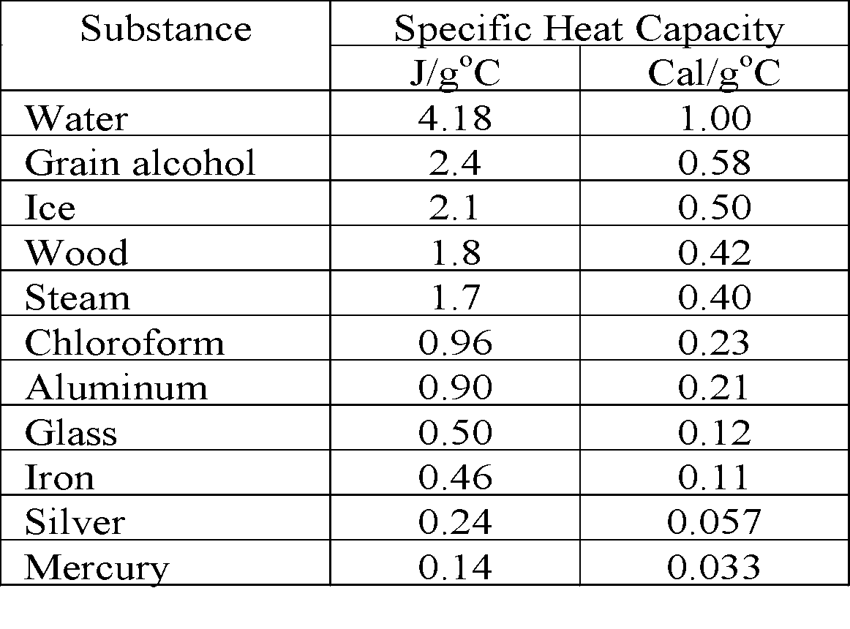
What does it mean to have a higher heat capacity??

Slide 23
Calculate the heat absorbed by 10.5g of water when its temperature increases from 20.0ºC to 80.0ºC

Slide 24
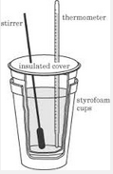
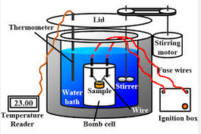
Measurement of heat change for chemical and physical processes.
Calorimeter: device used for measuring heat changes in chemical and physical processes. Assume solution specific heat is same as water.

Slide 25
A 65.3g piece of metal initially at 100.0ºC is dropped into a calorimeter with 100.0g of water initially at 20.0ºC. If the calorimeter water and metal system come to thermal equilibrium at 24.0ºC, what is the specific heat of the metal?
If 80.00 g of water at 70.00ºC is mixed with a 120.0 g of cool water at 20.00ºC. What is the final temperature of the mixture. The specific heat capacity of water is 4.184 J/gºC

Slide 26
50 mL of 1.0M HCL and 50 mL 1.0M NaOH are mixed in a coffee cup calorimeter. The temperature of the solution goes from 21ºC to 27.5ºC . Calculate the enthalpy change for the reaction if total volume of solution is 100mL and density is 1.0 g/mL. Specific heat of solution is the same as water.

Slide 27
50 mL of 1.0M HCL and 50 mL 1.0M NaOH are mixed in a coffee cup calorimeter. The temperature of the solution goes from 21ºC to 27.5ºC . Calculate the enthalpy change for the reaction if total volume of solution is 100mL and density is 1.0 g/mL. Specific heat of solution is the same as water.

Slide 28
Used to measure heat flow in reactions that produce very high temperatures like combustion.
Same process as before, but the device is a sealed “bomb”.
Calorimeter is calibrated with known reaction
Find C_{cal} then use to measure unknown reactions
q_{reaction} = -q_{calorimeter} = -C_{cal} x ΔT

Slide 30
Molar heat of fusion (kJ/mol)
Heat absorbed in melting one mole of solid at its melting point
q = nΔH_{fus}
Molar heat of vaporization (kJ/mol)
Heat absorbed in vaporizing one mole of liquid at its boiling point
q = nΔH_{vap}
Molar Heat of Solution (kJ/mol)
Heat change caused by the dissolution of one mole of substance
q = nΔH_{sol}
Be able to convert each of these to J/g!

Slide 31
Substance | MP (K) | ΔH_{fus} (KJ/mol) | BP (K) | ΔH_{vap} (KJ/mol)
Acetone | 177.8 | 5.72 | 329.4 | 29.1
Ammonia | 195.3 | 5.65 | 239.7 | 23.4
Argon | 83.8 | 1.2 | 87.3 | 6.5
Benzene | 278.7 | 9.87 | 353.3 | 30.8
Ethanol | 158.7 | 4.60 | 351.5 | 43.5
Helium | 3.5 | 0.02 | 4.22 | 0.08
Hydrogen | 14.0 | 0.12 | 20.3 | 0.90
Methane | 90.7 | 0.94 | 111.7 | 8.2
Methanol | 175.5 | 3.16 | 3372 | 35.3
Neon | 24.5 | 0.33 | 27.1 | 1.76
Nitrogen | 63.3 | 0.72 | 77.4 | 5.58
Oxygen | 54.8 | 0.44 | 90.2 | 6.82
water | 273.2 | 6.01 | 373.2 | 40.7

Slide 32
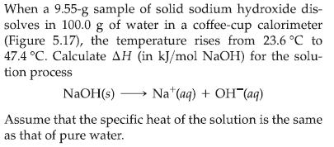

Slide 33
Magnitude of ΔH is directly proportional to the amount of reactant or product= If you multiply a reaction by a whole number, make sure you do the same to the enthalpy
ΔH changes sign when a reaction is reversed
ΔH for a reaction has the same value regardless of the number of steps i.e. H is a state property
=We can add reactions, making sure to cancel out anything that appears on both sides of the chemical equations and adding up anything that appears on the same side.

Slide 34
The following reaction is an endothermic process:
N₂ + 2O₂ -->2NO₂ ΔHº = +68 kJ
If the coefficients are doubled, so is the enthalpy, since twice as much reactants are being used.
2N₂ + 4O₂ -->4NO₂ ΔHº = +136 kJ
If the reaction is reversed, so is the sign of the enthalpy. If the reaction is endothermic in one direction (takes in energy) it must be exothermic in the opposite direction (gives off energy)
2NO₂ --> N₂ + 2O₂ ΔHº = -68 kJ

Slide 35
If a thermochemical equation can be expressed as the sum of two or more other equations, the enthalpy of the new equation is the sum of the enthalpies of the individual equations.
A + B => C ΔH = 10 kJ
C + B => D + ΔH = 20 kJ
A + 2B => D ΔH = 30kJ
Why does Hess Law work? Enthalpy is a state function (depends on the state of the system and not on the path)

Slide 41
Given:
N₂ + O₂ --> 2NO ΔHº = 180 kJ
2NO + O₂ --> 2NO₂ ΔHº = -112 kJ
Find the enthalpy of the following reaction:
2NO₂ --> N₂ + 2O₂ ΔHº = ?

Slide 42
Given the following reactions,
2SO₂(g) + O₂(g) => 2SO₃(g) ΔH = -196 kJ
2S(s) + 3O₂(g) => 2SO₃(g) ΔH = -790 kJ
Calculate the heat of reaction for
S(s) + O₂(g) => SO₂(g)

Slide 43
Chemical equation that includes heat (enthalpy) change for reaction as written
Extensive i.e. more material ⇒ more enthalpy change
Normal rules of stoichiometry apply to energy as well as mass
Examples:
CaO(s) + H₂O(l) => Ca(OH)₂(s) ΔH = -65.2KJ
CaO(s) + H₂O(l) => Ca(OH)₂(s) + 65.2KJ
How much heat is released by the production of 20.0g Ca(OH)₂?
2NaHCO₃(s) => Na₂CO₃(s) + H₂O(l) +CO₂(g) ΔH = +129KJ
2NaHCO₃(s) + 129KJ => Na₂CO₃(s) + H₂O(l) +CO₂(g)
How much heated is used in the decomposition of 0.25 mole of sodium bicarbonate?

Slide 44
Chemical equation that includes heat (enthalpy) change for reaction as written
Extensive i.e. more material ⇒ more enthalpy change
Normal rules of stoichiometry apply to energy as well as mass
Examples:
CaO(s) + H₂O(l) => Ca(OH)₂(s) ΔH = -65.2KJ
CaO(s) + H₂O(l) => Ca(OH)₂(s) + 65.2KJ
How much heat is released by the production of 20.0g Ca(OH)₂?
2NaHCO₃(s) => Na₂CO₃(s) + H₂O(l) +CO₂(g) ΔH = +129KJ
2NaHCO₃(s) + 129KJ => Na₂CO₃(s) + H₂O(l) +CO₂(g)
How much heated is used in the decomposition of 0.25 mole of sodium bicarbonate?

Slide 45
Enthalpy of Combustion
Ethanol (C₂H₅OH) is a flammable liquid with an enthalpy of combustion of -1368 kJ/mol.
1) Write the balanced thermochemical equation for the combustion of ethanol.
2) Determine what mass of ethanol would be necessary to produce 5,000. kJ by
complete combustion.
3) Determine the mass of oxygen consumed in the reaction.
4) How many kJ would a mixture of 20.0 g of ethanol and 6.0 L of oxygen gas at 25ºC
and 1atm release upon complete combustion?

Slide 46
Enthalpy of Combustion
Ethanol (C₂H₅OH) is a flammable liquid with an enthalpy of combustion of -1368 kJ/mol.
1) Write the balanced thermochemical equation for the combustion of ethanol.
2) Determine what mass of ethanol would be necessary to produce 5,000. kJ by
complete combustion.
3) Determine the mass of oxygen consumed in the reaction.
4) How many kJ would a mixture of 20.0 g of ethanol and 6.0 L of oxygen gas at 25ºC
and 1atm release upon complete combustion?

Slide 47
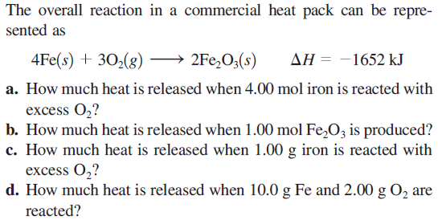

Slide 49
-Standard molar enthalpy of formation (ΔH_{f}º)
-List formation of different compounds from their elements along with their enthalpies under standard conditions
-Use these values to calculate the enthalpy of a reaction
Enthalpy change when one mole of a compound is formed from its elements in their standard states.
Standard state: most stable form at 1atm and 25ºC
ΔH_{f}º = 0 (by definition) for free elements in their standard state
O₂(g), C(s) (graphite), Fe(s), etc

Slide 50
Ag(s, 25ºC) + ½ Cl₂(g, 25ºC, 1atm) => AgCl (s, 25ºC) ΔHº = -127.1 kJ
ΔH_{f}º AgCl(s) = ?
O₂(g, 25ºC, 1atm) + ½ N₂(g, 25ºC, 1atm) => NO₂(s, 25ºC, 1atm) ΔHº = +33.2 kJ
ΔH_{f}º NO₂(g) = ?

Slide 51
Enthalpies of Formation: Estimating Enthalpy of Reaction
General Equation
ΔHº = Σ(ΔHº_{f} products) - Σ(ΔHº_{f} reactants)
(where ΔHº_{f} of each substance is multiplied by its coefficient in balanced
equation.)
Ex: Find ΔHº for the reaction 2NO_{(g)} + O_{2(g)} --> 2NO_{2(g)}
Given: ΔHº_{f}(NO) = 90.37 kJ/mol ΔHº_{f}(NO₂) = 33.85 kJ/mol

Slide 52
Use the heats of formation data provided to determine the
heat of formation of propane from the following combustion
equation:
C₃H₈(l) + 5 O₂(g) => 3 CO₂(g) + 4 H₂O(l) ΔHº =-2220kJ
ΔH_{f}º CO₂(g) = -394 kJ/mol ΔH_{f}º H₂O (l) = -286 kJ/mol

Slide 55
Formation of ions in solution is accompanied by an enthalpy change.
ΔH_{f}º H⁺(aq) = 0 (defined as a reference point for all other ions to be
measured against.)
When HCl dissolves, HCl(g) => H⁺ + Cl⁻ ΔHº = -74.9kJ
Use ΔHº = Σ(ΔHº_{f} products) - Σ(ΔHº_{f} reactants) to find ΔH_{f}º Cl⁻(aq)
-74.9kJ/mol = {ΔH_{f}º H⁺(aq) + ΔH_{f}º Cl⁻(aq)} - ΔH_{f}º HCl(g)
-74.9kJ/mol = 0 + ΔH_{f}º Cl⁻(aq) + 92.3kJ/mol
ΔH_{f}º Cl⁻(aq) = -167.2kJ/mol

Slide 56
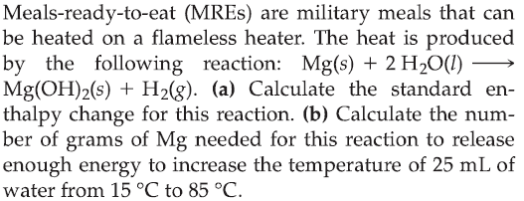

Slide 57
Energy change (ΔH) when one mole of bonds is broken in the gaseous state
Bond breaking is always endothermic
H₂(g) => 2H(g) ΔH = +436kJ
Cl₂(g) =>2Cl(g) ΔH = +234kJ
Bond making is always exothermic
H (g) + Cl(g) => HCl(g) ΔH = -431kJ
Reaction enthalpies can be estimated with bond energy changes

Slide 59
Nature of Energy
Explain the difference between kinetic and potential energy
Distinguish between the system and surroundings
Heat Energy
Define the SI unit of energy ‘joule’ and relate it to the calorie.
Define heat and explain the sign of ‘q’ with respect to the system.
Relate the heat flow to specific heat, mass, and change in temperature.
First Law of Thermodynamics
State and interpret the First Law of Thermodynamics.
Express the Law in a mathematical equation relating energy to heat energy and work for a system
Distinguish between endothermic and exothermic reactions.
Enthalpy
Define enthalpy
Calculate enthalpy of a reaction.
Calorimetry
Define specific heat capacity
Calculate ’q’ for a reaction or physical process from calorimetric data.
Phase Changes
Create and interpret heating and cooling curves
Calculate heat changes using heat of fusion and vaporization
Thermochemical Equations
Write and interpret thermochemical equations.
Apply stoichiometry to calculate heat of a reaction.
Hess’s Law
Explain and apply Hess’s Law to calculate enthalpy of a reaction.
Standard Enthalpy of Formation
Write the equation that expresses the standard enthalpy of formation of a compound.
Define standard enthalpy of formation and use the values to calculate enthalpy of a reaction.
Bond Enthalpies
Use bond enthalpies to estimate the energy changes in chemical reactions

