Slide 1
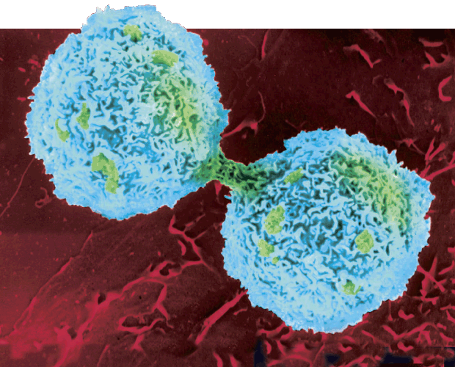
Cell Division

Slide 2
In eukaryotes, cell division occurs in two major stages:
The first stage, division of the cell nucleus, is called mitosis.
The second stage, division of the cell cytoplasm, is called cytokinesis.
*** Occurs in Somatic (Body) Cells

Slide 3
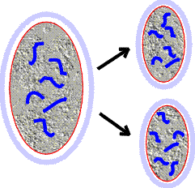
Goal of the cell cycle
to create 2 new somatic cells (daughter cells) exactly like the parent cell

Slide 4
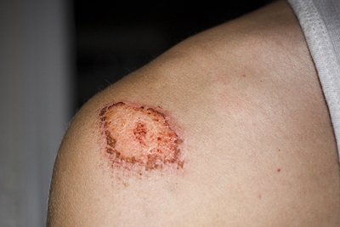
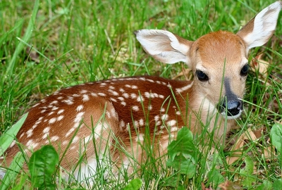
Formation of new cells
About 2 trillion cells are produced by an adult human body every day! (this is about 25 million new cells per second)
These new cells are formed when older cells divide for growth, development, or repair

Slide 5
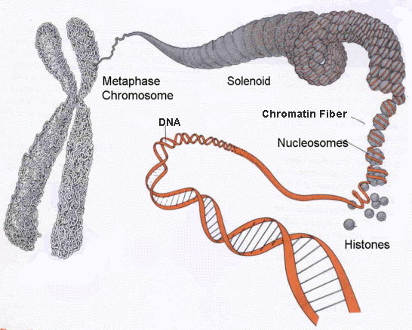
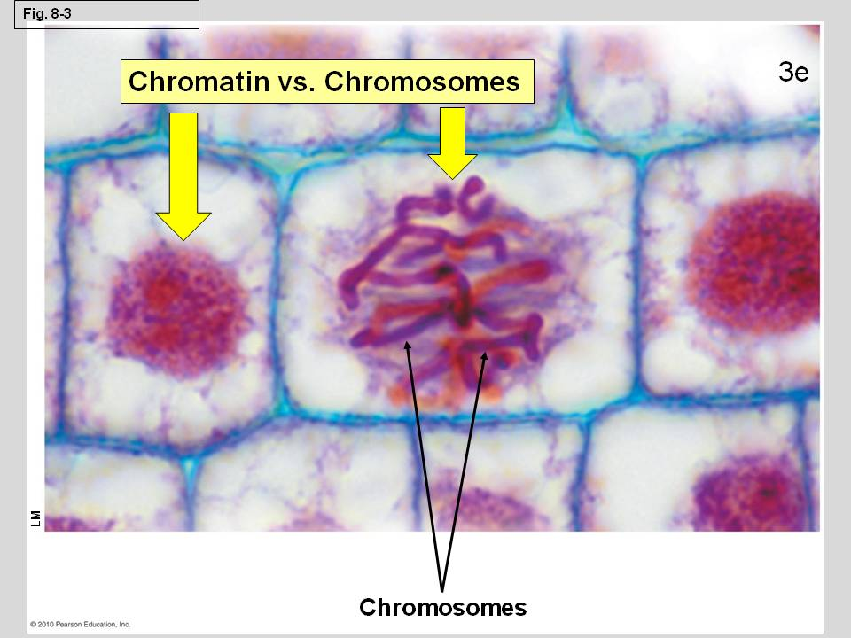
Chromatin vs Chromosomes
Genetic information is passed from one generation to the next on chromosomes.
Before cell division, each chromosome is duplicated, or copied.

Slide 6
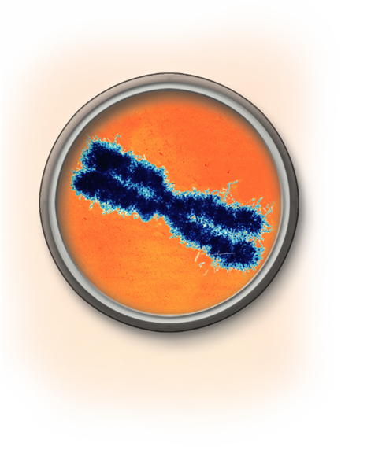
Each chromosome consists of two identical “sister” chromatids.
Each pair of chromatids is attached at an area called the centromere.
Sister chromatids
Centromere

Slide 7
When the cell divides, the chromatids separate.
Each new cell gets one chromatid.
The Cell Cycle
The cell cycle is the series of events that cells go through as they grow and divide.
Interphase is the period of growth that occurs between cell divisions.

Slide 8
What happens during the cell cycle?
a cell grows
prepares for division
divides to form two daughter cells, each of which begins the cycle again

Slide 9
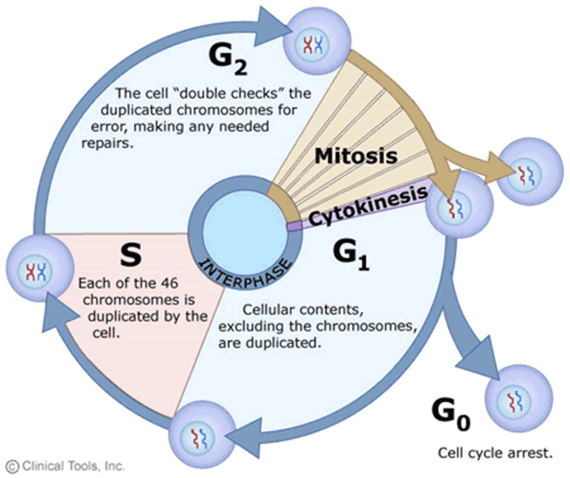
The cell cycle consists of four phases:
G₁ (First Gap Phase)
S Phase
G₂ (Second Gap Phase)
M Phase
Interphase

Slide 10
Events of the cell cycle
During G₁, the cell
increases in size
synthesizes new proteins and organelles

Slide 11
During the S phase,
chromosomes are replicated
DNA synthesis takes place
Once a cell enters the S phase, it usually completes the rest of the cell cycle.

Slide 12
The G₂ Phase (Second Gap Phase)
organelles and molecules required for cell division are produced
Once G₂ is complete, the cell is ready to start the M phase—Mitosis

Slide 13
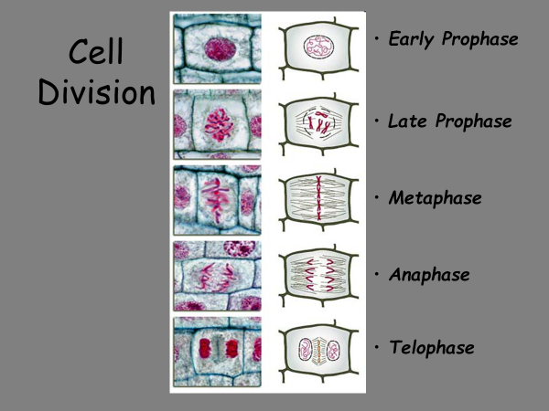
Cell Cycle Diagram

Slide 14
What are the four phases of mitosis?
Biologists divide the events of mitosis into four phases:
Prophase
Metaphase
Anaphase
Telophase
PMAT

Slide 15
Mitosis (M phase)

Slide 16
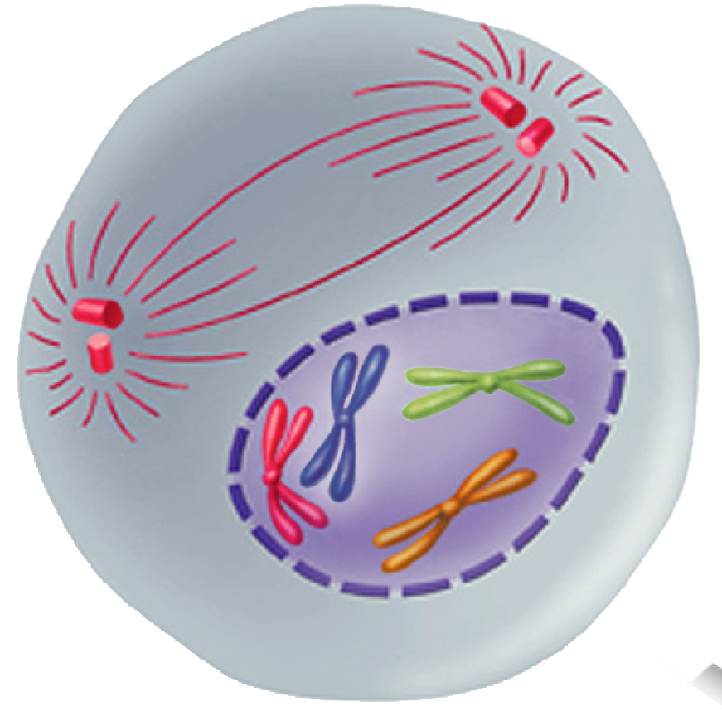
Prophase
Prophase is the first and longest phase of mitosis.
The centrioles separate and take up positions on opposite sides of the nucleus.

Slide 17
Chromatin condenses into chromosomes.
The centrioles separate and a spindle begins to form.
The nuclear envelope breaks down.
Spindle
forming
Centromere
Chromosomes
(paired chromatids)

Slide 18
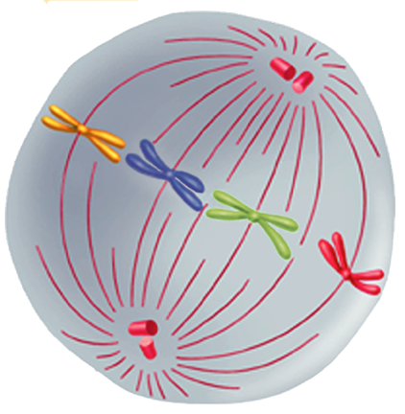
Metaphase
The second phase of mitosis is metaphase.
The chromosomes line up across the center of the cell.
Microtubules connect the centromere of each chromosome to the poles of the spindle.
Think meta- middle!

Slide 19
Anaphase
Individual
chromosomes
Anaphase is the third phase of mitosis.
The sister chromatids separate into individual chromosomes.
The chromosomes continue to move until they have separated into two groups.
Think Ana- apart!

Slide 20
Telophase
Telophase is the fourth and final phase of mitosis.
Chromosomes gather at opposite ends of the cell and lose their distinct shape.
A new nuclear envelope forms around each cluster of chromosomes.
Cleavage furrow

Slide 21
Cytokinesis
During cytokinesis, the cytoplasm pinches in half.
Each daughter cell has an identical set of duplicate chromosomes.
Usually occurs at the same time as telophase

Slide 22
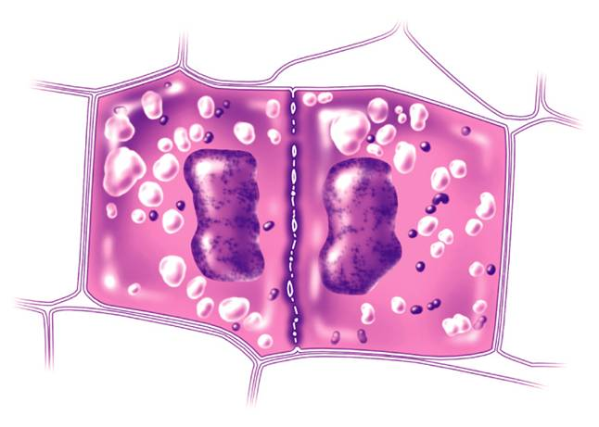
In plants, a structure known as the cell plate forms midway between the divided nuclei.
The cell plate gradually develops into a separating membrane.
A cell wall then begins to appear in the cell plate.

