Slide 1
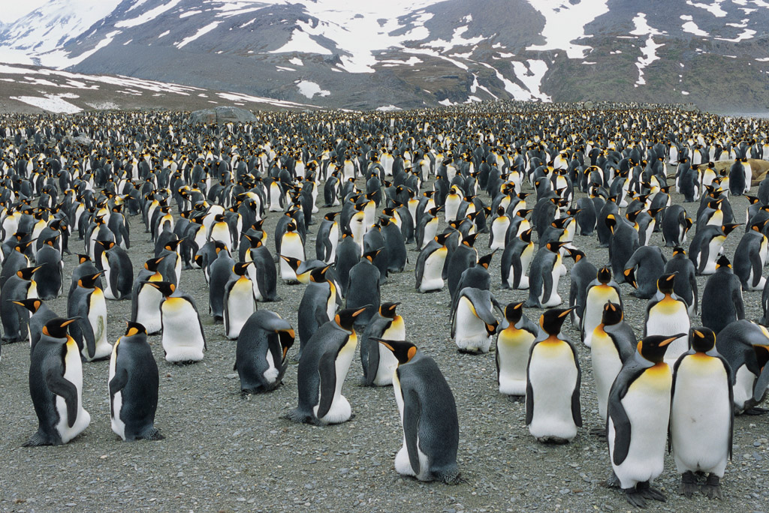
Genetic Variation in Populations
Population: All members of a species that live in a particular area
A population contains a range of phenotypes.
A population shares a common gene pool.
Genetic variation increases the chance that some individuals will survive.

Slide 2
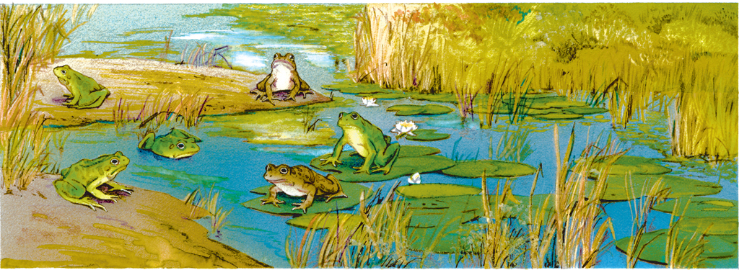
GENE POOL: Combined genetic information of all members of a particular population.
Genetic Variation in Populations
“Stores” genetic variation (all alleles in a population)
Allele Frequency: Measurement of the number of times that an allele occurs in a gene pool compared to the number of times other alleles occur.
Variation arises from mutations and recombination during Meiosis

Slide 3
MUTATIONS: Change in the DNA sequence that affects genetic information (random)
Genetic Variation in Populations
Single mutation can have a large effect
Evolutionary change is based on an accumulation of many mutations
can be beneficial, neutral, or harmful
do not “try” to supply what the organism “needs”
Best mutations=best adaptations=best survival and passing on to the next generation
Mutations in non-reproductive cells won’t be passed onto offspring
Causes of mutations:
mistake in copying DNA
External: radiation/chemicals

Slide 4
Natural Selection in Populations
Populations, not individuals, evolve
Individuals born with certain set of genes (phenotypes)
If one or more is “unfit”, individuals are selected for or against, but do not evolve.
Notes:
‹#›

Slide 5
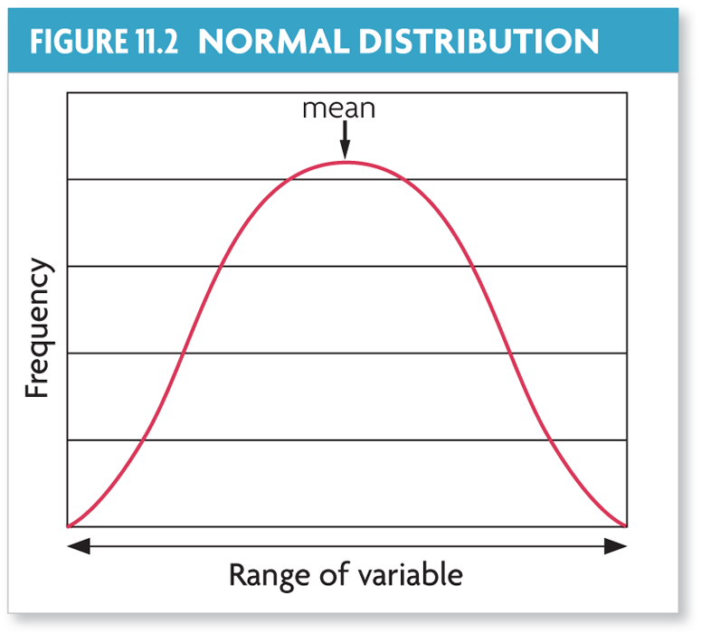
Natural selection acts on distributions of traits (changes the normal distribution of phenotypes).
Mechanisms of Evolution (How Evolution Happens)
A normal distribution graphs as a bell-shaped curve.
All organisms struggle for survival by competing for resources…
Higher fitness organisms pass more copies of the genotypes that express certain phenotypes.
Traits not undergoing natural selection have a normal distribution.
Notes:
‹#›

Slide 6
Natural selection can change the distribution of a trait in one of three ways.
Mechanisms of Evolution: Natural Selection
Microevolution is evolution within a population.
observable change in the allele frequencies
can result from natural selection; survival of the fittest
Fitness:
A genotype’s fitness depends on the environment in which an organism lives.
The fittest individual is not necessarily the strongest, fastest, or biggest, but rather its ability to survive, find a mate, and produce offspring
Notes:
‹#›

Slide 7
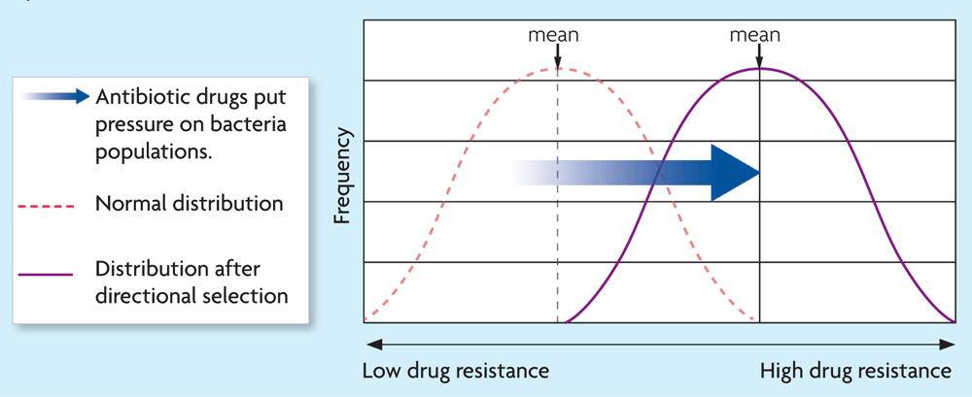
Mechanisms of Evolution: Natural Selection
Natural selection can take one of three paths.
DIRECTIONAL SELECTION favors phenotypes at one extreme variation of a trait.
Organisms at one end of the curve have higher fitness than organisms in the middle or at the other end of the curve
Anteaters: Long tongue favored over medium or short tongues.
Peppered Moths in England
Notes:
‹#›

Slide 8
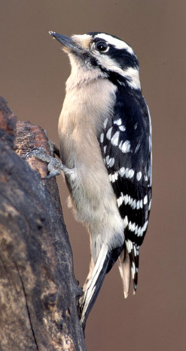
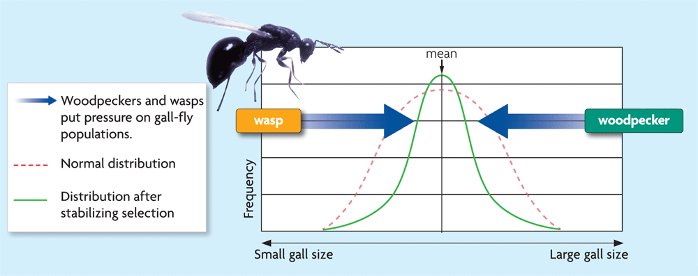
Mechanisms of Evolution: Natural Selection
Natural selection can take one of three paths.
STABILIZING SELECTION favors the intermediate phenotype.(Favors the average)
Human baby birth weight
Average more likely to survive
Notes:
‹#›

Slide 9
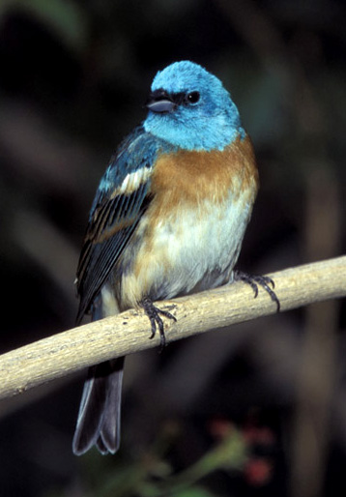
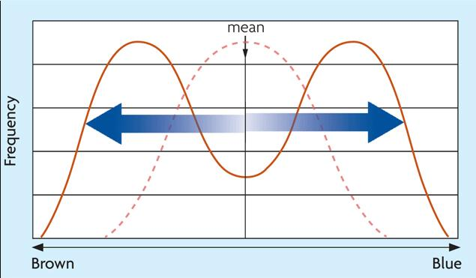
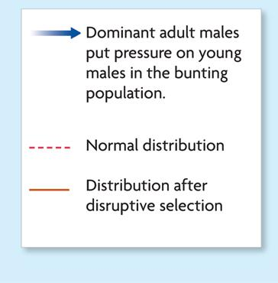
Mechanisms of Evolution: Natural Selection
Natural selection can take one of three paths.
DISRUPTIVE SELECTION favors both extreme phenotypes.(Average selected against)
Bird Beak size (if medium seed size becomes less common, birds that can eat the smallest and largest seed will survive
Notes:
‹#›

Slide 10
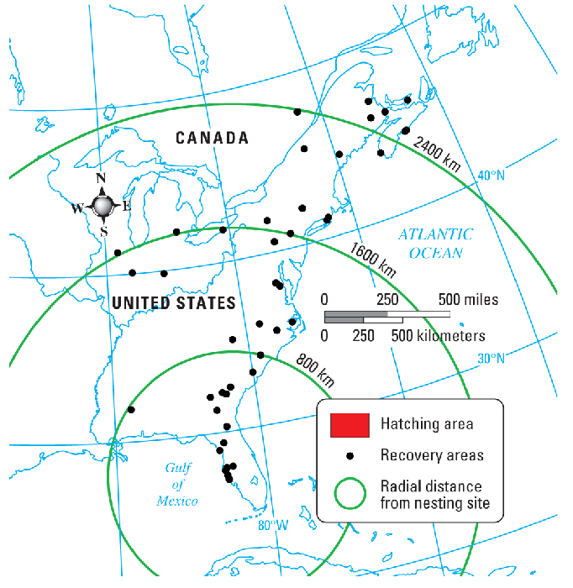
Gene flow is the movement of alleles between populations.
Mechanisms of Evolution: Gene Flow (Migration)
Gene flow occurs when individuals join new populations and reproduce.
Low gene flow increases the chance that two populations will evolve into different species.
bald eagle migration

Slide 11
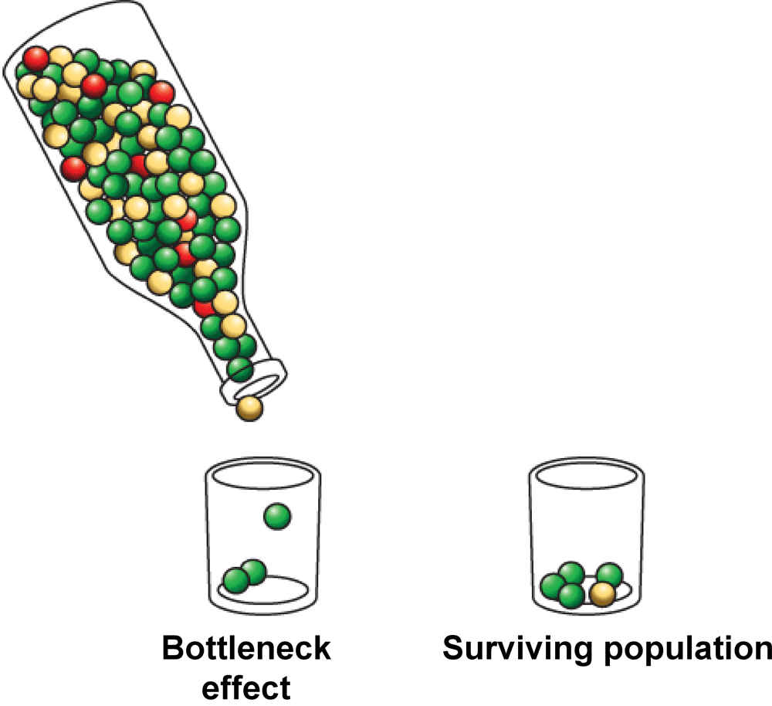
Genetic drift is a change in allele (gene) frequencies due to chance. A gene can become common in a population by chance.
Mechanisms of Evolution: Genetic Drift
Genetic drift causes a loss of genetic diversity.
It is most common in small populations.
A population bottleneck can lead to genetic drift.
It occurs when an event drastically reduces population size.
The bottleneck effect is genetic drift that
occurs after a bottleneck event.
Population experiences a storm, sickness,
overhunting that causes it to decrease to
just a few individuals.

Slide 12
Genetic Drift Example
Population of green and brown beetles:
Several green beetles were killed when someone stepped on them and thus produced no offspring.
The next generation would have a few more brown beetles than the previous generations, just by chance
These chance changes from generation to generation are known as genetic drift

Slide 13
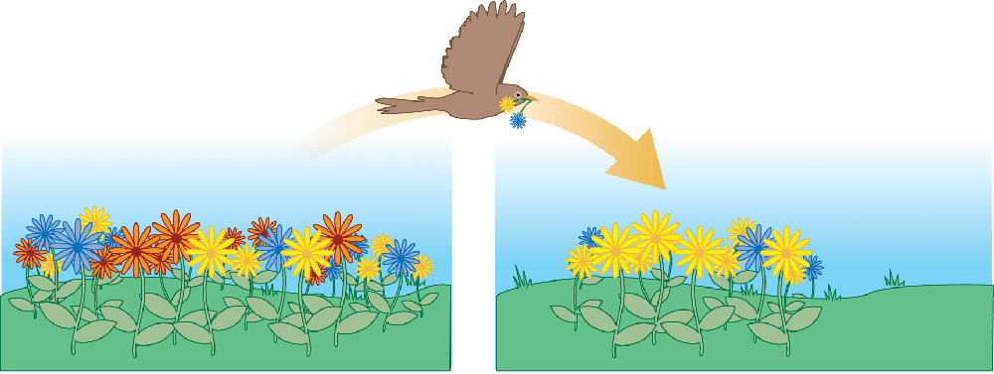
Mechanisms of Evolution: Genetic Drift
The founding of a small population can lead to genetic drift.
It occurs when a few individuals start a new population.
Their allele frequencies may be different than that of the original population
By chance, the new population will have different frequencies than the original group.
The founder effect is genetic drift that occurs after start of new population.

Slide 14
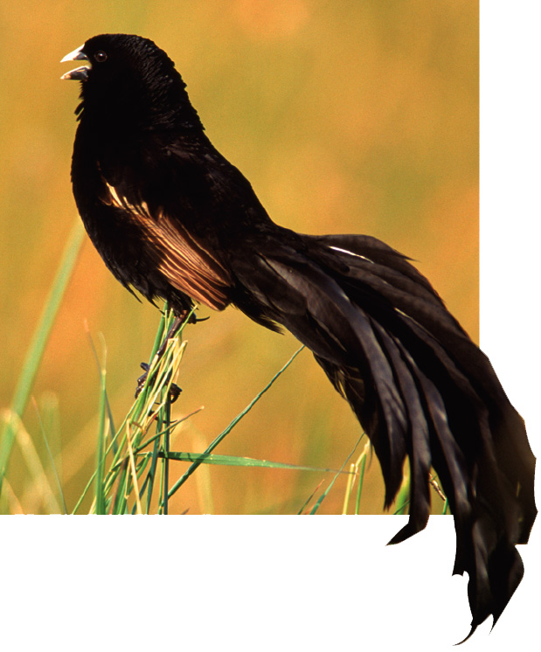
Sexual selection occurs when certain traits increase mating success. Selection based on heritable traits (size, strength, coloration)
Mechanisms of Evolution: Sexual Selection
Sexual selection occurs due to higher cost of reproduction for females.
males produce many sperm continuously
females are more limited in potential offspring each cycle

Slide 15
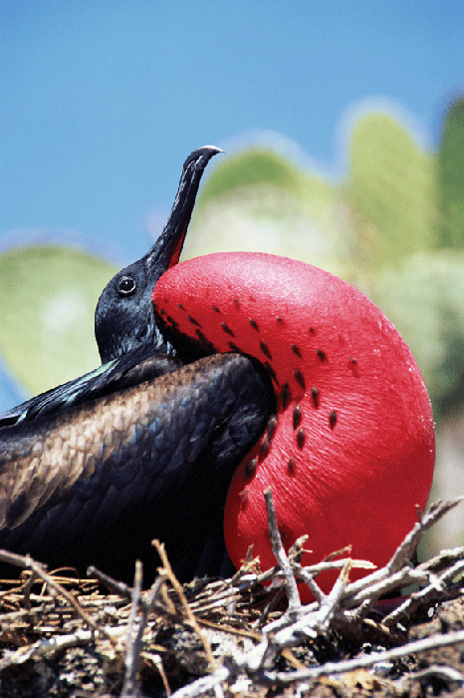
Mechanisms of Evolution: Sexual Selection
There are two types of sexual selection.
intrasexual selection: competition among males
Females increase their fitness by increasing the quality of their offspring by choosing superior male mates (choosier when finding a mate)
intersexual selection: males display certain traits to females
Males increase their fitness by maximizing the quantity of offspring produced→Males are showier (antlers, lion’s mane, colorful feathers)

Slide 16
Evolution vs. Genetic Equilibrium
If a population is NOT evolving, allele frequencies in the genepool do not change= Genetic Equilibrium
Hardy-Weinberg equilibrium states that allele frequencies remain constant unless one or more factors cause those frequencies to change (Predict genotype frequencies in populations)

Slide 17
Hardy-Weinberg equilibrium describes populations that are not evolving.
Evolution vs. Genetic Equilibrium
Equilibrium (genotype frequencies stay the same) occurs if five conditions are met:
very large population: no genetic drift
2. no emigration or immigration: no gene flow
3. no mutations: no new alleles added to gene pool
4. random mating: no sexual selection
5. no natural selection: all traits aid equally in survival

Slide 18
However, real populations (nature) rarely meet all 5 conditions!
Evolution vs. Genetic Equilibrium
Real populations rarely meet all five conditions.
Most populations are small and may mate with one another
There are always mutations (chance with every DNA replication)
Gene flow often occurs between populations
Mating is non-random
Natural Selection is always occurring
Therfore, in nature, there will always be changes in populations (microevolution)

Slide 19
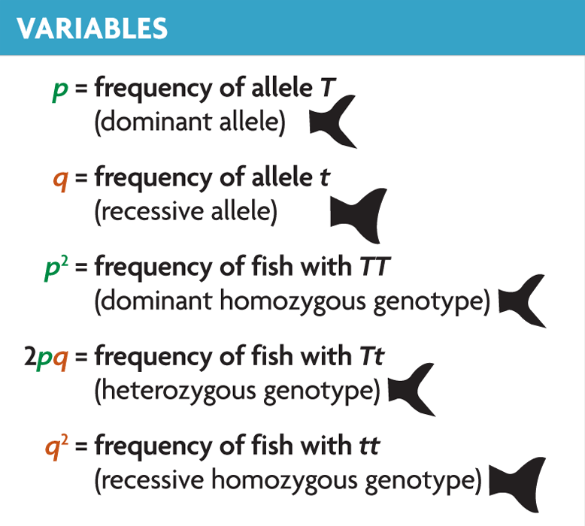
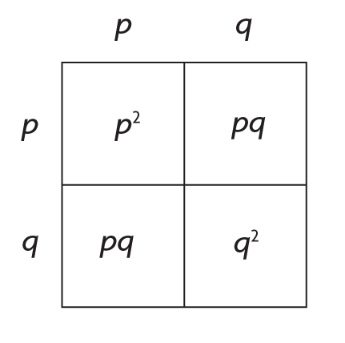
The Hardy Weinberg Equation
Evolution vs. Genetic Equilibrium
Predicted genotype frequencies are compared with actual frequencies.
used for traits in simple dominant-recessive systems
must know frequency of recessive homozygotes
p² + 2pq + q² = 1
"The Hardy-Weinberg equation is based on Mendelian genetics. It is derived from a simple Punnett square in which p is the frequency of the dominant allele and q is the frequency of the recessive allele."

Slide 20
5 Factors Leading to Evolution
Natural Selection
Mutations (produce the genetic variations
Genetic Drift (changes allele frequencies due to chance)
Gene Flow (migration)
Sexual Selection

Slide 21
Speciation
Speciation: Formation of a new species
Species: a group of organisms that breed with one another and produce fertile offspring
If a genetic change increases the fitness, that allele will eventually be found in many members of the population.
New Species can arise when populations become reproductively isolated from each other.
When members of 2 populations cannot reproduce to produce fertile offspring= Reproductive Isolation
-The 2 groups have separate gene pools

Slide 22
Allopatric Speciation: Species separates into 2 groups which are isolated from one another.
The isolation of populations can lead to speciation.
Speciation
Populations become isolated when there is no gene flow.
Isolated populations adapt to their own environments.
Genetic differences can add up over generations.

Slide 23
Populations can become isolated in several ways.
Speciation
Behavioral Isolation
2 populations are physically able to interbreed but have different courtship rituals or other types of mating behaviors.
Geographic Isolation
Geographic barriers (rivers, mountains, roads) prevent genes from being exchanged, including advantageous mutations and variations
Temporal Isolation
Species reproduce at different times and therefore are unlikely to reproduce with each other.

Slide 24
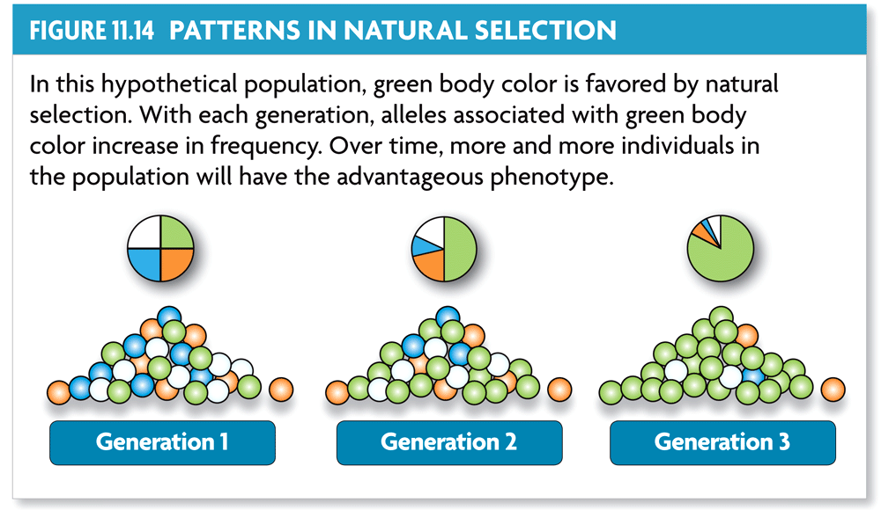
Evolution through natural selection is not random.
Patterns of Evolution
Natural selection can have direction.
The effects of natural selection add up over time.

Slide 25
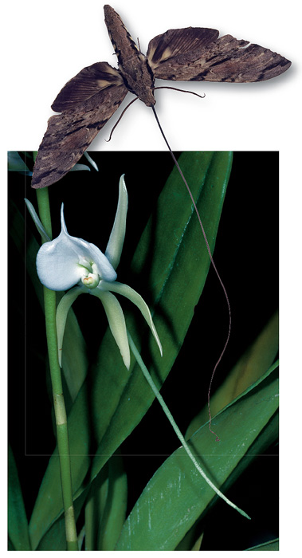
Patterns of Evolution
Convergent evolution describes evolution toward similar traits in unrelated species.

Slide 26
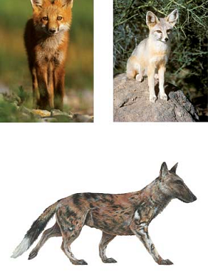
Patterns of Evolution
Divergent evolution describes evolution toward different traits in closely related species.
kit fox
red fox
ancestor
How do convergent and divergent evolution illustrate the directional nature of natural selection?

Slide 27
Species can shape each other over time.
Patterns of Evolution
Two or more species can evolve together through coevolution.
evolutionary paths become connected
species evolve in response to changes in each other

Slide 28
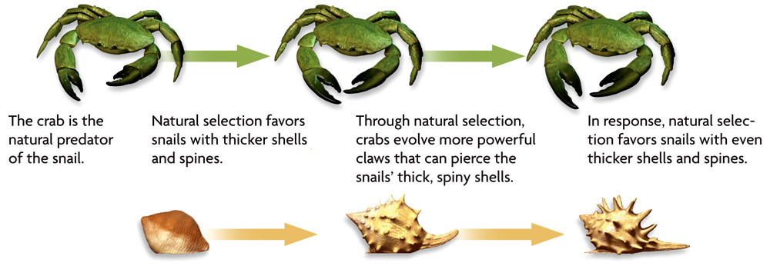
Patterns of Evolution
Coevolution can occur in competitive relationships, sometimes called evolutionary.

Slide 29
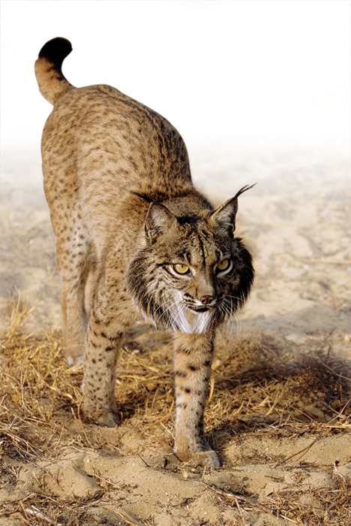
Species can become extinct.
Patterns of Evolution
Extinction is the elimination of a species from Earth.
Background extinctions occur continuously at a very low rate.
occur at roughly the same rate as speciation
usually affects a few species in a small area
caused by local changes in environment

Slide 30
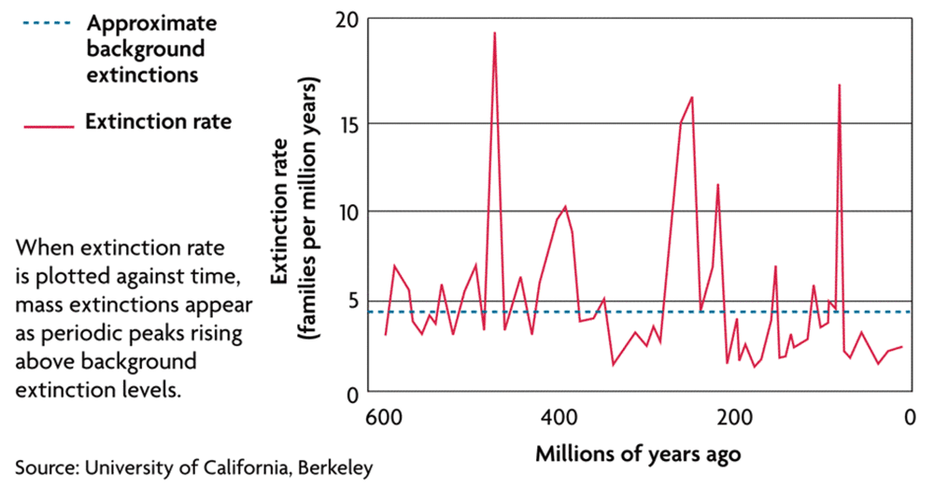
Patterns of Evolution
Mass extinctions are rare but much more intense.
destroy many species at global level
thought to be caused by catastrophic events
at least five mass extinctions in last 600 million years

Slide 31
Speciation often occurs in patterns.
Patterns of Evolution
A pattern of punctuated equilibrium exists in the fossil record.
theory proposed by Eldredge and Gould in 1972
episodes of speciation occur suddenly in geologic time
followed by long periods of little evolutionary change
revised Darwin’s idea that species arose through gradual transformations

Slide 32
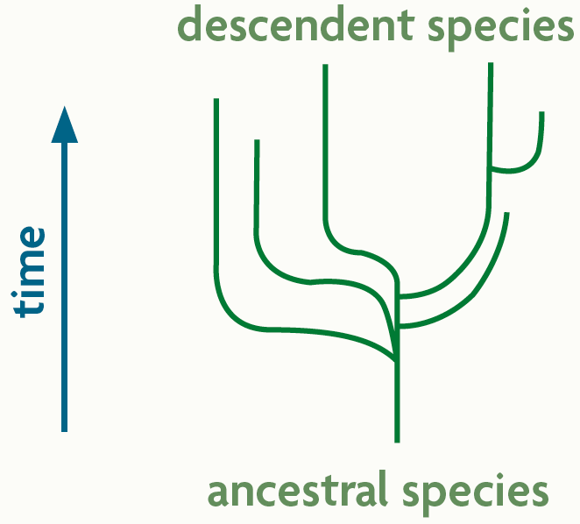
Patterns of Evolution
Many species evolve from one species during adaptive radiation.
ancestral species diversifies into many descendent species
descendent species usually adapted to wide range of environments

