Slide 1
Foundations of Astronomy
Earth/Space Science

Slide 2
Distances in Space are Vast
Kilometers (km) – (1km= 0.621371 miles) (1 mile=1.609km)
Astronomical Units (AU)- Distance from Earth to the Sun
1 AU= 93,000,000 miles (150 million km)
Lightyear- Distance that light travels in one year
=5.88 trillion miles (9.4607 x 10^12 km)
=63,241 AU

Slide 3
Example Distances
Earth is:
8.3 light-minutes away from the Sun
320 lightyears from Polaris (the North Star)
4.3 lightyears from Proxima Centauri (closest neighboring star)
26,000 lightyears away from the center of the Milky Way Galaxy
2.5 million lightyears away from the nearest galaxy, Andromeda
13.4 billion lightyears away from the oldest observed galaxy, GN-z11
If you multiply the circumference of Earth by 7.5, it is only 1 light second
An airplane traveling at 600mph would take 1,141,552 years to travel 1 lightyear.

Slide 4
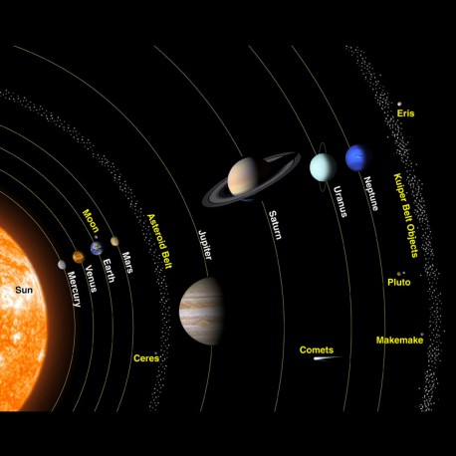

Slide 5
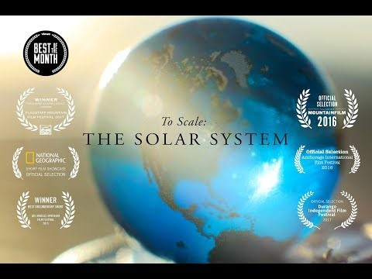
To Scale: The Solar System

Slide 6
Scale and Sizes of Solar System
Create a chart or map that displays this info and show calculation work
Convert diameters into miles
Convert distances from Sun into Lightyears, AU, and Kilometers
Determine Ratios of Size
Diameters of Solar System Objects
Sun (diameter- 1,392,000 km)
Mercury (diameter- 4,880 km)
Venus (diameter- 12,102 km)
Earth (diameter- 12,756 km)
Moon (diameter- 3,474 km)
Mars (diameter- 6,796 km)
Jupiter (diameter- 142,984 km)
Saturn (diameter- 120,536 km)
Uranus (diameter- 51,118 km)
Neptune (diameter- 49,528 km)
Distances from the Sun
Sun- 0 miles
Mercury- 35.98 million miles
Venus- 67.24 million miles
Earth- 92.96 million miles
Mars- 141.6 million miles
Jupiter- 483.8 million miles
Saturn- 890.8 million miles
Uranus- 1.784 billion miles
Neptune- 2.793 billion miles

