Slide 1
Mutations
Notes:
Mutations Presentation, Mutations lesson, TeachEngineering.org

Slide 2
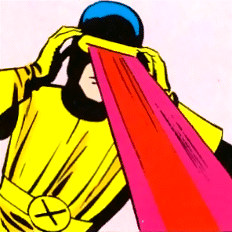
Superheroes
How did Cyclops from the X-Men get his superpowers?
He was born with the mutation
How did the Hulk and Spiderman get their superpowers?
The Hulk was exposed to gamma radiation and Spiderman was bitten by a radioactive spider
Notes:
Today we will discuss some of the science behind how these mutations could happen. While the superpowers and abilities may be fictional, it is true that mutations can have significant impacts on people and evidence exists that radiation exposure can lead to an increased rate of mutations. First, let’s discuss the different types of mutations, then where or how they can occur. We will also talk about some environmental factors that can influence the rate of mutations, and finish by looking at some possible effects of mutations.
///
Image source: Artwork of Cyclops from Marvel Comics. Art by Jack Kirby, pencils, and Paul Reinman, inks. 2008 Wikipedia https://en.wikipedia.org/wiki/File:Cyclopsclassic.png
Fair use rationale: use of low-resolution image to illustrate a copyright character where no free alternative exists or can be created

Slide 3
Learning about Mutations
Types of mutations and how they occur
How environmental factors influence mutations
Effects of mutations
Notes:
Types of Mutations
Mutations can be classified several different ways. In this lesson, we will focus on sorting mutations by their effects on the structure of DNA or a chromosome. For this categorization, mutations can be organized into two main groups, each with multiple specific types. The two general categories are small-scale and large-scale mutations.

Slide 4
Types of Mutations
Small-scale mutations
Affect DNA at the molecular level by changing the normal sequence of nucleotide base pairs
Occur during the process of DNA replications (either meiosis or mitosis)
Normal DNA
CAT
AAG
TAT
CCT
GTA
Protein
His
Lys
Tyr
Pro
Val
Notes:
Small-Scale Mutations
Small-scale mutations are those that affect the DNA at the molecular level by changing the normal sequence of nucleotide base pairs. These types of mutations may occur during the process of DNA replication during either meiosis or mitosis. Three possible types of small-scale mutations may occur.

Slide 5
Small-Scale Mutations
#1
Substitution (or a “point” mutation”)
Substitutions occur when a nucleotide is replaced with a different nucleotide in the DNA sequence
This type of mutation only affects the codon for a single amino acid
Substitution
TAT
CAT
CGT
AAG
GTA
Protein
His
Lys
Tyr
ARG
Val
Notes:
Substitution
Also referred to as a “point” mutation, substitutions occur when a nucleotide is replaced with a different nucleotide in the DNA sequence. The most common substitutions involve the switching of adenine and guanine (A ↔ G) or cytosine and thymine (C ↔ T). Since the total number of nucleotides is conserved, this type of mutation only affects the codon for a single amino acid.

Slide 6
Small-Scale Mutations
#2
Deletion (a “frameshift” mutation)
Deletion is the removal of a nucleotide from the DNA sequence
Removal of even a single nucleotide from a gene alters every codon after the mutation
Deletion
C_TC
AAG
TAT
CTA
TA
Protein
Leu
Arg
Tyr
Leu
…
Notes:
Deletion
A deletion is the removal of a nucleotide from the DNA sequence. Deletions are referred to as “frameshift” mutations because the removal of even a single nucleotide from a gene subsequently alters every codon after the mutation; it is said that the reading frame is “shifted.” (This is illustrated in Figure 1 for both deletions and insertions.) The change in the number of nucleotides changes which ones should normally be read together.

Slide 7
Small-Scale Mutations
#3
Insertion (a “frameshift” mutation)
Addition of a nucleotide to the DNA sequence
Addition of even a single nucleotide to a gene alters every codon after the mutation
Insertion
CAT
TAA
A
TAT
CGC
GGT
Protein
His
Stop
Tyr
Arg
Gly
Notes:
Insertion
An insertion in the addition of a nucleotide to the DNA sequence. Similar to a deletion, insertions are also considered “frameshift” mutations and alter every codon that is read after the mutation.

Slide 8
Large-Scale Mutations
Affect entire portions of the chromosome
Some large-scale mutations affect only single chromosomes, others occur across nonhomologous pairs
Entire genes or sets of genes are altered rather than only single nucleotides of the DNA
Mutations involving multiple chromosomes are likely to occur in meiosis, during the prophase I
Notes:
Large-scale mutations are those which effect entire portions of the chromosome. Some large-scale mutations affect only single chromosomes, others occur across nonhomologous pairs. Some large-scale mutations in the chromosome are analogous to the small-scale mutations in DNA; the difference is that for large-scale mutations, entire genes or sets of genes are altered rather than only single nucleotides of the DNA. Single chromosome mutations are most likely to occur by some error in the DNA replication stage of cell growth, and therefore could occur during meiosis or mitosis. Mutations involving multiple chromosomes is more likely to occur in meiosis during the crossing-over that occurs during the prophase I.

Slide 9
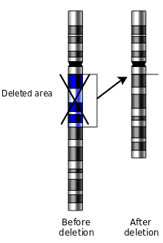
Large-Scale Mutations
Deletion
Single chromosome mutation
The loss of one or more gene(s) from the parent chromosome
Ex: DiGeorge Syndrome (deletion of portion of c-22)
Ex: Cri du Chat Syndrome (deletion of portion of c-5)
Notes:
Image source: 2013 Mirmillon at French Wikipedia, vectorized from File:Deletion.gifNational Human Genome Research (USA); originally from fr.wikipedia; the image is a work of the National Institutes of Health, U.S. Department of Health and Human Services (public domain) https://commons.wikimedia.org/w/index.php?curid=28205173

Slide 10
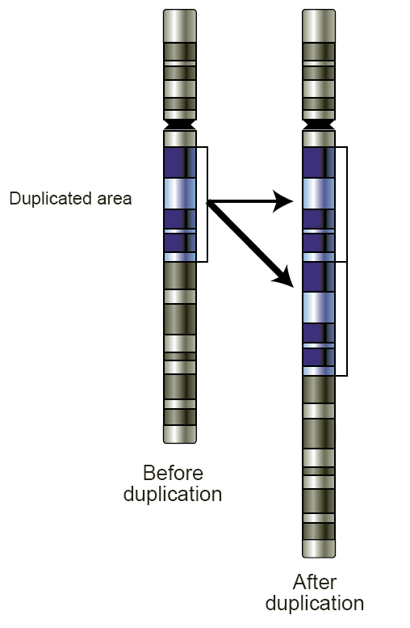
Large-Scale Mutations
Duplication (amplifications)
Single chromosome mutation
The addition of one or more gene(s) that are already present in the chromosome
Notes:
Image source: 2006 National Human Genome Research Institute, Wikimedia Commons (public domain) https://commons.wikimedia.org/w/index.php?curid=552474

Slide 11
Large-Scale Mutations
Inversion
Inversion (chromosomal inversions)
Single chromosome mutation
The complete reversal of one or more gene(s) within a chromosome; the genes are present, but the order is backwards from the parent chromosome
Notes:
Image source: 2014 Richard Wheeler (Zephyris) and NikNaks (vector version), Wikimedia Commons (Creative Commons Attribution-Share Alike 3.0 Unported license) https://commons.wikimedia.org/wiki/File:Single_Chromosome_Mutations.svg https://creativecommons.org/licenses/by-sa/3.0/deed.en

Slide 12
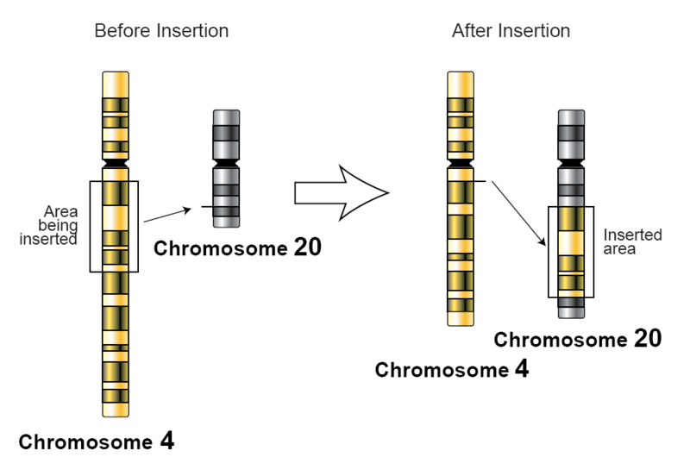
Large-Scale Mutations
Insertion
Multiple chromosome mutation
One or more gene(s) are removed from one chromosome and inserted into another nonhomologous chromosome
Can occur by an error during the prophase I of meiosis when the chromosomes are swapping genes to increase diversity
Notes:
Image source: 2005 National Human Genome Research Institute (U.S. government; public domain), Wikimedia Commons https://commons.wikimedia.org/wiki/File:Insertion-genetics.png

Slide 13
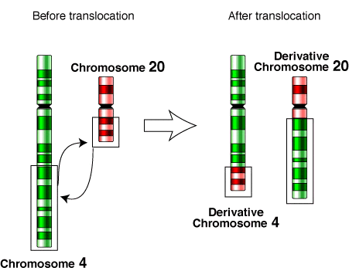
Large-Scale Mutations
Translocation
Multiple nonhomologous chromosome mutation
Chromosomes swap one or more gene(s) with another chromosome
Notes:
Image source: 2006 National Human Genome Research Institute, Wikimedia Commons (public domain) https://commons.wikimedia.org/w/index.php?curid=935175

Slide 14
Large-Scale Mutations
Nondisjunction
Does not involve any errors in DNA replication or crossing-over
Mutations occur during the anaphase and telophase when the chromosomes are not separated correctly into the new cells
Common nondisjunctions are missing or extra chromosomes
Notes:
When gametes with nondisjunctions are produced during meiosis, it can result in an offspring with a monosomy or trisomy (a missing or extra homologous chromosome).

Slide 15
Effects of Mutations
The effects of mutations may range from nothing to the unviability of a cell
All mutations affect the proteins that are created during protein synthesis, but not all mutations have a significant impact
Notes:
The effects can also be looked at differently between the small-scale and large-scale mutations.

Slide 16
Small-Scale Mutation Effects
Silent
The nucleotide is replaced, but the codon still produces the same amino acid
Missense
The codon now results in a different amino acid, which may or may not significantly alter the protein’s function
Nonsense
The codon now results in a “stop” command, truncating the protein at the location where the mutated codon is read; this almost always leads to a loss of protein functionality
Notes:
Frameshift mutations, insertions and deletions on genes have similar effects. When a nucleotide is added or removed from the DNA sequence, the sequence is shifted and every codon after the mutation is changed. This results in severe alterations to the proteins that are encoded by the DNA, which can lead to a loss of functionality for those proteins.
Substitutions, or point mutations, are much more subtle and have three possible effects: Silent, missense, nonsense.
These mutations may occur anywhere in the DNA. So the effect of the mutation really depends on its location. If the mutation occurs in a gene, the result is an altered protein, but the mutation can also occur in a nongenic region of the DNA. In the latter case, the mutation has no effect on the organism.

Slide 17
Large-Scale Mutation Effects
Effects of large-scale mutations are more obvious than those of small-scale mutations
Duplication of multiple genes causes those genes to be overexpressed while deletions result in missing or incomplete genes
Mutations that change the order of the genes on the chromosome—such as deletions, inversions, insertions and translocations—result in genes that are close together

Slide 18
Large-Scale Mutation Effects
When certain genes are positioned closely together, they may encode for a “fusion protein”
A fusion protein is a protein that would not normally exist but is created by a mutation in which two genes were combined
The new proteins give cells a growth advantage, leading to tumors and cancer
Notes:
Astrocytoma, a type of brain tumor, is the result of a deletion that creates a new fusion gene that permits the cells to become cancerous.

Slide 19
Large-Scale Mutation Effects
Often, large-scale mutations lead to cells that are not viable
The cell dies due to the mutation
Notes:
This is especially true with nondisjunction mutations in gametes in which entire chromosomes are missing or extra. In humans, when the gamete from a male (sperm) merges its chromosomes with the gamete from a female (egg), the offspring receives 23 chromosomes from each parent to form 23 homologous pairs. However, when one of the gametes has a nondisjunction mutation, the resulting offspring end up with only one homolog in a pair (monosomy) or with three homologs in a pair (trisomy). Most of the time, these offspring are not viable. The ones that do result in viable offspring will possess some noticeable differences due to the extra or missing chromosome; this alteration leads to a permanent syndrome in the offspring. The most well-known syndrome is trisomy 21, an extra 21st chromosome; this particular nondisjunction mutation leads to Down syndrome.
Several other syndromes are caused by these mutations. The suggested homework assignment is for the students to research some syndrome caused by extra or missing chromosomes and write a short paragraph detailing which chromosome is altered and what effects that mutation causes.

Slide 20
Mutation Influences
Exposure to certain chemicals
Carcinogenic chemicals may cause cancer
Exposure to radiation
Retroviruses
Retroviruses such as HIV naturally experience mutations at a much higher rate than other organisms
Notes:
Mutations naturally occur over time, which is the underlying cause of evolution. As we can see, evolution is a very slow process with a net benefit to an organism, but some environmental factors may influence or induce additional mutations. These induced mutations often lead to harmful diseases such as cancer.
Exposure to certain chemicals is one environmental factor that may induce DNA mutations. Typically, anything that we identify as carcinogenic (may cause cancer), has negative side effects on DNA, and may lead to cancer. This includes the chemicals found in cigarette smoke as well as those found in meats cooked on the grill. These chemicals belong to a larger class called mutagens, meaning they can lead to changes in genetic material.
Chemicals are not the only types of mutagens that we encounter; physical mutagens also exist in the environment, namely radiation. Ultraviolet radiation from the sun can damage genetic material by changing the properties of nucleotides in the DNA. Overexposure to ultraviolet radiation is known to lead to skin cancer. X-rays and gamma radiation are also physical mutagens and forms of ionizing radiation; this means that these types of radiation possess enough energy to remove electrons from atoms, thus forming ions and affecting how different biomolecules interact. While a typical dose of x-rays received during a medical procedure is low, it does marginally increase a person’s cancer risk.
Alternatively, retroviruses such as HIV naturally experience mutations at a much higher rate than other organisms. This can be attributed to the fact that they possess RNA instead of DNA. The process by which RNA is copied and replicated is not as precise as that of DNA. Therefore, by the time our immune system has adjusted to fight a virus like HIV, the HIV virus has already mutated again and the immune system must start over. The mutations in the HIV’s RNA lead to alterations in the protein markers on the virus that the immune system targets, and if the target is always changing, it is almost impossible for the immune system to remove the virus.

Slide 21
Engineering Connection
Humans have been genetically modifying plants and animals for thousands of years
Example: Breeding watermelons to be larger and have fewer seeds
Example: Breeding chickens to have more white meat and more breast meat
Notes:
While mutations occur naturally over time, biological engineers are able to genetically modify various organisms.
Humans have been genetically modifying plants and animals for thousands of years. Humans have accomplished this by selectively breeding or inbreeding in order to produce and “improve” specific traits, such as breeding watermelons to be larger and have fewer seeds or breeding chickens to have more white meat and more breast meat.

Slide 22
Engineering Connection
Engineers can directly manipulate the genetic code of plants and animals (controversial)
Examples: Disease-resistant papaya, vitamin A-rich rice, and drought-tolerant corn
Engineers and scientists are currently studying gene editing in the womb
May prevent the child from having diseases and disabilities
Notes:
With the advancement of technology, engineers can directly manipulate the genetic code of plants and animals. Some examples of genetically modified (and controversial) organisms include disease-resistant papaya, vitamin A-rich rice and drought-tolerant corn.
Currently, researchers are studying gene editing in the womb. If it is determined that an unborn child has a disease or disability, then we may one day be able to edit the genes of the unborn child and prevent the issue from appearing in the child.

Slide 23
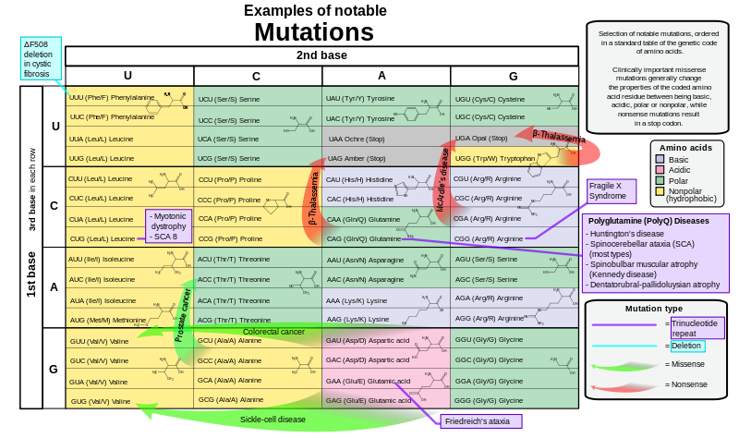
Examples of Notable Mutations
Notes:
Optional slide to insert after slide 16, if desired by the teacher.
Shows how some point mutations may lead to common disorders.
///
Image source: 2009 Mikael Häggström, Wikimedia Commons {PD} http://commons.wikimedia.org/wiki/File:Notable_mutations.svg

