Slide 1
Hydroelectric Energy
Alexis Abdullah, Brionna Francis and Yasmine Soumahoroyah
APE.S.

Slide 2
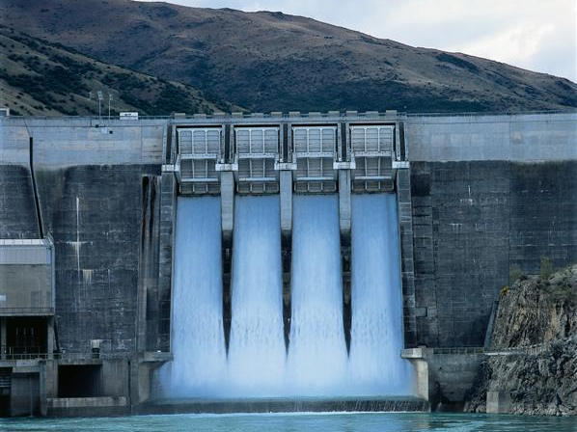
What is it?
The production of electrical power through the use of the gravitational force of falling or flowing water.

Slide 3
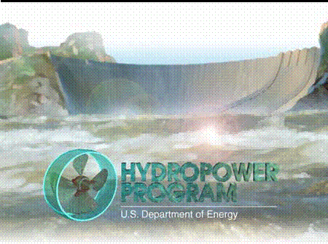
Where is it used?
Hydroelectric Energy powers homes, offices, factories, hospitals, and schools.
Hydroelectric energy is usually one of the first methods a developing country uses to bring affordable electricity to rural areas

Slide 4
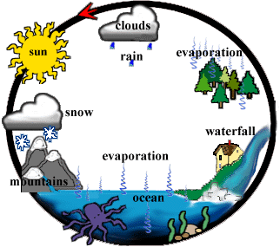
Why is it renewable?
Hydroelectricity relies on water, which is a clean, renewable energy source.
Water is renewable because the water cycle is continually recycling itself.
Water evaporates, forms clouds, and then rains down on the Earth, starting the cycle again.

Slide 5
Advantages & Disadvantages
Throughout the twentieth century some $2 trillion was spent on dams.
Advantages
Disadvantages
Fuel is not burned so there is minimal pollution
Water to run the power plant is provided free by nature
Hydropower plays a major role in reducing greenhouse gas emissions
Relatively low operations and maintenance costs
The technology is reliable and proven over time
It's renewable
High investment costs
Hydrology dependent (precipitation)
Inundation of land and wildlife habitat
Loss or modification of fish habitat
Fish entrainment or passage restriction
Changes in reservoir and stream water quality
Displacement of local populations
Silt build up

Slide 6
Process to Obtain Energy
Water is allowed to build up behind a dam which creates potential energy.
The water is released and directed through turbines that converts from potential to kinetic energy.
This energy which is mechanical energy spins the turbine.
The turbines are coupled to generators, and the mechanical energy of the turbines is converted to electricity in the generators.
The electricity is routed to a transformer bank to increase the voltage.
The higher voltages allow for less power loss during transit, and the energy is transported to the points of use.
Then it is reduced to relatively "safe" voltages and routed out to electrical equipment and devices.

Slide 7
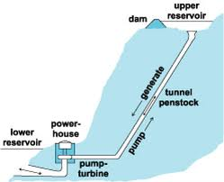
Pumped Storage Plant
The power is sent from a power grid into the electric generators.
The generators then spin the turbines backward, which causes the turbines to pump water from a river or lower reservoir to an upper reservoir, where the power is stored.

Slide 8
Waste/ Widespread Use
No fossil fuels are required to produce the electricity, and the earth's hydrologic cycle naturally replenishes the "fuel" supply. Therefore no pollution is released into the atmosphere and no waste that requires special containment is produced
Countries all over the world make use of hydroelectricity
You need lots of water and a lot of land where you can build a dam and reservoir, which all takes a LOT of money, time, and construction
Most of the good spots to locate hydro plants have already been taken.

Slide 9
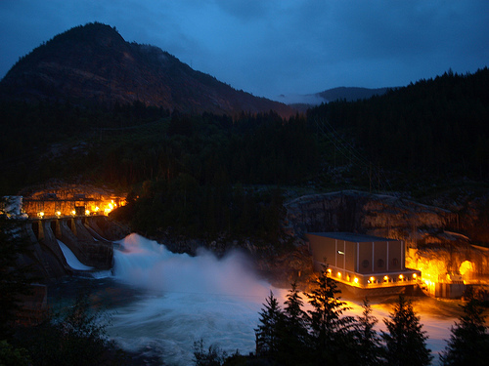
Availability
Castlegar, located in British Columbia, is known as the “Greatest Dam City in the World”
Hydroelectric energy is already easily accessible to the general public in places that can support the infrastructure. So it is not a matter of when the energy will the accessible to people but rather when will cities be able to support such infrastructures.

Slide 10
C’est Tout!
http://wwf.panda.org/what_we_do/footprint/water/dams_initiative/quick_facts/
http://education.nationalgeographic.com/education/encyclopedia/hydroelectric-energy/?ar_a=1
http://ga.water.usgs.gov/edu/wuhy.html

