Slide 1
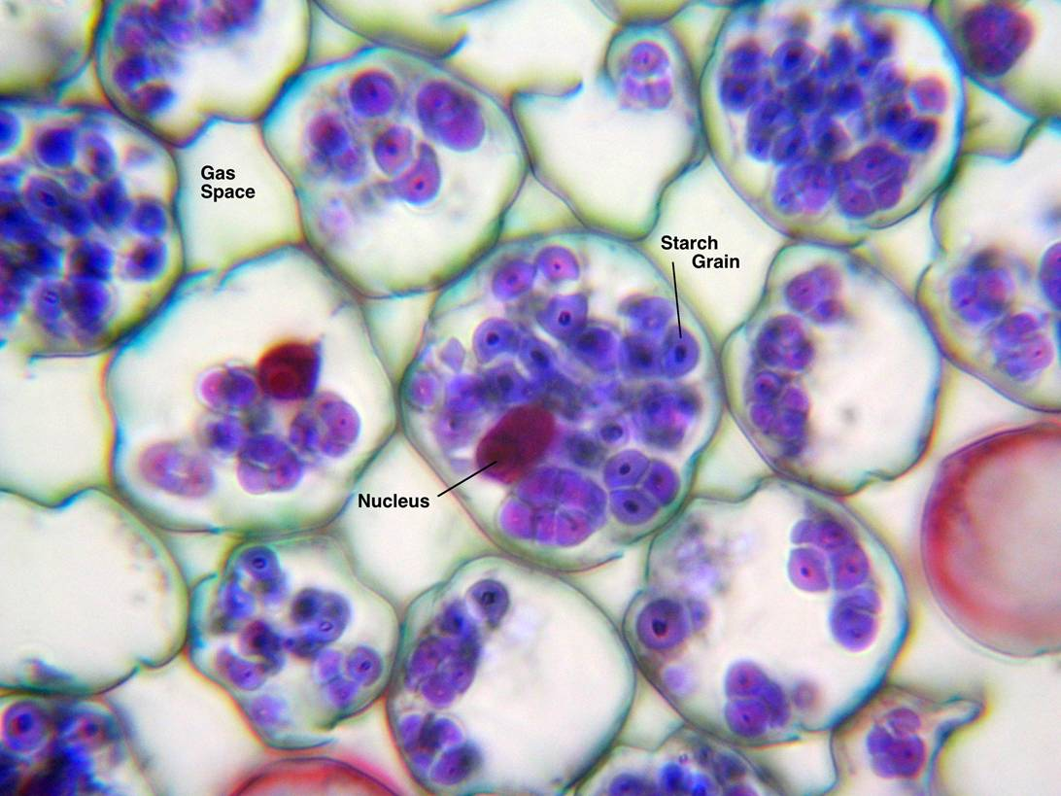
Unit 1: Cells
Part 1: Organic Chemistry: Macromolecules and Enzymes

Slide 2
Origin of Cellular Life
The Earth formed about 4.6 billion years ago.
For about 500 million years, the Earth was continually bombarded by chunks of rock and ice in the solar system.
Following this heavy bombardment, the early atmosphere of Earth contained:
Water vapor H₂O
Nitrogen N₂
Carbon dioxide CO₂
Methane CH₄
Ammonia NH₃

Slide 3
Origin of Cellular Life
How did life arise from such a harsh environment?
Two scientists designed a model of what conditions were like on Earth at this time.
This is called the Miller-Urey Apparatus.

Slide 4
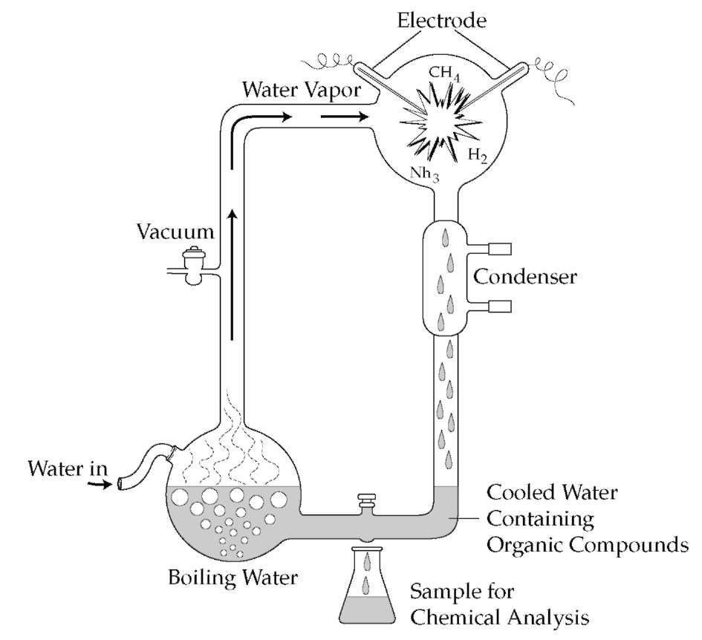
This apparatus simulated three important conditions on Earth:
The high amount of lightning.
Heat and gases released by volcanic activity.
Water vapor present in the atmosphere.

Slide 5
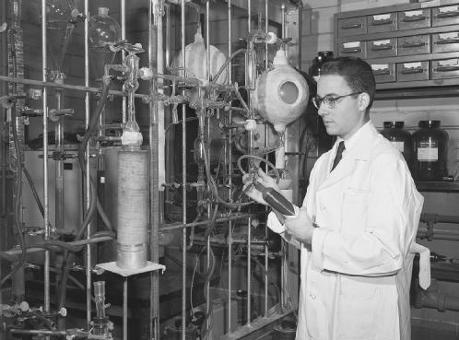
After 2 weeks, 10-15% of the carbon had been used to form sugars, amino acids, and parts of nucleic acids.
These simple organic compounds could have produced the proteins, lipids, and carbohydrates that make up life today.

Slide 6
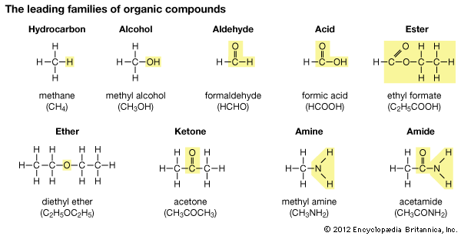
Organic Chemistry
Organic chemistry is the study of the carbon compounds that make up living organisms.
Carbon is considered the backbone of all organic compounds because of its unusual ability to form four covalent bonds with other atoms.

Slide 7
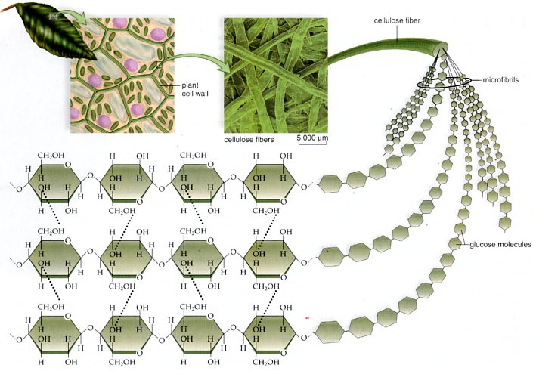
Macromolecules
The most common organic molecules found in living organisms are huge – as many as thousands of atoms of carbon and other atoms bonded together.
Due to their size, they are referred to as macromolecules.

Slide 8
Carbohydrates
Carbohydrates are organic molecules consisting of carbon, hydrogen, and oxygen.
The simplest sugars are referred to as monosaccharides.
“Mono” means one or single.
“Saccharide” means sugar.
There many different types of monosaccharides.
Specific Ratio: 1 Carbon: 2 Hydrogen: 1 Oxygen
Extra Tip: End in the letters -ose

Slide 9
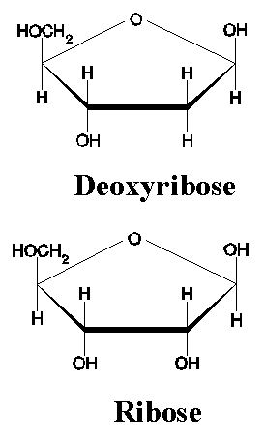
Glucose (blood sugar), galactose, and fructose (fruit sugar) are found in both structural and energy-storage molecules.
Ribose and deoxyribose are sugars that are primarily found in DNA and RNA.

Slide 10
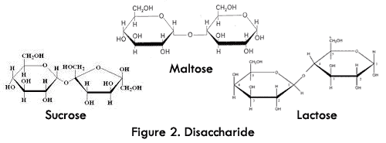
Disaccharides are double-sugars, made of two monosaccharides chemically bonded together.
“Di” means two.
Sucrose is table sugar (glucose + fructose), maltose is malt sugar (glucose + glucose), and lactose is milk sugar (glucose + galactose).

Slide 11
Polysaccharides are polymers of sugars.
“Poly” means many.
Polysaccharides are an example of a polymer -- a molecule that has a large number of repeating similar units bonded together.
Polysaccharides in living organisms fill one of two roles:
Providing structure.
Energy storage.

Slide 12
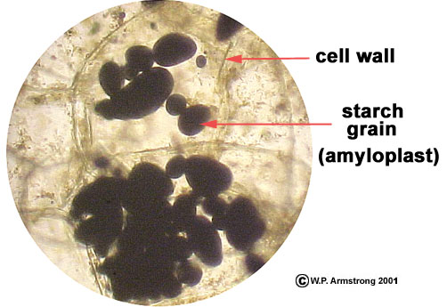
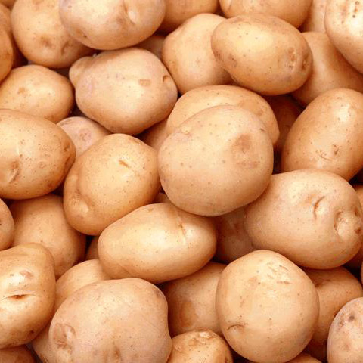
Starch is an energy storage polysaccharide of plants.
Made of 300-1000 glucose molecules joined together.

Slide 13
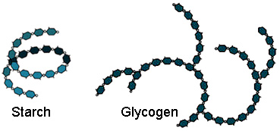
Glycogen is a storage polysaccharide in animals.
Nearly identical to starch, except that the molecule branches off more.
Humans and other vertebrates store glycogen mainly in liver and muscle cells
This is an energy reserve utilized for quick bursts of activity.

Slide 14
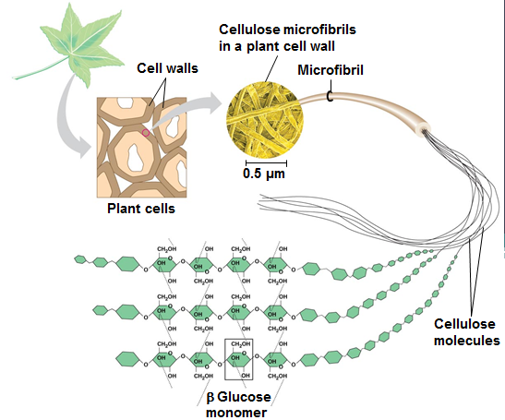
Cellulose is a structural polysaccharide that makes the strongest part of the cell wall of plants.
Allows plants to be sturdy and rigid.
Cellulose is very similar to starch and is also made from glucose molecules.
The bonds between the glucose molecules are slightly different and only digestible for certain animals.

Slide 15
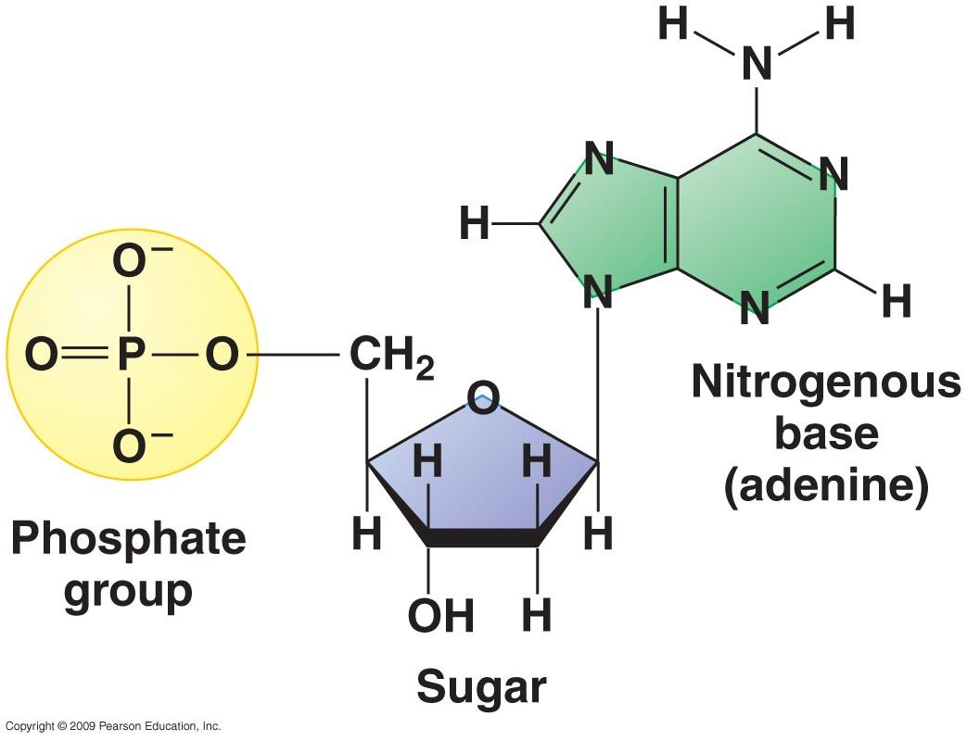
Nucleic Acids
The genetic material of our cells, DNA and RNA, are made of a class of macromolecule called nucleic acids.
A nucleic acid is a polymer made of repeating units called nucleotides.
Each nucleotide is made of:
A phosphate (PO4) group.
A nitrogen-containing base.
A sugar
Ribose for RNA
Deoxyribose for DNA.

Slide 16
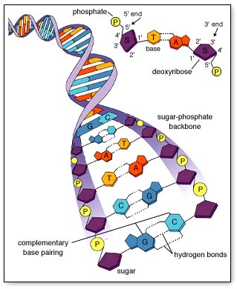
DNA is made of two strands of nucleotides that form a double-helix shape.
The nitrogenous bases form hydrogen bonds with each other.
RNA is a single-stranded molecule.

Slide 17
Lipids
Lipids, like carbohydrates, are organic molecules made of carbon, hydrogen, and oxygen.
Unlike carbohydrates, lipids are the only class of macromolecule that do not form polymers.
There are a wide variety of molecules in the lipid class, but they are all considered hydrophobic because they cannot dissolve in water.

Slide 18
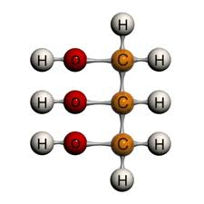
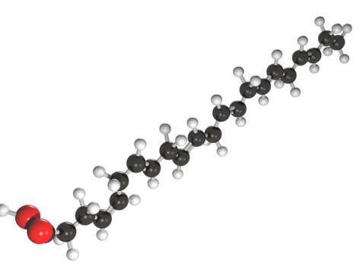
Triglycerides
Triglycerides, the biggest component of plant and animal fat, are a combination of two types of molecules:
A type of alcohol called glycerol.
Long chains of carbon, hydrogen, and oxygen called fatty acids.

Slide 19
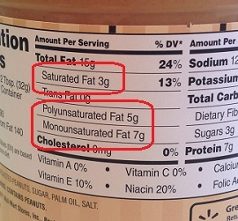
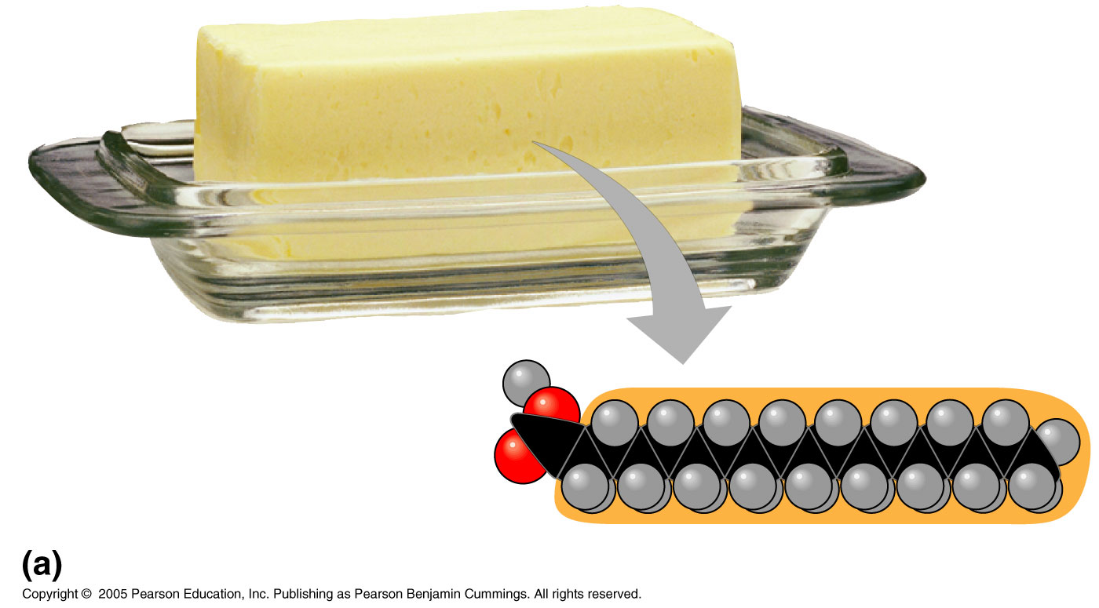
Fatty acids vary in two ways:
Length (number of carbons).
The presence of double bonds.
Saturated fatty acids have the maximum number of hydrogen atoms possible and no double bonds.
Saturated fats most often come from animal sources and are solid at room temperature.
They have a straighter shape can be packed more tightly together.

Slide 20
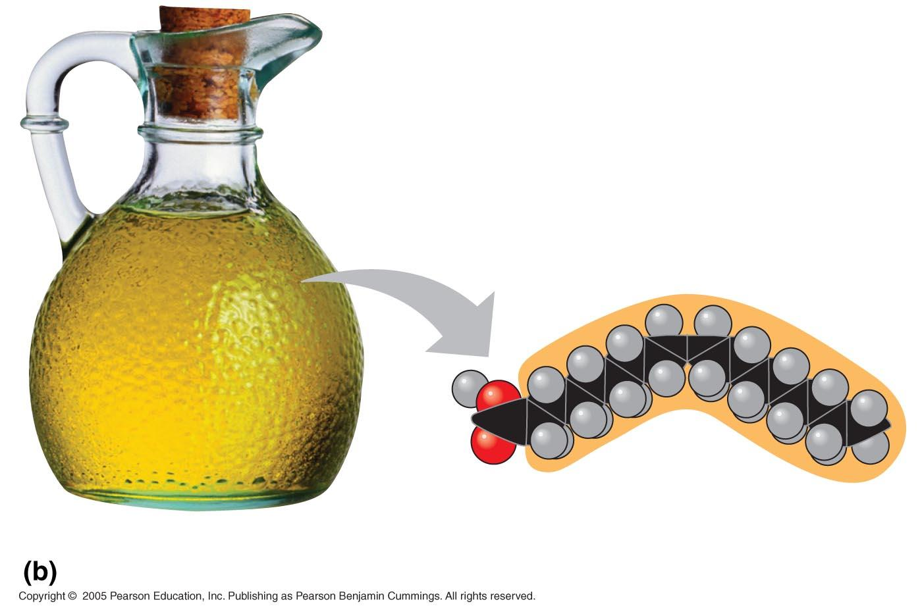
Unsaturated fatty acids have one or more double bonds.
Unsaturated fats usually come from plant sources or fish and are liquid at room temperature.
Curved shape due to the presence of one or more double bonds.

Slide 21
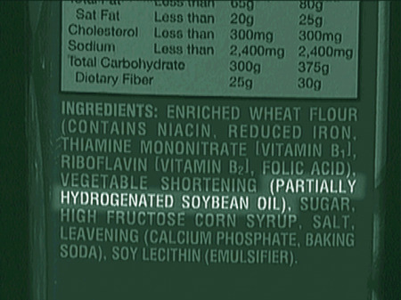
Trans fats are unsaturated fatty acids that have been changed to have fewer double bonds.
Gives them desirable properties, such as being solid at room temperature, melting when baked, etc.
Increases risk of heart disease.

Slide 22
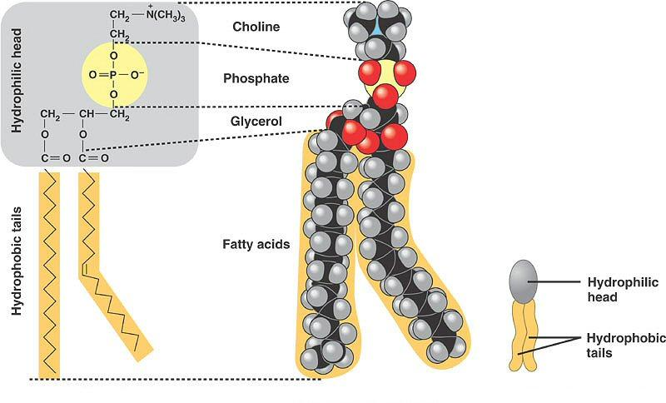
Phospholipids
In a phospholipid, one of the fatty acids is replaced by a phosphate (PO₄).
The two fatty acid tails are hydrophobic, but the phosphate head is hydrophilic, meaning it will dissolve in water.

Slide 23
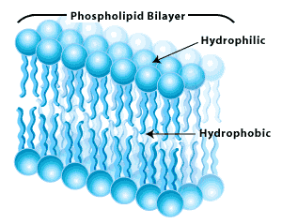
When phospholipids are added to water, they self-assemble into a double-layered film of molecules called a bilayer.
This property has resulted in them becoming the most abundant lipid component of cell membranes.

Slide 24
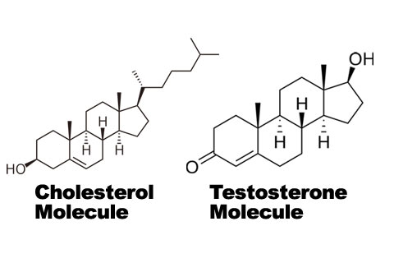
Steroids
Steroids have a structure completely different than other lipids – the chains of carbon and hydrogen form four interlocking rings.
Steroids include cholesterol, cortisone, and the sex hormones.

Slide 25
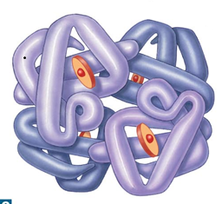
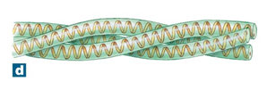
Proteins
Proteins are made of chains of amino acids.
There are only 20 amino acids, but they can be combined in nearly infinite ways.
The sequence of amino acids determines the shape of the protein.
The shape of the protein is the biggest factor that determines its function.
Keratin, a linear protein.
Hemoglobin, a globular protein.

Slide 26
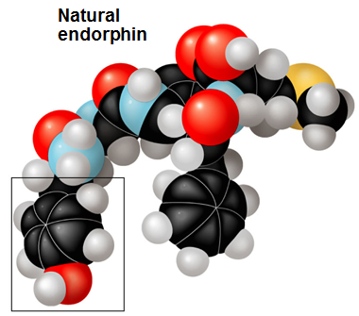
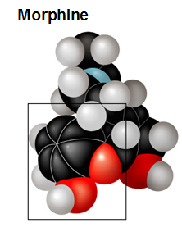
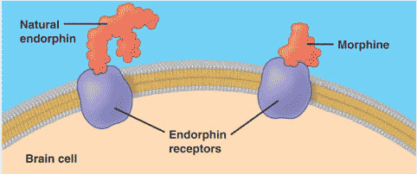
Morphine has a similar chemical structure to the neurotransmitter endorphin.
Endorphin is a protein that reduces pain and stimulates feelings of euphoria in the nervous system.
Morphine, activates many of the same protein receptors on cell membranes and causes similar effects.

Slide 27
Proteins account for 20% of total body weight, and perform a variety of important functions:
Protein functions include
Structural support
Movement
Transportation within cells
Buffering against changes in pH
Regulation of chemical reactions
Control (via hormones)
Defense (e.g. antibodies)

Slide 28
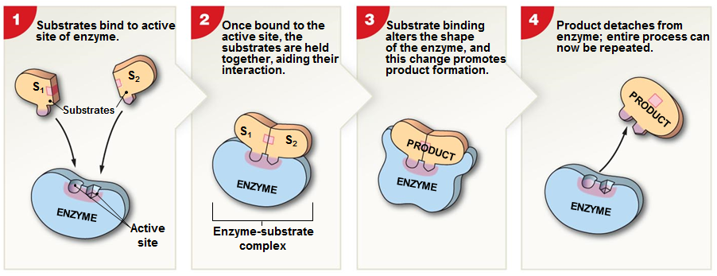
Enzymes
Enzymes are special proteins that catalyze, or speed up the rate of chemical reactions in the body.
The reactants, or inputs, are called substrates.
The products are the substances that are produced following the reaction.

Slide 29
Enzymes, like other proteins, must maintain a certain shape to be functional.
A change in shape that disables a protein’s function is called denaturation.
Protein denaturation is most often caused by heat or exposure to acid.

