Slide 1
Intermolecular Forces
#3:

Slide 2
Phase Diagrams
Shows relationships among solid, liquid, and gas states in a sealed container
Shows state or states of matter of a substance for a given pressure and temperature
Lines between phases represent equilibrium conditions between those phases
Triple point: condition at which all three states coexist in equilibrium
All three lines on phase diagram meet

Slide 3
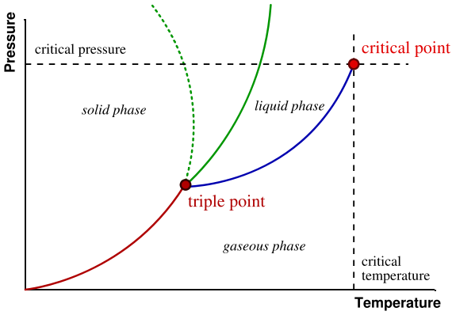
Phase Diagram

Slide 4
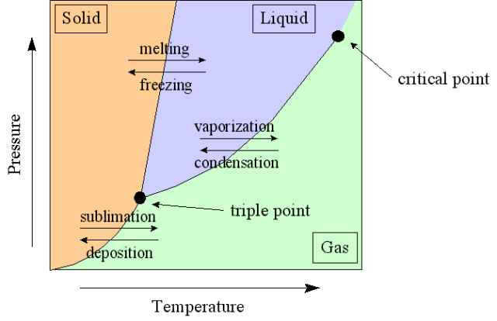
Phase Diagram

Slide 5
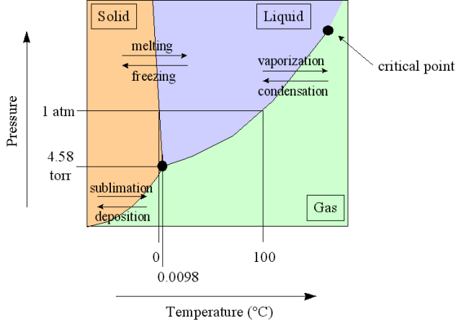
Phase Diagram for Water

Slide 6
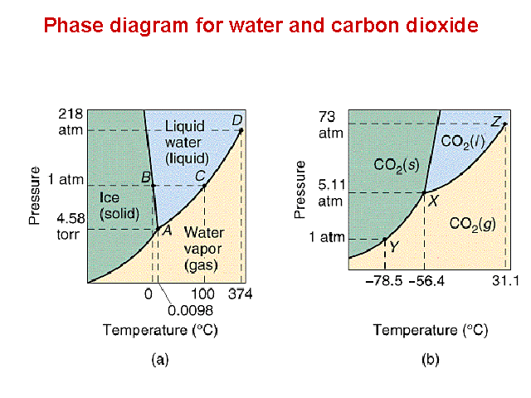
Phase Diagrams

Slide 7
Critical Temperature and Pressure
Critical Temperature
Temperature above which no amount of pressure can liquefy substance
Above this temperature there is no distinction between liquid and gas states
Critical Pressure
Pressure required to liquefy vapor at critical temperature
Vapor pressure at critical temperature

Slide 8
Melting Point
Temperature at which solid and liquid phases are in equilibrium
Increasing pressure favors formation of more dense phase
Large pressures required to see significant difference

Slide 9
Solid ⬄ Gas Transitions
Sublimation
Change of a substance from solid to gas or vapor state without passing through the liquid state
Example: CO₂ or “dry” ice
Application in freeze drying
Deposition
Condensation of gas to solid state

Slide 10
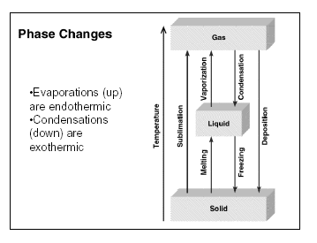
Summary of Changes of State
Phase Diagrams Quiz

