Slide 1
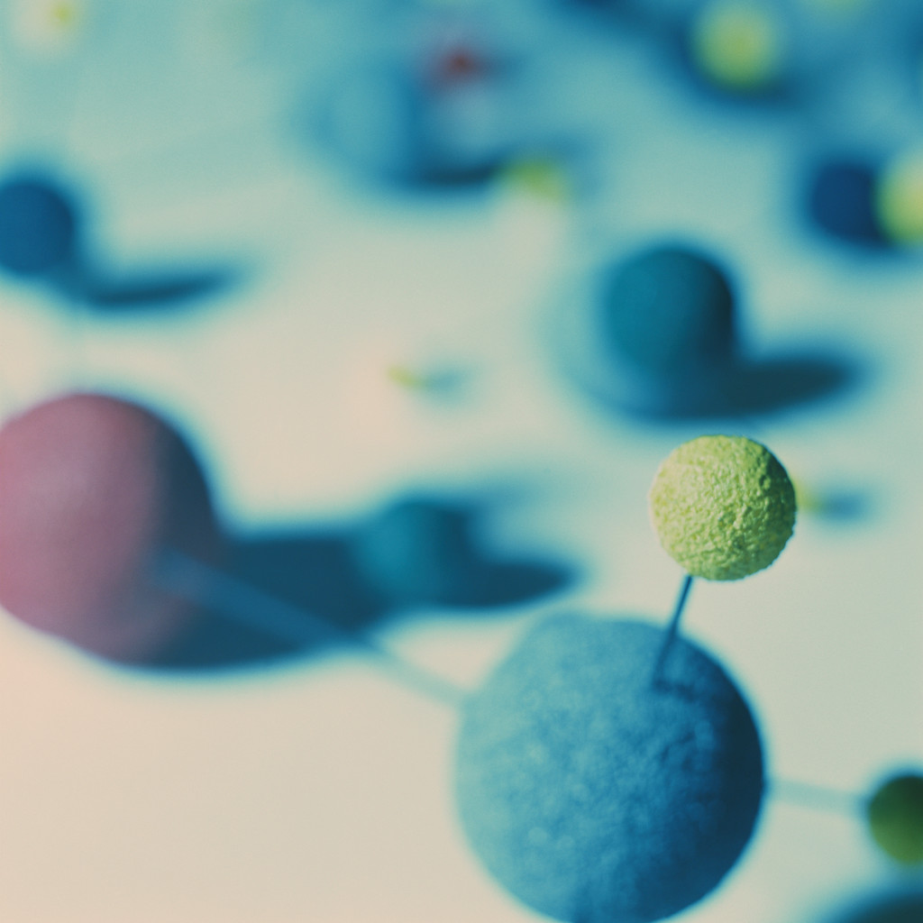
Unit 1: Lecture 2:
Atoms, Molecules and Ions

Slide 2
The Language of Chemistry
Atoms
  Composed of electrons, protons and neutrons
Molecules
  Combinations of atoms
Ions
  Charged particles

Slide 3
Laws of Chemical Composition
(1790) Antoine Lavoisier, The Father of Modern Chemistry
Law of Conservation of Matter
Total mass remains constant during a chemical reaction; or
Total mass of reactants = total mass of products.

Slide 4
Law of Conservation of Mass:
A Conceptual Example
Jan Baptista van Helmont (1579–1644) first measured the mass of a young willow tree and, separately, the mass of a bucket of soil and then planted the tree in the bucket. After five years, he found that the tree had gained 75 kg in mass even though the soil had lost only 0.057 kg. He had added only water to the bucket, and so he concluded that all the mass gained by the tree had come from the water. Explain and criticize his conclusion.

Slide 5
Laws of Chemical Composition
Joseph Proust, Law of Constant Composition
(a.k.a. Law of Definite Composition or Definite Proportions)
All samples of a compound have the same composition, or all samples have the same proportion by mass of the elements present.

Slide 6
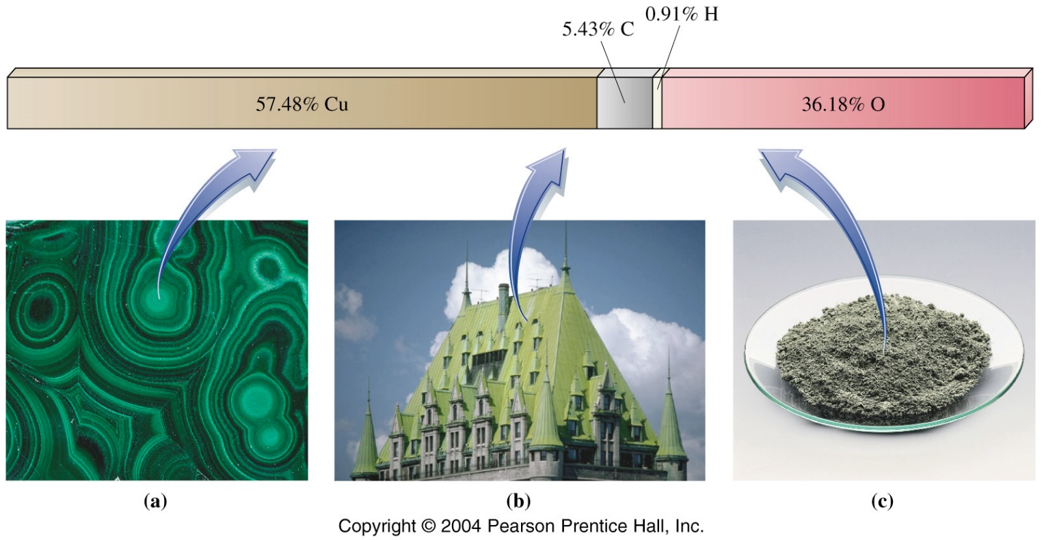
Law of Constant Composition: Example
Example: CuHCO₃ is ALWAYS
57.48% Cu, 5.43% C, 0.91% H and 36.18% O by mass

Slide 7
John Dalton and the Atomic Theory of Matter
Importance:
Dalton explained the Laws of Conservation of Mass and Constant Composition and extended them to cover another law…
The Law of Multiple Proportions

Slide 8
Main ideas of Dalton’s model
1. All matter consists of small, indivisible particles called atoms.
2. All atoms of a given element are alike but atoms of any one element are different from the atoms of every other element.
3. Compounds are formed when atoms of different elements unite in small, whole-number ratios.
4. Chemical reactions involve rearrangement of atoms; no atoms are created, destroyed or broken apart in a chemical reaction.
According to Dalton, atoms are indivisible and indestructible.

Slide 9
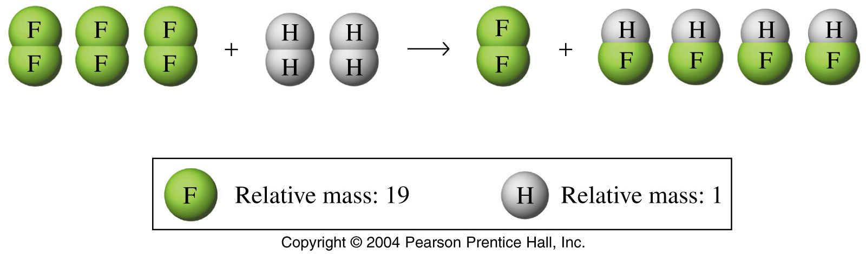
Dalton’s Atomic Theory:
Conservation of Mass and Definite Proportions
… six fluorine atoms and four hydrogen atoms after reaction. Mass is conserved.
Six fluorine atoms and four hydrogen atoms before reaction …
HF always has one H atom and one F atom; always has the same proportions (1:19) by mass.

Slide 10
Another Important Law
Law of Multiple Proportions
A given set of elements may combine to produce two or more different compounds, each with a unique composition.
Example: H₂O (water) &
H₂O₂ (hydrogen peroxide)

Slide 11
Law of Multiple Proportions (cont’d)
Four different oxides of nitrogen can be formed by combining 28 g of nitrogen with:
16 g oxygen, forming Compound I
48 g oxygen, forming Compound II
64 g oxygen, forming Compound III
80 g oxygen, forming Compound IV
Compounds I–IV are N₂O, N₂O₃, N₂O₄, N₂O₅
What is the ratio 16:48:64:80 expressed as small whole numbers?

Slide 12
Dalton’s Model of the Atom
NO subatomic particles!
In modern atomic theory, the atom is divided into protons, neutrons and electrons.

Slide 13
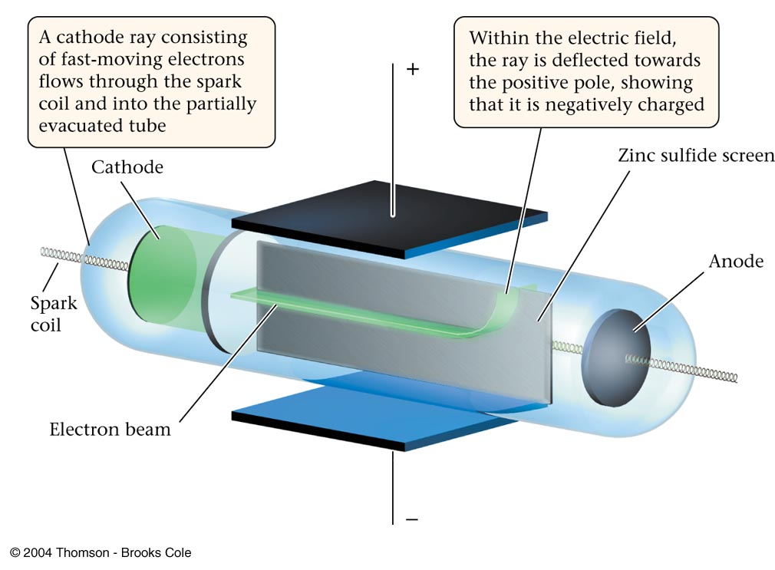
1897 JJ Thomson
Thomson experimented with CATHODE RAY TUBES
-Caused stream of negative particles that were always the same, no matter what gas was used
Cathode Ray Tube Demonstration

Slide 14
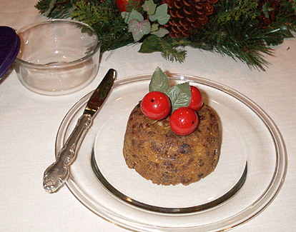
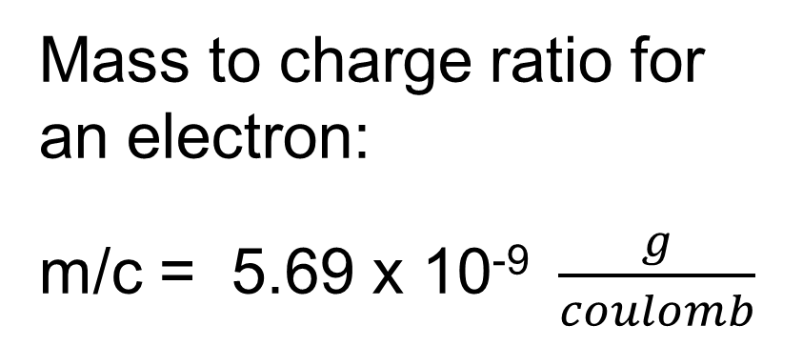
1897 JJ Thomson
Thomson known as discoverer of the ELECTRON—led to the “plum pudding model” of the atom

Slide 15
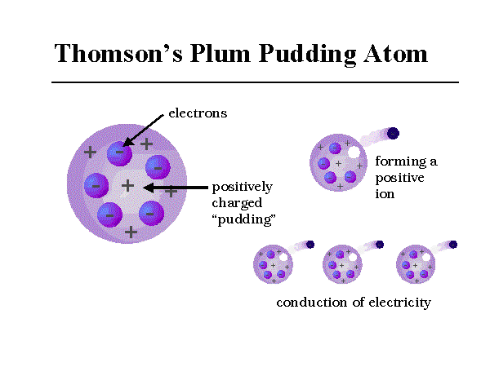
15

Slide 16
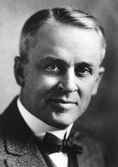
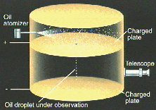
Robert Millikan:
Oil Drop Experiment
Obtained the charge of an electron, which coupled with Thomson’s work, allowed the calculation of the mass of an electron.
Oil Drop Experiment Demo

Slide 17
Millikan’s Conclusions
Measured the charge of an electron:
1.602 x 10⁻¹⁹ coulomb (C)
Calculated the mass of an electron:
9.109 x 10⁻³¹ kg

Slide 18
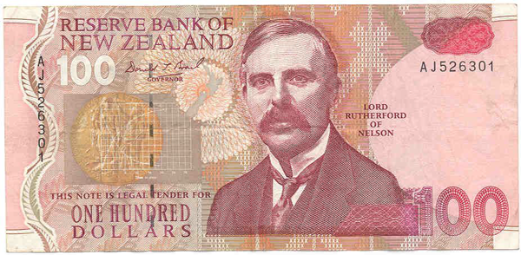
The modern view of the atom was developed by Ernest Rutherford of New Zealand (1871-1937).

Slide 19
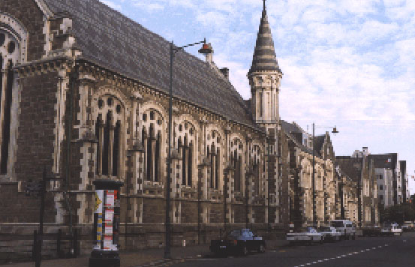
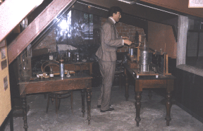
Ernest Rutherford
Canterbury University in Christchurch, NZ
Rutherford laboratory

Slide 20
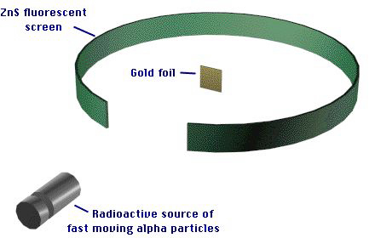
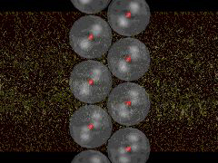
Gold Foil Experiment
Gold Foil Experiment Demonstration

Slide 21
Rutherford’s Main Conclusions
1. The atom is mostly empty space.
All of the positive charge, and most of the mass, is concentrated in a very small volume:
  THE NUCLEUS!
3. Electrons are outside the nucleus.

Slide 22
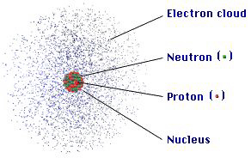
Protons
The mass of a proton is about the same as the mass of an H atom (1 atomic mass unit)
In a neutral atom…
Positive charge from protons =
negative charge from electrons

Slide 23
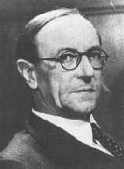
Neutrons
(James Chadwick, 1932)
The nucleus also contains neutrons: particles with masses almost identical to protons but with no charge
***Neutrons also help disperse the strong repulsion of positive charges within the nucleus due to the protons in the nucleus.

Slide 24
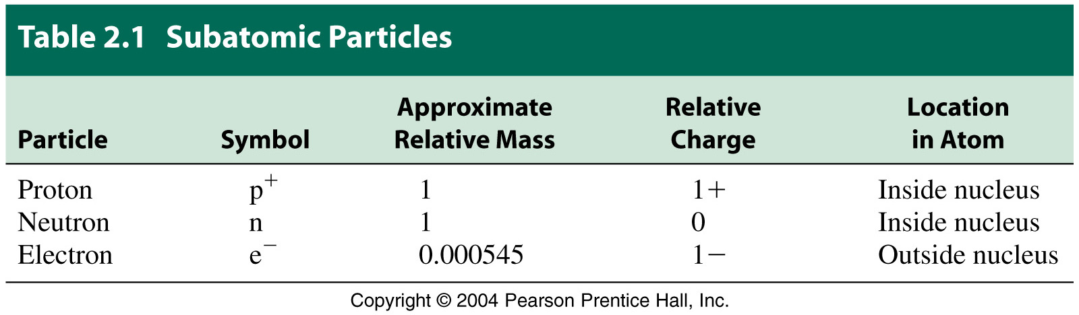
Summary

Slide 25
Atomic Symbols
Atomic symbol – the letter or letters that represent an element.
13
Atomic number
Al
Atom symbol
26.981
Atomic mass or weight

Slide 26
Mass Number, A
The Mass Number (A) = # protons + # neutrons
A Boron atom can have:
A = 5 p + 5 n = 10 amu
Named as boron-10

Slide 27
Atomic Number, Z
Atomic number, Z =
the number of protons in the nucleus. (same for every atom of that element)
13
Atomic number
Al
Atom symbol
26.981
Atomic mass or weight

Slide 28
Isotopes
Atoms of the same element (same Z) with different mass numbers (A).
Boron-10 has 5 p and 5 n: ¹⁰₅B
Boron-11 has 5 p and 6 n: ¹¹₅B
¹¹B
¹⁰B

Slide 29
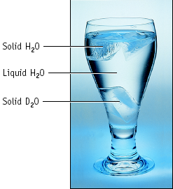
Hydrogen Isotopes
Hydrogen has 3 isotopes:
1 proton and 0 neutrons, protium
¹₁H
1 proton and 1 neutron, deuterium
²₁H
1 proton and 2 neutrons, tritium
***radioactive
³₁H

Slide 30
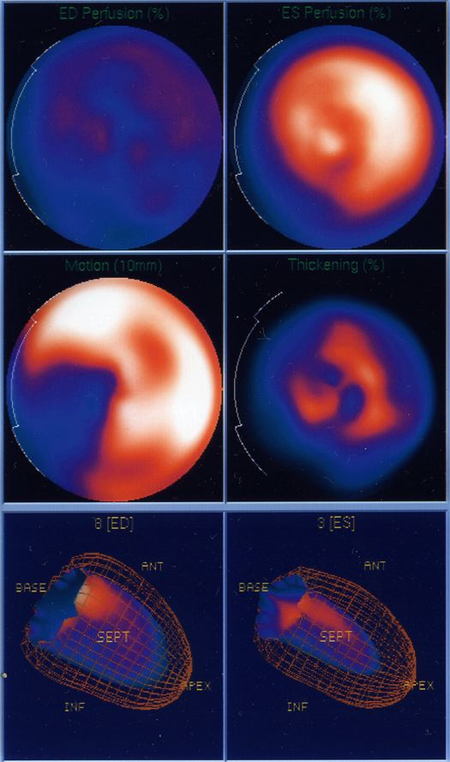
Isotopes & Their Uses
Heart scans with radioactive technetium-99.
⁹⁹₄₃Tc
Emits gamma rays

Slide 31
Sample Problem
Example 2.1
Write the atomic symbols for the following species:
a. the isotope of carbon with a mass of 13
b. the nuclear symbol when Z = 92 and the number of neutrons = 146.

Slide 32
Solution to Problem
¹³ C
⁶
²³⁸ U
⁹²

Slide 33
Ions: particles w/ a charge
Atoms GAIN electrons to become negative ions, or anions.
Atoms LOSE electrons to become positive ions, or cations.
How are ions represented?
Charges are always shown to upper right of symbol.

Slide 34
Sample Problem
Example 2.2 Write the atomic symbols for the following:
a. a species with 16 protons, 16 neutrons and 18 electrons
b. the phosphide ion (P) with an overall charge of -3

Slide 35
Solution
³² S ²⁻
¹⁶
³¹ P ³⁻
¹⁵

Slide 36
Atomic Mass
An atomic mass unit (amu or u) is defined as exactly one-twelfth the mass of a carbon-12 atom
1 u = 1.66054 × 10^{–24} g
The atomic mass of an element is the relative mass of an atom compared to a standard (carbon-12 atom). It is NOT equal to the mass number!

Slide 37
Atomic Mass Is Not Equal to Mass Number!!
The atomic mass is a weighted average of the masses of the naturally occurring isotopes.
(Atomic mass is also called atomic weight)
13
Atomic number
Al
Atom symbol
26.981
Atomic mass or weight

Slide 38
Atomic Mass
The weighted average is the addition of the contributions from each isotope.
Isotopic Abundance is the percent or fraction of each isotope found in nature.

Slide 39
Most Abundant Isotope
Usually can round atomic mass on the periodic table to nearest whole number
(but not always!!)
13
Atomic number
Al
Atom symbol
26.981
Atomic mass or weight

Slide 40
Example 2.3 Determine the average atomic mass of magnesium which has three isotopes with the following masses: 23.98 (78.6%), 24.98 (10.1%), 25.98 (11.3%).

