Slide 1
Tidal (Wave) Power

Slide 2
How and What…
2 forms of energy can be derived:
Tidal Stream: Kinetic Energy: Difference between the ebbing and surging
Barrage: Potential Energy: Difference between the height of the high, and low water marks

Slide 3
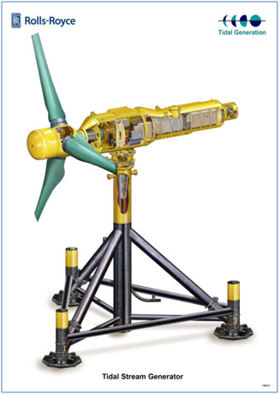
Tidal Stream
Similar to Wind Turbines…
Underwater turbines collect the kinetic energy from the waves

Slide 4
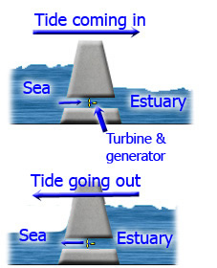
Similar to Hydroelectric Dams…
During high tides, the water is collected, and when the tide recedes, the water is forced through the turbines (and generator) back out
Tidal Barrage

Slide 5
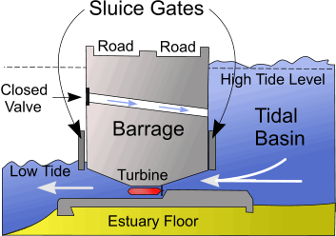
Tidal Barrage

Slide 6
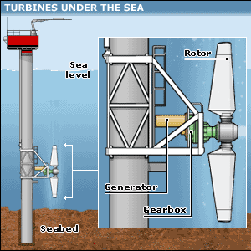
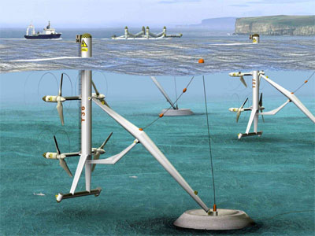
Tidal Stream

Slide 7
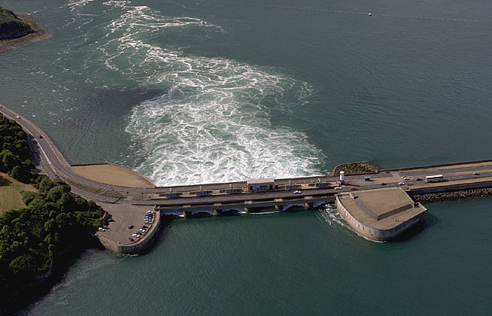
Depending on the size of the barrage or stream, it can cost anywhere from a few hundred million, to billions.
Cost

Slide 8
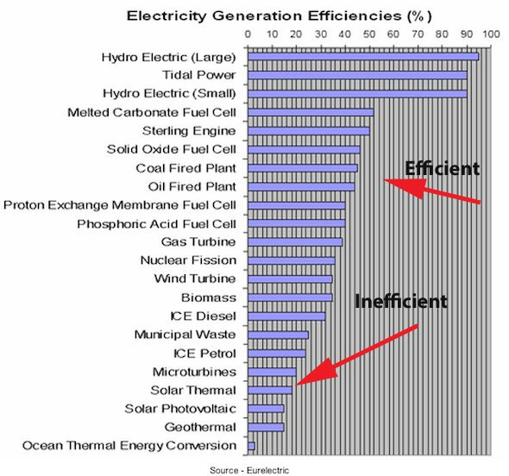
Efficiency

Slide 9
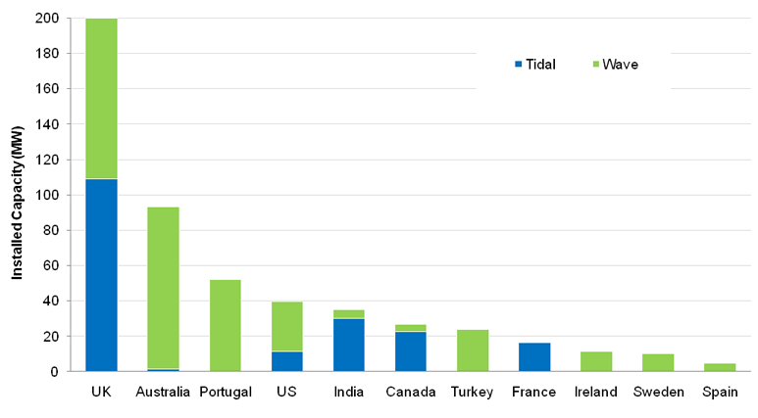
Coal and oil are cheaper, and easier resources to find, though the extraction of these are not friendly to anyone; the environment, the people, and the economy.
Why isn’t it more widely used?

Slide 10
Pros | Cons
No Waste -No CO2 | Unknown Environmental Impacts - Not widely used enough to provide thorough environmental impact research
Extremely efficient -2nd highest efficient form of renewable, alternative energy | Cost
Never Runs Out -Tides will last as long as there is a sun and moon; although the tides do vary | Specific location requirements –Needs to be in areas were there are stronger tides, and underwater flow
Pros Vs. Cons

Slide 11
http://www.youtube.com/watch?v=tSBACzRE3Gw
http://www.odec.ca/projects/2006/wong6j2/tidalAnimation.html
http://www.youtube.com/watch?v=8-sFLGMSMac
http://www.esru.strath.ac.uk/EandE/Web_sites/01-02/RE_info/Tidal%20Power.htm
Helpful Videos and Resources

