Slide 1
Thermochemistry
Unit 7-Chapter 16: Lesson 2

Slide 2
Recap of Calorimetry
Calorimetry: Process of measuring amount of heat absorbed or released by substance or reaction. Measured with a device that creates a closed system called a Calorimeter.
Used to determine heat transfer
Used to identify unknown substance based on it’s specific heat.
If water heats up, the system (metal) released energy (-q)
The heat absorbed is equal to, but with opposite sign, of the heat released by the system.
q (system) = - q(water)

Slide 3
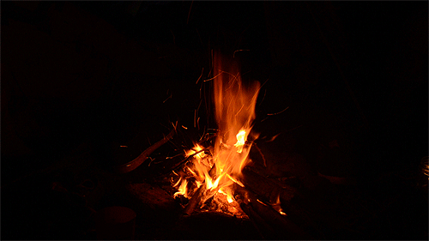
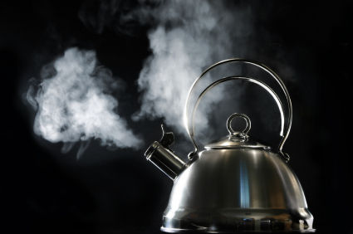
Thermochemistry → Study of energy changes that occur during chemical reactions and changes of state
*Molecules want lowest possible energy
*During a rxn:
Bonds break (Rxt)= Energy Needed (Absorbed)
Bonds form (Pro)= Energy Released (-)

Slide 4
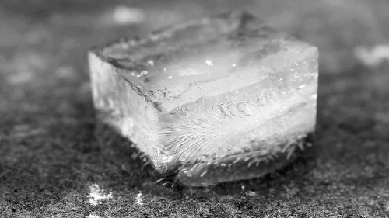
Endothermic
Process that absorbs/gains heat
Heat flows into the system (+q)
Heat removed from the surroundings (-q)
Surroundings feel cold

Slide 5
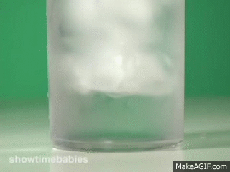
Exothermic
Process that releases/produces heat
Heat flows out of the system (-q)
Heat added to the surroundings (+q)
Surroundings may feel warm/hot

Slide 6
Exothermic Endothermic
-q +q
-q -q +q +q

Slide 7
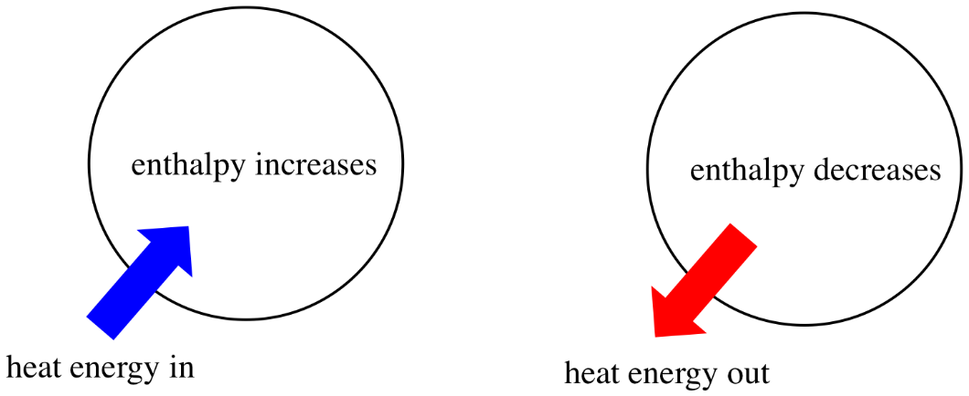
Enthalpy (H) → the heat content of a system; measured in kJ
ΔH (Change in Enthalpy) = Energy required to break bond-Energy released by bonds forming
*assuming pressure is constant, no work is done by reactions
Energy= Work + Heat; so… ΔH = q
ΔH depends on # of bonds and bond strength
Endothermic = + ΔH
Exothermic = - ΔH

Slide 8
ΔH & Changes of State
Change in state always involves a change in heat energy

Slide 9
Endothermic changes of state absorb heat energy,
increasing in temperature
Melting (fusion)
Vaporization
Sublimation

Slide 10
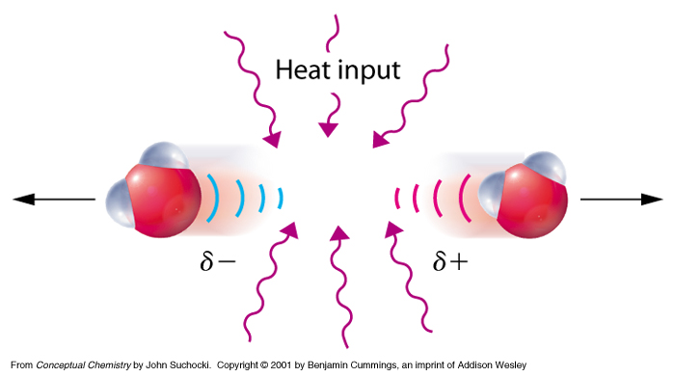
As more heat is added the temperature increases, meaning the particles are moving faster.
To make a substance melt or vaporize you continuously add heat to:
*increase the speed of the
molecules
*break the (IMFs) attractions
between molecules causing
them to separate

Slide 11
Melting (fusion)
The Heat of Fusion is the amount of heat needed to melt one gram of a substance at standard pressure.
Heat of Fusion (H_{f}) of water is 334 J/g.
Standard, known values
q = m·H_{f}

Slide 12
How much heat is added when 15.7 moles of water melts?
q = m·H_{f}
15.7 mol
18.016 g
= 282.85 g
1 mol
q = (282.85 g)(334 J/g)
q = 94,471 J
q = 94.5 kJ

Slide 13
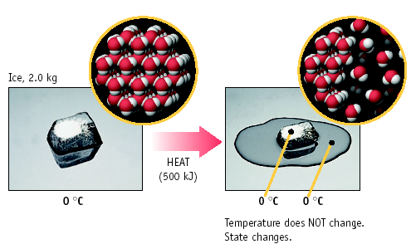
In the diagram, how much heat is needed for the ice to melt?
q = m · H_{f}
q = 2000 g · 334 J/g
q = 668000 J
= 670 kJ

Slide 14
Vaporization/Boiling
The Heat of Vaporization is the amount of heat needed for one gram of the substance to change from liquid to gas at standard pressure.
Heat of Vaporization (H_{v}) of water is 2260 J/g.
INFO you can look up
q = m·H_{v}

Slide 15
How much heat is absorbed when 24.8 g H₂O at 100.0 ºC is converted to steam at 100.0 ºC?
You NEED to recognize that 100°C is the boiling point for water
q = m·H_{v}
q = (24.8 g)(2260 J/g)
q = 56,048 J
q = 56.0 kJ

Slide 16
Exothermic changes of state release heat energy,
decreasing in temperature
Freezing
Condensation
Deposition

Slide 17
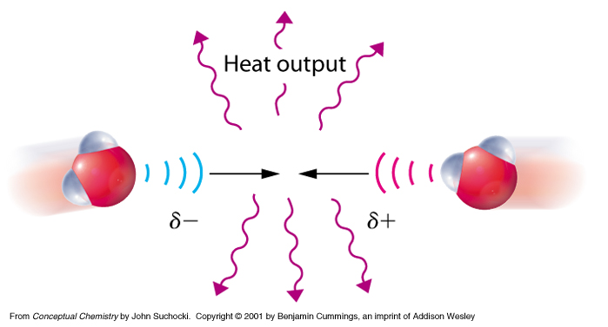
As heat is removed the temperature decreases, meaning the particles are moving slower.
To make a substance freeze or condense you continuously remove heat to:
*decrease the speed of the
molecules
*increase the (IMFs) attractions
between molecules causing them
to clump

Slide 18
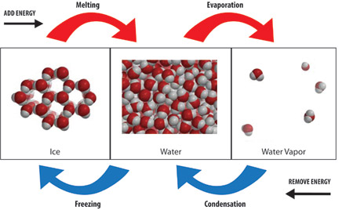

Slide 19
ΔH & Chemical Reactions
ΔH= ΔH product - ΔH reactant
Enthalpy of Reaction (Heat of Reaction) ΔHrxn
Chemical reactions always involves a change in heat energy

Slide 20
Endothermic Reactions
+ΔH
C(s) + 2H₂O(g) + 113 kJ → CO₂(g) + 2H₂(g)
Heat energy is written in the equation as a reactant since it is coming in/being used.
Surrounding area feels cool
ΔH_{rxn} = +113 kJ
meaning 113kJ are absorbed

Slide 21
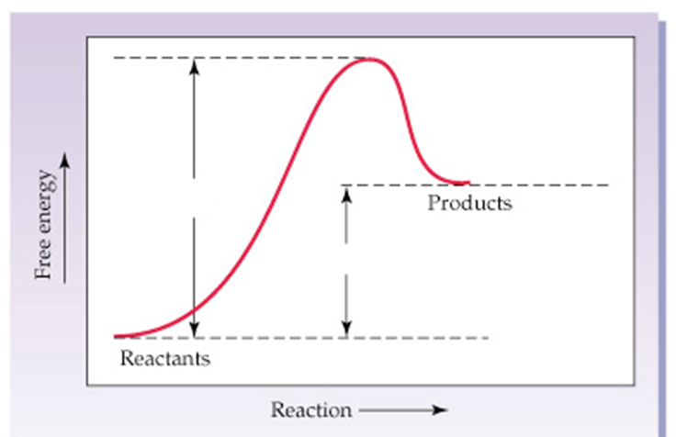
Endothermic because….
Potential energy diagram
1. Products have more energy than the reactants
2. ΔH is positive, >0
Activation Energy
ΔH

Slide 22
Exothermic Reactions
-ΔH
C₃H₈ + 5O₂ → 3CO₂ + 4H₂O + 2043 kJ
Heat energy is written in the equation as a product since it is released/produced.
Surrounding area feels warm
ΔH_{rxn} = -2043 kJ . . .
meaning 2043 kJ of heat is released

Slide 23
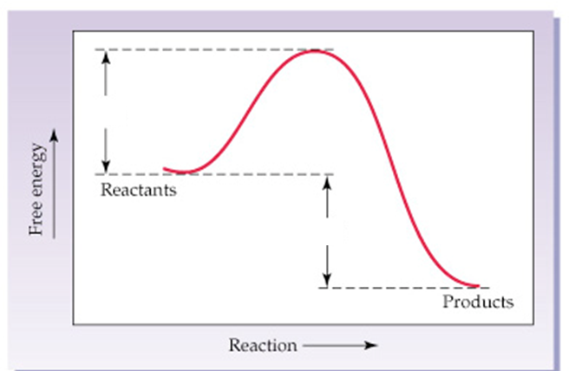
Potential energy diagram
Exothermic because….
1. Products have less energy than the reactants
Activation Energy
2. ΔH is negative
ΔH

Slide 24
Thermochemistry & Stoichiometry
If you know the ΔH for a balanced equation, you may determine the amount of energy used or released by a reaction.

Slide 25
ΔH (enthalpy) is proportional to the coefficients for a balanced equation, therefore they may be used to write conversion factors.
2 H₂O₂(l) → 2 H₂O(l) + O₂(g)
ΔH_{rxn} = -190 kJ
2 mole H₂O₂ = -190 kJ
1 mole O₂ = -190 kJ
Or
Or

Slide 26
Example
How much heat will be released if 1.0 g of hydrogen peroxide (H₂O₂) decomposes in a bombardier beetle to produce a steam spray?
2 H₂O₂(l) → 2 H₂O(l) + O₂(g)
ΔH_{rxn} = -190 kJ
1.0 g H₂O₂
1 mol
-190 kJ
= - 2.8 kJ
34.016 g
2 mol H₂O₂

Slide 27
Example
How much heat is transferred when 9.22 g of glucose (C₆H₁₂O₆) in your body reacts with O₂ according to the following equation?
C₆H₁₂O₆(s) + 6O₂(g) → 6CO₂(g) + 6H₂O(l)
ΔH_{rxn} = -2803 kJ
9.22 g C₆H₁₂O₆
1 mol
-2803 kJ
= - 143 kJ
180.156 g
1 mol C₆H₁₂O₆

Slide 28
Example
How much energy will be required to extract 59.5 grams of tin?
SnO₂(s) + 4NO₂(g) + 2H₂O(l) + 192 kJ → Sn(s) + 4HNO₃(aq)
ΔH_{rxn} = +192 kJ
59.5 g Sn
1 mol
192 kJ
= + 96.2 kJ
118.71 g
1 mol Sn

