Slide 1
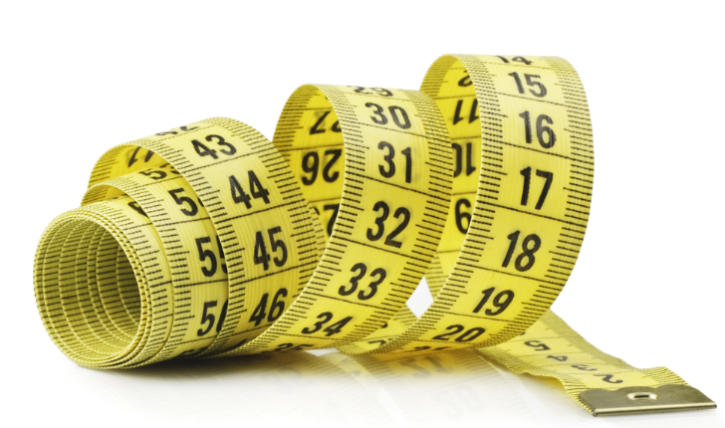
Unit 0 Lecture 1 Scientific Measurement

Slide 2
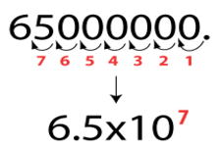
Measurements and Their Uncertainty
A measurement is a quantity that has both a number and a unit.
The unit typically used in the sciences are those of the International System of Measurements (SI).
In scientific notation, a given number is written as the product of two numbers: a coefficient and 10 raised to a power.
In scientific notation, the coefficient is always a number equal to or greater than one and less than ten.

Slide 3
Sample Problems
Write the following numbers in scientific notation:
39400000
2800
0.000567
0.0000002
Write the following numbers in regular notation:
3.22 x 10⁴
2.1 x 10⁻⁵
8 x 10²
7.90 x 10⁻⁶
3.94 x 10⁷
2.8 x 10³
5.67 x 10⁻⁴
2 x 10⁻⁷
32200
0.000021
800
0.00000790

Slide 4
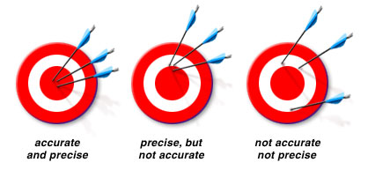
Accuracy vs. Precision
Accuracy is a measure of how close a measurement comes to the actual or true value.
Precision is a measure of how close a series of measurements are to one another.

Slide 5
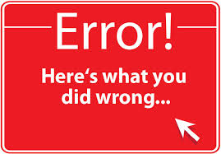
Error
Error = experimental value – actual value
The accepted value is the correct value.
The experimental value is the value measured in the lab.
The percent error is the absolute value of the error divided by the accepted value.
Percent Error = I Error I x 100
Accepted value
So in other words,
%E = I e – a I x 100
a

Slide 6
Sample Problem
A block of aluminum has a mass of 147.3g. A student measures the mass of the block as 138.9g. What is the student’s error?
What is the percent error?
-8.4g
5.70%

Slide 7
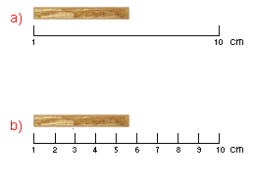
Significant Figures
The significant figures in a measurement include all the digits that are known, plus a last digit that is estimated.

Slide 8
Rules for Significant Figures
Every nonzero digit is significant. Ex: 254 or 65.43
Zeros between significant figures are significant. Ex: 3005 or 1.083
Zeros before (to the left) the significant figures are not significant. Ex: 0.07902 or 0.6932
Zeros after (to the right) the significant figures AND after the decimal place are significant. Ex: 20.3200 or 63000
Numbers that can be counted and conversion factors have an infinite number of significant figures. 370 crayons or 1km = 1000m (both have an infinite number of sig. figs.)

Slide 9
Sample Exercise
How many significant figures are in each measurement?
a. 123 m
b. 40506 mm
c. 9.8000 x 10⁷ m
d. 22 meter sticks
e. 0.07080 m
f. 98000 m
3
5
5
Infinity
4
2

Slide 10
Practice Exercise
How many significant figures are in each measurement?
a. 0.05730 m
b. 8765 m
c. 0.00073 m
d. 8.750 x 10⁻² g
4
4
2
4

Slide 11
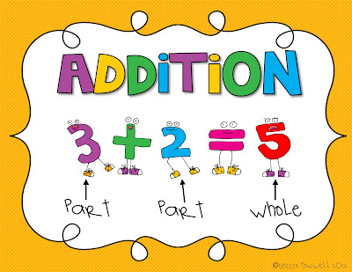
Significant Figures in Calculations
In general, a calculated answer cannot be more precise than the least precise measurement from which it was calculated.
Addition and Subtraction
When adding or subtracting, your answer can only have the same amount of decimal places as the number with the least amount of decimal places.

Slide 12
Sample Exercise
Calculate the sum of the three measurements. Give the answer to the correct number of significant figures.
12.52 m
349.0 m
+ 8.24 m
2
1
2
369.76 m
Rounding to 1 decimal place
369.8m

Slide 13
Practice Exercise
Perform each operation. Express your answers to the correct number of significant figures.
a. 61.2 m + 9.35 m + 8.6 m =
b. 34.61 m – 17.3 m =
79.15 m, round to 1 decimal place = 79.2 m
17.31 m, round to 1 decimal place = 17.3 m

Slide 14
Multiply and Divide
When multiplying or dividing, your answer can only have the same amount of significant figures as the number with the lowest amount of significant figures.

Slide 15
Sample Exercise
Perform the following operations. Give the answers to the correct number of significant figures.
7.55 m x 0.34 m =
2.567 m²
3 2
Rounding to 2 sig. figs. = 2.6 m²

Slide 16
Practice Exercise
Solve each problem and report your answer with the correct amount of significant figures.
2.10 m x 0.70 m =
8432 m / 12.5 =
1.47 m², rounded to 2 sig. figs. = 1.5 m²
674.56 m, rounded to 3 sig. figs. = 675m

Slide 17
Section Assessment
1. How are accuracy and precision evaluated?
2. A technician experimentally determined the boiling point of octane to be 124.1ºC. The actual boiling point of octane is 125.7ºC. Calculate the error and the percent error.
3. Determine the number of significant figures in each of the following:
a. 11 soccer players
b. 0.070020 m
c. 10800 m
d. 5.00 m³

Slide 18
Section Assessment
4. Solve each of the following and express your answer with the correct number of significant figures.
a. 0.00072 x 1800 =
b. 0.912 – 0.047 =
c. 54000 x 3500000000 =
1.296, rounded to 2 sig. figs. = 1.3
0.865, rounded to 3 decimal places = 0.865
189000000000000, rounded to 2 sig. figs. =
190000000000000 or 1.9 x 10¹⁴

Slide 19
The International System of Units
The International system of Units (SI) is a revised version of the metric system that scientists use around the world.
Quantity | SI Base Unit | Symbol
length | meter | m
mass | kilogram | kg
temperature | kelvin | K
time | second | s
amount of substance | mole | mol
luminous intensity | candela | cd
electric current | ampere | A

Slide 20
Prefixes
Prefixes are used to show a very large or small quantity.
For your prefixes sheet it is important to remember the following:
1 prefix unit = 10^{x} base unit
Example of Base Units Example of Prefix Units
m cm
L mL
g kg

Slide 21
Writing Conversion Factors
Remember: 1 prefix unit = 10^{x} base unit
Write the conversion factors for the following:
cm → m
g → kg
s → ns
dL → L
1 cm = 10⁻² m
1 kg = 10³ g
1 ns = 10⁻⁹ s
1 dL = 10⁻¹ L

Slide 22
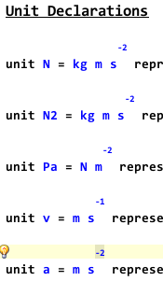
Derived Units
Some units are a combination of SI base units. These are called derived units.
Volume = length x width x height
(m) (m) (m) = m³
Density = mass (kg) = kg/m³
volume (m³)

Slide 23
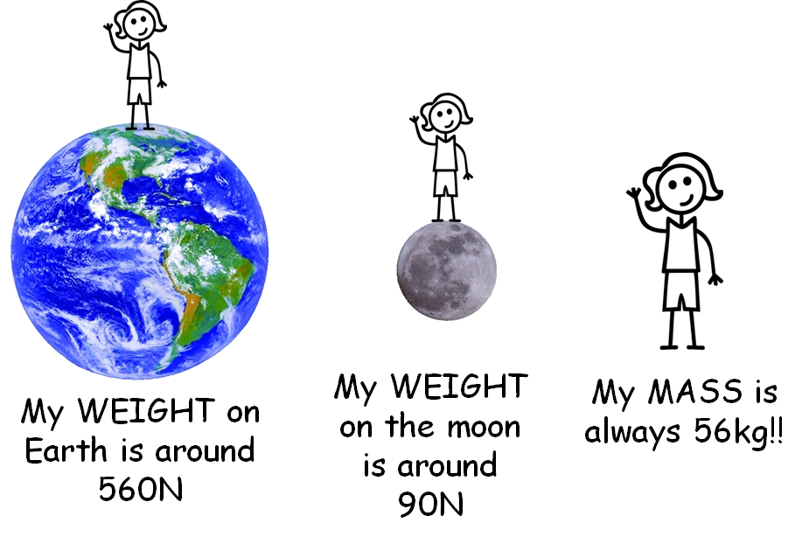
Mass vs. Weight
Mass is the amount of matter that an object contains. The SI unit is kilograms.
Weight is the force that measures the pull of gravity on a given mass. The SI unit is Newtons.
Since weight is based on gravity, it changes with location.
Mass stays constant regardless of location.

Slide 24
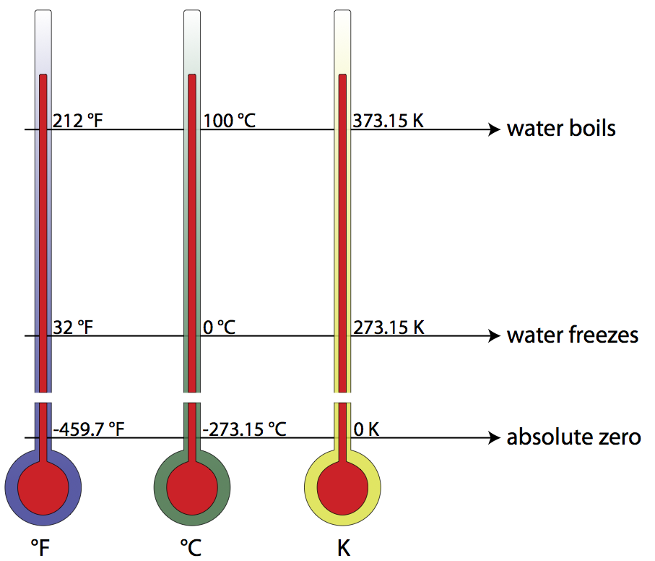
Temperature
Temperature is a measure of how hot or cold an object is. (It is the measure of the average kinetic energy of an object’s particles)
There are 3 temperature scales that are used: Celsius, Fahrenheit, and Kelvin.

Slide 25
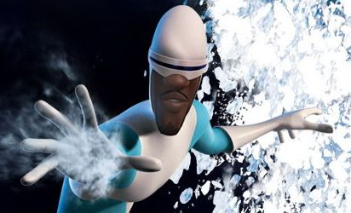
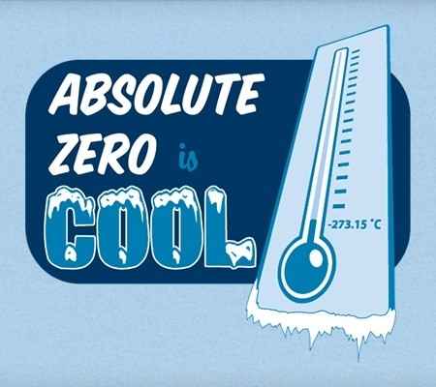
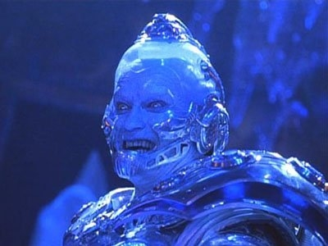
Absolute Zero
Absolute zero is zero on the Kelvin scale.
Kelvin temperature is directly proportional to the kinetic energy (speed) of the particles.
If the particles are not moving, then the Kelvin temperature is zero.
Since the particles cannot go slower than stopped, then the Kelvin scale does not have any negative values.

Slide 26
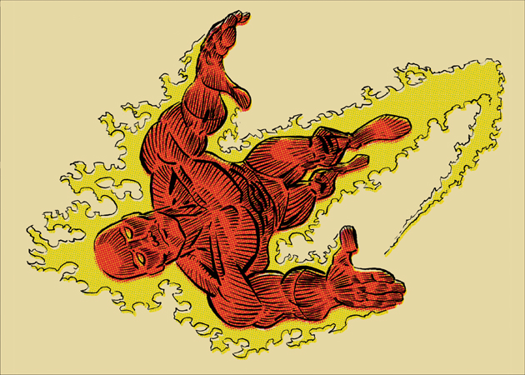
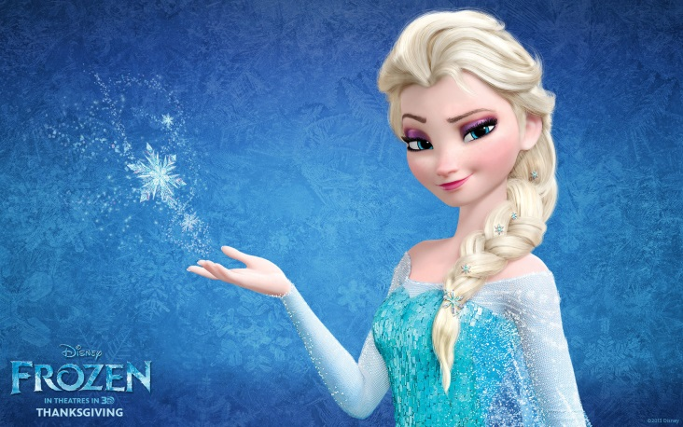
Converting Temperatures
The following formulas are used to convert between temperatures:
K = ºC + 273 ºC = 5/9(ºF – 32)
ºC = K – 273 ºF = 9/5(ºC) + 32

Slide 27
Sample Exercise
Normal human body temperature is 37ºC. What is that temperature in kelvin?
310 K

Slide 28
Practice Exercise
Make the following temperature conversions.
a. 77.2K → ºC
b. 120ºC → ºF
c. 56ºF → K
-195.8ºC
248ºF
286.3K

Slide 29
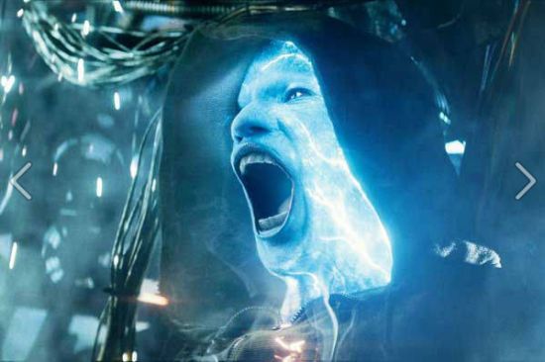
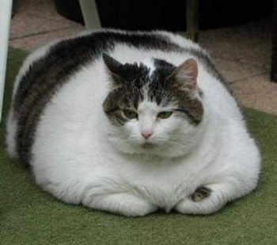
Energy
Energy is the ability to do work or supply heat.
The SI unit of energy is the Joule (J).
In America, we use calories instead of Joules.
1 cal = 4.184J

Slide 30
Conversion Problems & Dimensional Analysis
A conversion factor is a ratio of two equivalent measurements.
Whenever two measurements are equivalent, then
the ratio equals 1.
12 in = 1 ft or 1 ft = 12 in
Ratio form:
12 in or 1 ft
1 ft 12 in

Slide 31
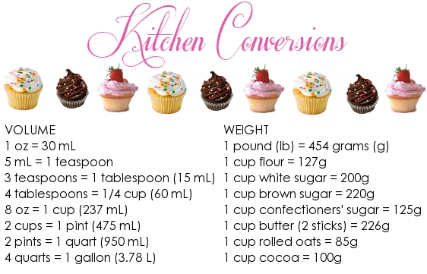
Dimensional Analysis
Dimensional analysis is a way to analyze and solve problems using the units of the measurements.
Some conversion factors that you should be familiar with involve time:
1 min = 60 s
60 min = 1 hr
24 hr = 1 day
365 days = 1 yr
3600s = 1 hr

Slide 32
Sample Problem
How many seconds are in a workday that lasts exactly eight hours?
28800 s

Slide 33
Practice Problems
How many minutes are there in exactly 1 week?
How many seconds are in exactly 40 hours?
How many years is 895600000 s?
10080 min
144000 s
28.4 years

Slide 34
Sample Problem
Convert 750 dg to grams.
75g

Slide 35
Practice Problems
Convert 0.044 km to meters.
Convert 6.7 s to milliseconds.
Convert 4.6 mg to grams.
44 m
6700ms
0.0046g

Slide 36
Sample Problem
What is 0.073 cm in micrometers?
730 μm

Slide 37
Practice Problems
Convert 0.227 nm to centimeters.
Convert 1.3 x 10⁴ km to decimeters.
Convert 1325 dag to megagrams.
2.27 x 10⁻⁸ cm
1.3 x 10⁸ dm
0.01325 Mg

Slide 38
Sample Problem (Honors)
Convert 60 g/mL to kg/dL.
6 kg/dL

Slide 39
Practice Problems (Honors)
Convert 90 km/hr to m/s.
Convert 78 hg/μL to g/L.
25 m/s
7.8 x 10⁹ g/L

Slide 40
Sample Problem (Honors)
Convert 20 km² to cm².
2 x 10¹¹ cm²

Slide 41
Practice Problems (Honors)
Convert 140 dm³ to hm³.
Convert 50 m/s² to km/hr².
1.4 x 10⁻⁷ hm³
648000 km/hr²

Slide 42
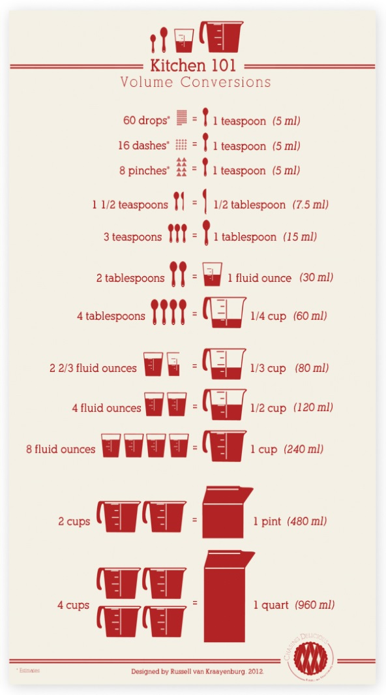
Other Conversion Factors
Here is a list of other conversion factors that you need to memorize:
1 in. = 2.54 cm
1 kg = 2.2 lbs.
1 cm³ = 1 mL
1 cal = 4.184 J

Slide 43
Sample Problem
Convert 120 lbs. into kg.
54.5 kg

Slide 44
Practice Problems
Convert 250 cal into joules.
Convert 50 cm³ into liters.
Convert 25 m into feet.
1046 J
0.05 L
82.02 ft

Slide 45
Section 3.3 Assessment
1. What conversion factor would you use to convert between these pairs of units?
a. minutes to hours
b. grams to milligrams
c. cubic decimeters to milliliters
2. Make the following conversions:
a. 14.8 g to micrograms
b. 3.72 x 10⁻³ kg to grams
c. 66.3 L to cubic centimeters
1.48 x 10⁷ μg
3.72 g
66300 cm³

Slide 46
Section 3.3 Assessment
3. An atom of gold has a mass of 3.271 x 10⁻²³ g. How many atoms of gold are in 5.00 g of gold?
4. Convert the following:
a. 7.5 x 10⁴ J to kilojoules
b. 3.9 x 10⁵ mg to decigrams
c. 2.21 x 10⁻⁴ dL to microliters
1.53 x 10²³ atoms
75 kJ
3900 dg
22.1 μL

Slide 47
Section 3.3 Assessment
5. (Honors) Light travels at a speed of 3.00 x 10¹⁰ cm/s. What is the speed of light in kilometers per hour?
1.08 x 10⁹ km/hr

Slide 48
Section 3.4 - Density
Density is the ratio of the mass of an object to its volume.
Density = mass
volume
Density is an intensive property that depends only on the composition of a substance, not on the size of the sample.

Slide 49
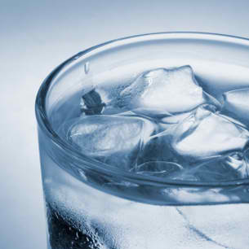
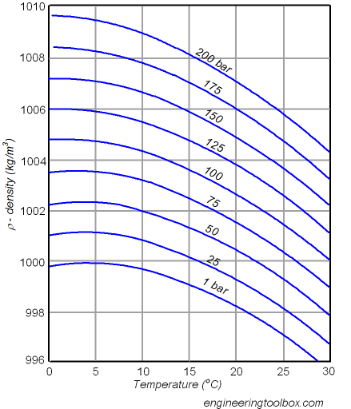
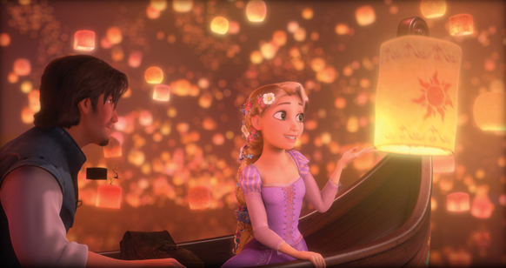
Density and Temperature
The density of a substance generally decreases as its temperature increases.
Water is an exception to this rule.

Slide 50
Sample Problem
A copper penny has a mass of 3.1 g and a volume of 0.35 cm³. What is the density of copper?
8.9 g/cm³

Slide 51
Practice Problems
A bar of silver has a mass of 68.0 g and a volume of 6.48 cm³. What is the density of silver?
A substance has a density of 0.38 g/mL and a volume of 20 mL. What is the mass of the object?
A metal block has a density of 0.66 g/cm³ and has a mass of 2 kg. What is the volume of the block?
10.5 g/cm³
7.6 g
3030.3 cm³

Slide 52
Section 3.4 Assessment
What determines the density of an object?
How does density vary with temperature?
A weather balloon is inflated to a volume of 2.2 x 10³ L with 37.4 g of helium. What is the density of helium in grams per liter?
A 68 g bar of gold is cut into 3 equal pieces. How does the density of each piece compare to the density of the original gold bar?
A plastic ball with a volume of 19.7 cm³ has a mass of 15.8 g. Would this ball sink or float in a container of gasoline? (Density of gasoline = 0.675 g/cm³)
0.017 g/L
Density 0.802 g/cm³ so it would sink.

Slide 53
Section 3.4 Assessment
6. What is the volume, in cubic centimeters, of a sample of cough syrup that has a mass of 50.0 g? The density of cough syrup is 0.950 g/cm³.
7. What is the mass, in kilograms, of 14.0 L of gasoline? (Assume that the density of gasoline is 0.680 g/cm³.)
52.6 cm³
9.52 kg

Slide 54
THE END

