Slide 1
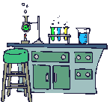
Unit 1: Chapter 1 “Matter and Change” The Composition & Properties of matter
Gulf breeze high school
Honors chemistry

Slide 2
Matter
Matter is anything that: a) has mass, and b) takes up space
Mass = a measure of the amount of “stuff” (or material) the object contains (don’t confuse this with weight, a measure of gravity)
Volume = a measure of the space occupied by the object

Slide 3
Matter Flowchart
MATTER
yes
no
Can it be physically separated?
MIXTURE
PURE SUBSTANCE
yes
Is the composition uniform?
no
yes
Can it be chemically decomposed?
no
Homogeneous Mixture
(solution)
Heterogeneous Mixture
Compound
Element
Colloids
Suspensions

Slide 4
Properties are…
Physical Properties- a property that can be observed and measured without changing the material’s composition.
Examples- color, hardness, melting point, boiling point
Chemical Properties- a property that can only be observed by changing the composition of the material.
Examples- ability to burn, decompose, ferment, reactivity with…, etc.

Slide 5
Describing Matter
Properties can be classified as:
Extensive – depends on the amount of matter in the sample
- Mass, volume, calories are examples
Intensive – depends on the type of matter, not the amount present
- Hardness, Density, Boiling Point, conductivity

Slide 6
Kinetic Molecular Theory
All matter is made up of particles
Particles of matter are always in motion.
The kinetic energy (speed) of these particles increases as temperature increases.
The temperature and kinetic energy of the particles determines the state of matter

Slide 7
States of matter
Solid- matter that can not flow (definite shape) and has definite volume.
Liquid- definite volume but takes the shape of its container (flows).
Gas- a substance without definite volume or shape and can flow.
Vapor- a substance that is currently a gas, but normally is a liquid or solid at room temperature. (Which is correct: “water gas”, or “water vapor”?)

Slide 8
States of Matter
Result of a Temperature Increase?
Definite Volume?
Definite Shape?
Will it Compress?
Small Expansion
Solid
YES
YES
NO
Liquid
NO
Small Expansion
NO
YES
Gas
Large Expansion
NO
NO
YES

Slide 9
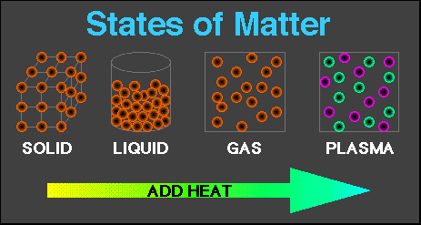
4th state: Plasma - formed at high temperatures; ionized phase of matter as found in the sun

Slide 10
Condense
Freeze
Melt
Evaporate
Sublimation
Solid
Liquid
Gas

Slide 11
Physical vs. Chemical Changes
Physical change will change the visible appearance, without changing the composition of the material.
Boil, melt, cut, bend, split, crack
Is boiled water still water?
Can be reversible, or irreversible
Chemical change - a change where a new form of matter is formed.
Rust, burn, decompose, ferment

Slide 12
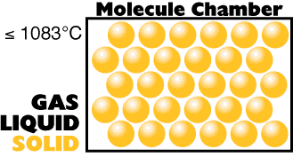
Copper Phases - Solid

Slide 13
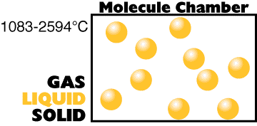
Copper Phases - Liquid

Slide 14
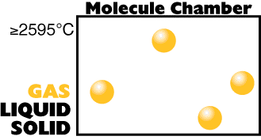
Copper Phases – Vapor (gas)

Slide 15
Section II: Mixtures

Slide 16
Mixtures are a physical blend of at least two substances; have variable composition. They can be either:
Heterogeneous – the mixture is not uniform in composition
Chocolate chip cookie, gravel, soil.
Homogeneous - same composition throughout; called “solutions”
Kool-aid, air, salt water
Every part keeps it’s own properties.

Slide 17
Solutions are homogeneous mixtures
Mixed molecule by molecule, thus too small to see the different parts
Can occur between any state of matter: gas in gas; liquid in gas; gas in liquid; solid in liquid; solid in solid (alloys), etc.
Thus, based on the distribution of their components, mixtures are called homogeneous or heterogeneous.

Slide 18
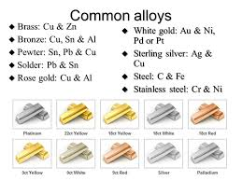

Slide 19
Separating Mixtures
Some can be separated easily by physical means by using Differences in physical properties:
Filtration
Decanting
Evaporation
Centrifuge
Magnets
Distillation
Chromatography

Slide 20
Separation of a Mixture
Components of dyes such as ink may be separated by paper chromatography.

Slide 21
Separation of a Mixture
Distillation: takes advantage of different boiling points.
NaCl boils at 1415 ºC

Slide 22
pure Substances are either:
a) elements, or
b) compounds

Slide 23
Substances: element or compound
Elements- simplest kind of matter
cannot be broken down any simpler and still have properties of that element!
all one kind of atom (Building block of matter)
Compounds are substances that can be broken down only by chemical methods
when broken down, the pieces have completely different properties than the original compound.
made of two or more atoms, chemically combined (not just a physical blend (or mixture)!)

Slide 24
Compound vs. Mixture
Compound
Mixture
Made of one kind
of material
Made of more than
one kind of material
Made by a
chemical change
Made by a
physical change
Definite
composition
Variable
composition

Slide 25
Properties of Compounds
Quite different properties than their component elements.
Due to a CHEMICAL CHANGE, the resulting compound has new and different properties:
Table sugar – carbon, hydrogen, oxygen
Sodium chloride – sodium, chlorine
Water – hydrogen, oxygen

Slide 26
Mixture
Compound
Element

Slide 27
Elements vs. Compounds
Compounds can be broken down into simpler substances by chemical means, but elements cannot.
A “chemical change” is a change that produces matter with a different composition than the original matter.

Slide 28
Chemical Changes
The ability of a substance to undergo a specific chemical change is called a chemical property.
iron plus oxygen forms rust, so the ability to rust is a chemical property of iron
During a chemical change (also called chemical reaction), the composition of matter always changes.

Slide 29
Chemical Reactions are…
When one or more substances are changed into new substances.
Reactants- the stuff you start with
Products- what you make
The products will have NEW PROPERTIES different from the reactants you started with
Arrow points from the reactants to the new products

Slide 30
Recognizing Chemical Changes
Energy is absorbed or released (temperature changes hotter or colder)
Color changes
Gas production (bubbling, fizzing, or odor change; smoke)
formation of a precipitate - a solid that separates from solution (won’t dissolve)
Irreversibility - not easily reversed
But, there are examples of these that are not chemical – boiling water bubbles, etc.

Slide 31
Chemical Change
A change in which one or more substances are converted into different substances.
Heat and light are often evidence of a chemical change.

Slide 32
Symbols & Formulas
Currently, there are 117 elements
Elements have a 1 or two letter symbol, and compounds have a formula.
An element’s first letter always capitalized; if there is a second letter, it is written lowercase: B, Ba, C, Ca, H, He

Slide 33
Conservation of Mass
During any chemical reaction, the mass of the products is always equal to the mass of the reactants.
All the mass can be accounted for:
Burning of wood results in products that appear to have less mass as ashes; where is the rest?
Law of conservation of mass

Slide 34
- Page 55
43.43 g Original mass
= 43.43 g Final mass
reactants
= product

