Slide 1
Unit #2
Molecular and Ionic Compound Structures and Properties

Slide 2
General Overview of Unit 2
2.1 Types of Chemical Bonds
2.2 Intramolecular Force and Potential Energy
2.3 Structure of Ionic Solids
2.4 Structure of Metals and Alloys
2.5 Lewis Diagrams
2.6 Resonance and Formal Charge
2.7 VSEPR and Bond Hybridization

Slide 3
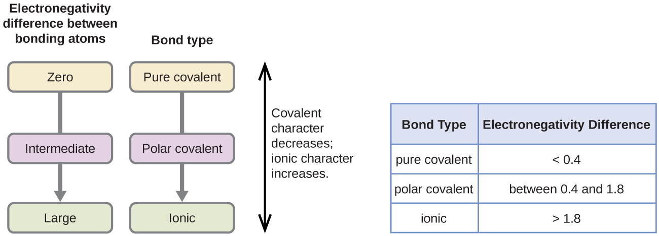
2.1 Types of Chemical Bonds
Electronegativity: The tendency of an atom within a bond to attract a shared pair of electrons towards itself. (Fluorine is the most EN)
Increases from left to right across a period
Decreases down a group
Polarity: the degree of electron sharing within a molecule.
Polar: Two atoms share electrons unequally (atoms of different EN)
Atom with higher EN will develop a partial negative charge
Nonpolar: Two atoms share electrons equally (atoms of similar EN)
Remember an ionic bond is between a metal & nonmetal (or polyatomic ion)
Learning Objective: Explain the relationship between the type of bonding and the properties of the elements participating in the bond

Slide 4
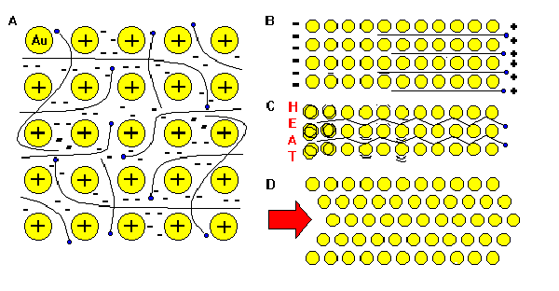
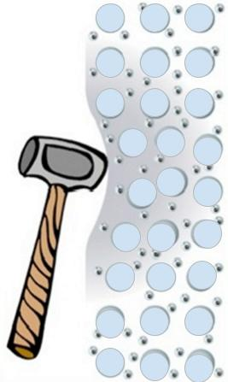
2.1 Metallic Bonds – Sea of Electrons
The metallic bond is not the easiest type of bond to understand, so an analogy may help. Imagine filling your bathtub with golf balls. Fill it right up to the top. The golf balls will arrange themselves in an orderly fashion as they fill the space in the tub. Do you see any spaces between the golf balls? If you turn on the faucet and plug the drain, the water will fill up those spaces. What you now have is something like metallic bonding. The golf balls are the metal atoms, and the water represents the valence electrons shared by all of the atoms.
The valence electrons are delocalized.

Slide 5
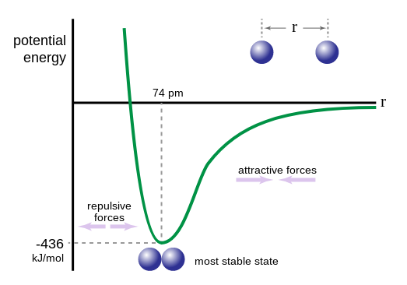
2.2 Intramolecular Force & Potential Energy
What does this graph tell us?
Illustrates the energy between two atoms as a function of distance
The “lowest” part of the curve shows the energy that would be necessary to break the bond between atoms as well as the ideal bond length
Atoms repel at short distances
Atoms are attracted to one another at longer distances but eventually are too far apart to experience attractive forces

Slide 6
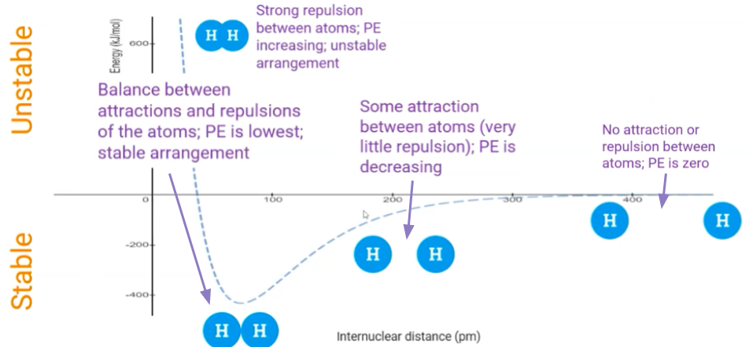
Internuclear distance: the distance between the two nuclei within the bond
If potential energy is greater than zero, there is an unstable atom arrangement
If potential energy is less than zero, this is a stable arrangement.
When the attractive and repulsive forces balance, a bond is formed.

Slide 7
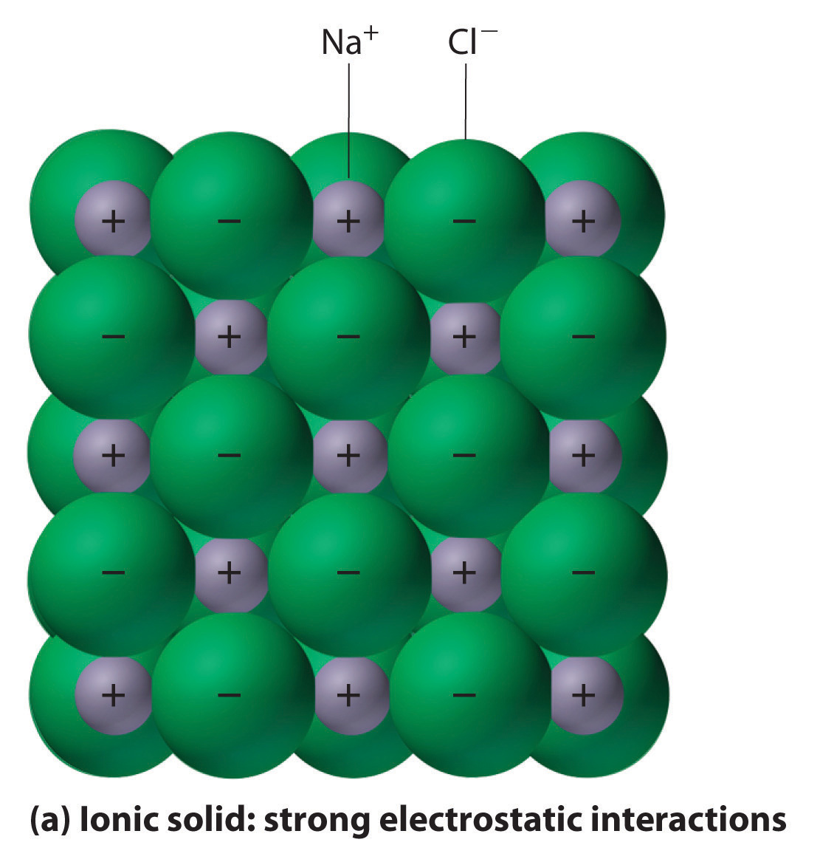
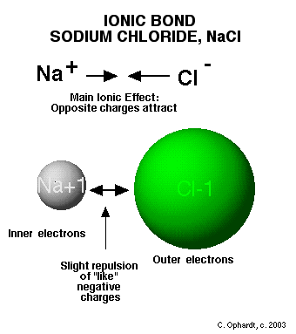
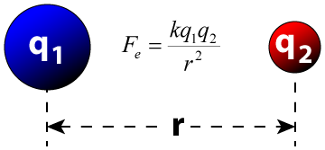
2.3 Structure of Ionic Solids
Coulomb’s law can be used to understand the strength of interactions between cations and anions.
Because the interaction strength is proportional to the charge on each ion, larger charges lead to stronger interactions.
Because the interaction strength increases as the distance between the centers of the ions (nuclei) decreases, smaller ions lead to stronger interactions.
Learning Objective: Represent an ionic solid with a particulate model that is consistent with Coulomb’s law and the properties of the constituent ions.

Slide 8
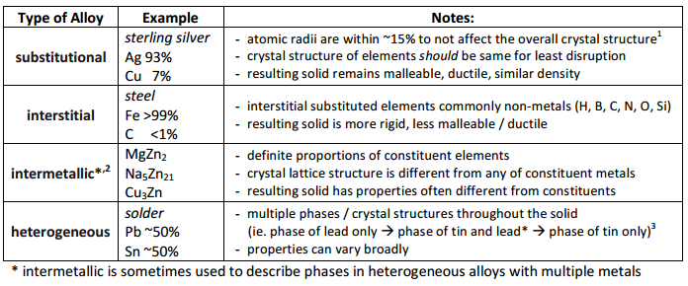
2.4 Alloys
Metallic bonding can be represented as an array of positive metal ions surrounded by delocalized valence electrons (i.e., a “sea of electrons”).
Interstitial alloys form between atoms of different radii, where the smaller atoms fill the interstitial spaces between the larger atoms (e.g., with steel in which carbon occupies the interstices in iron).
Substitutional alloys form between atoms of comparable radius, where one atom substitutes for the other in the lattice. (In certain brass alloys, other elements, usually zinc, substitute for copper.)
Learning Objective: Represent a metallic solid and/or alloy using a model to show essential characteristics of the structure and interactions present in the substance.

Slide 9
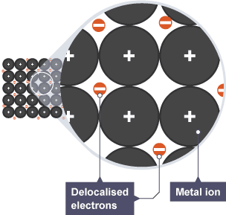
Metallic Solids - Alloys

Slide 10
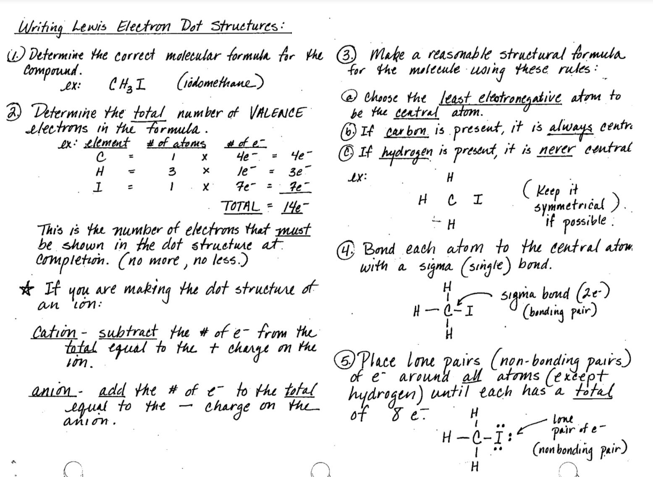
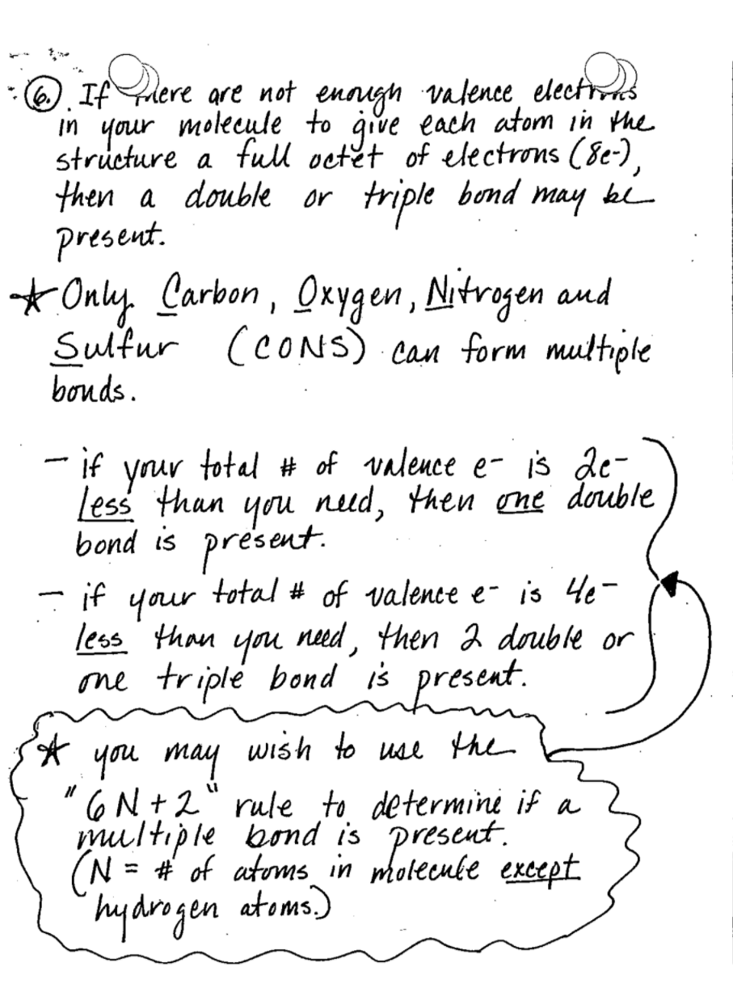
2.5 Lewis Diagrams
Remember to always count the number of valence electrons BEFORE drawing the Lewis structure.
Atoms should follow the octet rule, and only atoms in row 3 and below can have an expanded octet!
Learning Objective: Represent a molecule with a Lewis diagram.

Slide 11
2.6 Resonance and Formal Charge
A set of two or more Lewis structures that can be used to describe a single molecule or polyatomic ion.
The movement of delocalized electrons
Arrangement of atoms does not change
Not all resonance structures are equally stable
The most stable resonance structure:
Has all or most of the atoms with a formal charge of zero
Remember to calculate formal charge, use the circles!
Puts the negative formal charge on the most electronegative atom
Learning Objective: Represent a molecule with a Lewis diagram that accounts for resonance between equivalent structures or that uses formal charge to select between nonequivalent structures.

Slide 12
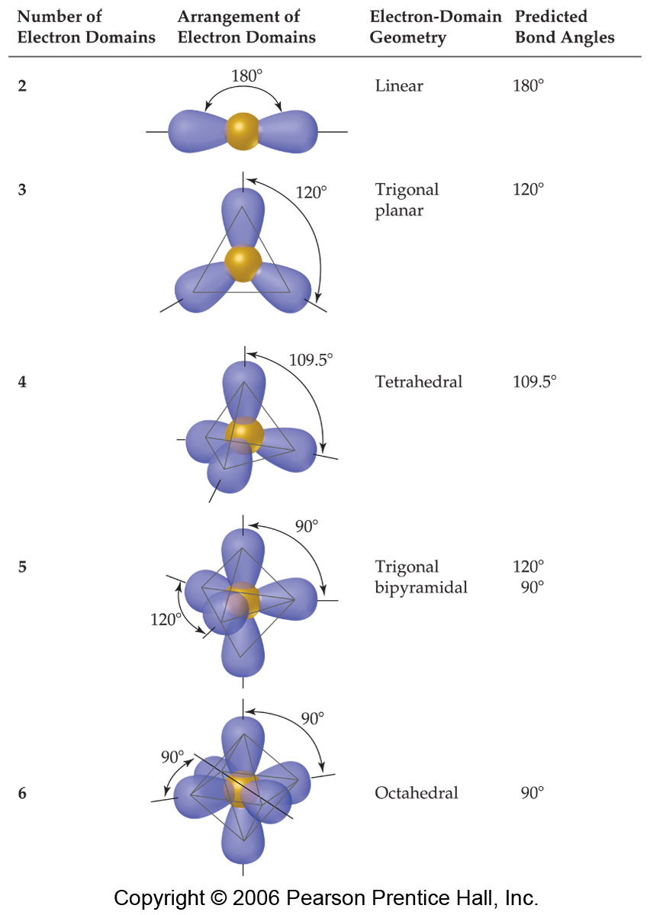
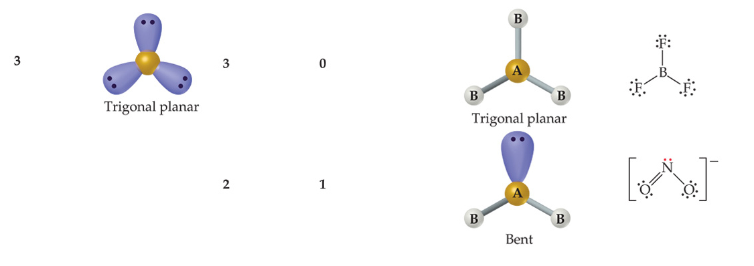
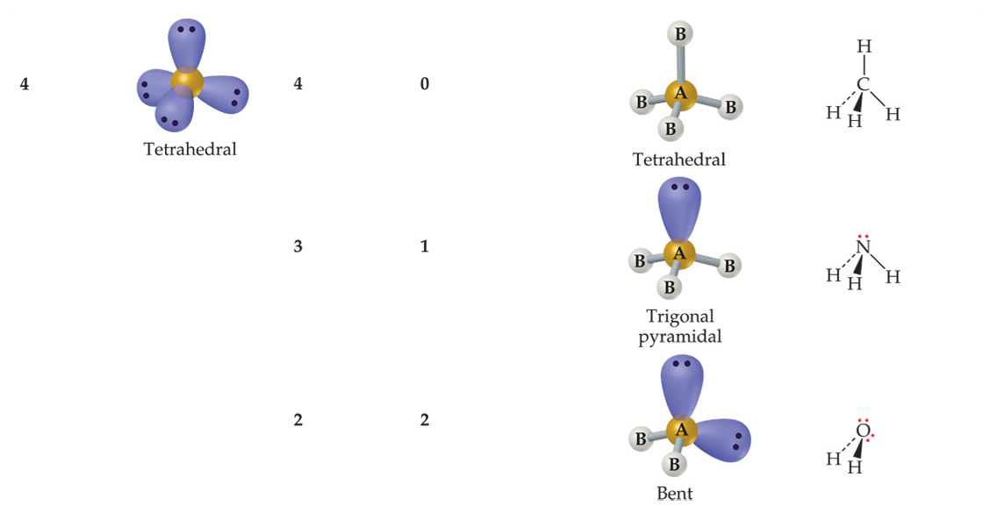
2.7 VSEPR & Hybridization
Electron domain geometry: Molecular Geometry:
“Fundamental shape” Takes into account bonds & lone pairs
Learning Objective: Based on the relationship between Lewis diagrams, VSEPR theory, bond orders, and bond polarities:
Explain structural properties of molecules and explain electron properties of molecules.

Slide 13
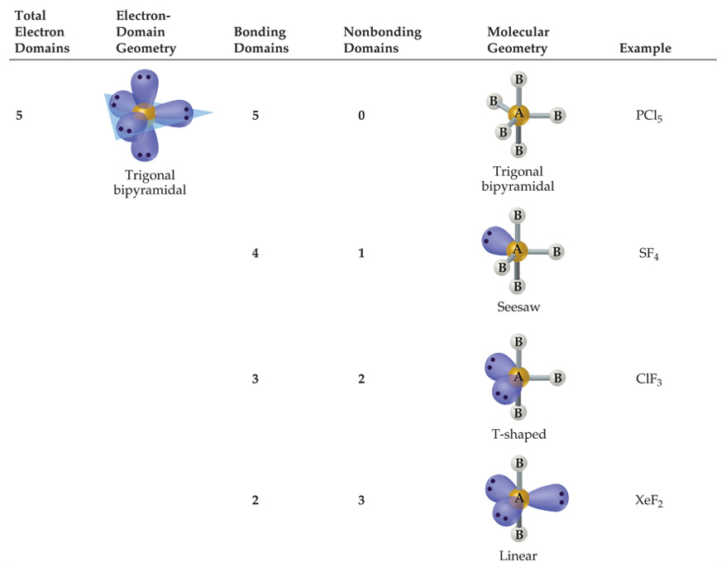
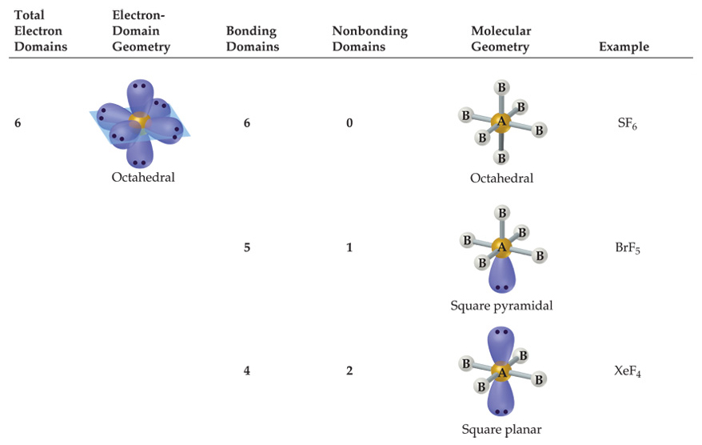
VSEPR & Hybridization
Molecular Geometry:
Takes into account bonds & lone pairs
Learning Objective: Based on the relationship between Lewis diagrams, VSEPR theory, bond orders, and bond polarities:
Explain structural properties of molecules and explain electron properties of molecules.

Slide 14
VSEPR & Hybridization
You must be able to predict:
Molecular geometry
Bond angles
Relative bond energies based on bond order
Relative bond lengths (multiple bonds, effects of atomic radius)
Presence of a dipole moment
Hybridization of valence orbitals of the molecule
Hybridization:
sp hybridized = 180° (two areas of electrons around central atom)
sp² hybridized = 120° (three areas of electrons around central atom)
sp³ hybridized = 109.5° (four areas of electrons around central atom)
Single & Double bonds:
Single bonds are sigma bonds
The first bond of a multiple bond is a sigma bond, the rest are pi bonds
Learning Objective: Based on the relationship between Lewis diagrams, VSEPR theory, bond orders, and bond polarities:
Explain structural properties of molecules and explain electron properties of molecules.

