Slide 1
Mendelelian Genetics
‹#›
Notes:
Mendelian Genetics
*
‹#›

Slide 2
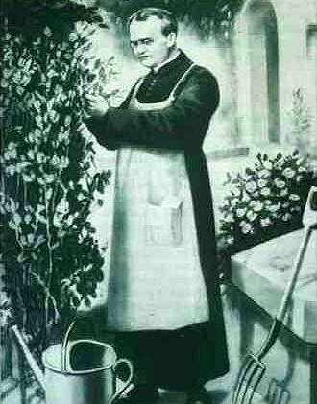
Gregor Mendel (1822-1884)
-Responsible for the Laws governing Inheritance of Traits
-”Father of Genetics”
‹#›
Notes:
Mendelian Genetics
*
‹#›

Slide 3
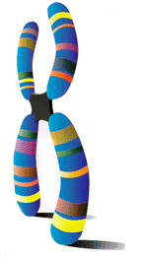
Particulate Inheritance
Mendel stated that physical traits are inherited as “particles”
Mendel did not know that the “particles” were actually Chromosomes & DNA
‹#›
Notes:
Mendelian Genetics
*
‹#›

Slide 4
Genetic Terminology
Trait - any characteristic that can be passed from parent to offspring
Heredity - passing of traits from parent to offspring
Genetics - study of heredity
‹#›
Notes:
Mendelian Genetics
*
‹#›

Slide 5
Types of Genetic Crosses
Monohybrid cross - cross involving a single trait e.g. flower color
Dihybrid cross - cross involving two traits e.g. flower color & plant height
‹#›
Notes:
Mendelian Genetics
*
‹#›

Slide 6
Punnett Square
Used to help solve genetics problems
‹#›
Notes:
Mendelian Genetics
*
‹#›

Slide 7
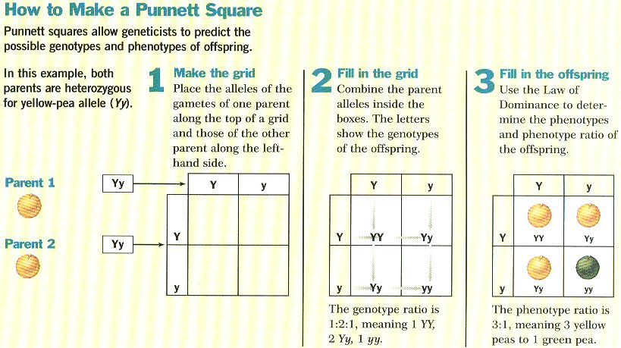
‹#›
Notes:
Mendelian Genetics
*
‹#›

Slide 8
Designer “Genes”
Gene- Section of chromosome that codes for a trait
Alleles - two forms of a gene (dominant & recessive) (2 alleles make up a gene)
Dominant - stronger of two genes expressed in the hybrid; represented by a capital letter (R)
Recessive - gene that shows up less often in a cross; represented by a lowercase letter (r)
‹#›
Notes:
Mendelian Genetics
*
‹#›

Slide 9
More Terminology
Genotype - gene combination for a trait (e.g. RR, Rr, rr)
Phenotype - the physical feature resulting from a genotype (e.g. red, white)
‹#›
Notes:
Mendelian Genetics
*
‹#›

Slide 10
Genotype & Phenotype in Flowers
Genotype of alleles: R = red flower r = yellow flower
All genes occur in pairs, so 2 alleles affect a characteristic
Possible combinations are:
Genotypes RR Rr rr
Phenotypes RED RED YELLOW
‹#›
Notes:
Mendelian Genetics
*
‹#›

Slide 11
Genotypes
Homozygous genotype - gene combination involving 2 dominant or 2 recessive genes (e.g. RR or rr); also called pure
Heterozygous genotype - gene combination of one dominant & one recessive allele (e.g. Rr); also called hybrid
‹#›
Notes:
Mendelian Genetics
*
‹#›

Slide 12
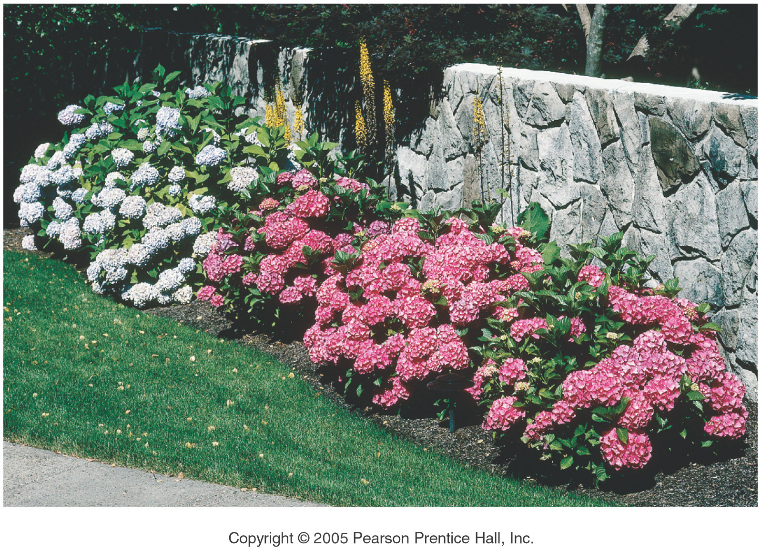
Genes and Environment Determine Characteristics
‹#›
Notes:
Mendelian Genetics
*
‹#›

Slide 13
Eight Pea Plant Traits
Seed shape --- Round (R) or Wrinkled (r)
Seed Color ---- Yellow (Y) or Green (y)
Pod Shape --- Smooth (S) or wrinkled (s)
Pod Color --- Green (G) or Yellow (g)
Seed Coat Color ---Gray (G) or White (g)
Flower position---Axial (A) or Terminal (a)
Plant Height --- Tall (T) or Short (t)
Flower color --- Purple (P) or white (p)
‹#›
Notes:
Mendelian Genetics
*
‹#›

Slide 14
‹#›
Notes:
Mendelian Genetics
*
‹#›

Slide 15
‹#›
Notes:
Mendelian Genetics
*
‹#›

Slide 16
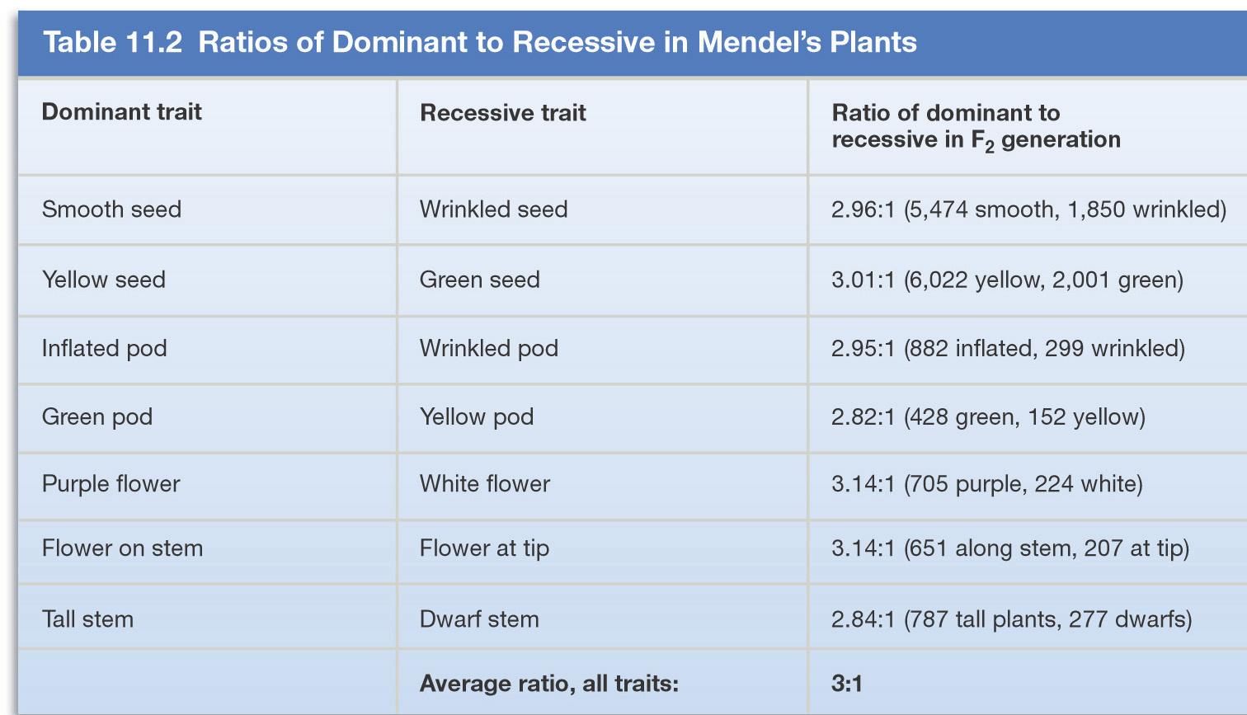
Mendel’s Experimental Results
‹#›
Notes:
Mendelian Genetics
*
‹#›

Slide 17
Did the observed ratio match the theoretical ratio?
The theoretical or expected ratio of plants producing round or wrinkled seeds is 3 round :1 wrinkled
Mendel’s observed ratio was 2.96:1
The discrepancy is due to statistical error
The larger the sample the more nearly the results approximate to the theoretical ratio
‹#›
Notes:
Mendelian Genetics
*
‹#›

Slide 18
Generation “Gap”
Parental P₁ Generation = the parental generation in a breeding experiment.
F₁ generation = the first-generation offspring in a breeding experiment. (1st filial generation)
From breeding individuals from the P₁ generation
F₂ generation = the second-generation offspring in a breeding experiment. (2nd filial generation)
From breeding individuals from the F₁ generation
‹#›
Notes:
Mendelian Genetics
*
‹#›

Slide 19
Following the Generations
Cross 2 Pure Plants TT x tt
Results in all Hybrids Tt
Cross 2 Hybrids get 3 Tall & 1 Short TT, Tt, tt
‹#›
Notes:
Mendelian Genetics
*
‹#›

Slide 20
Monohybrid Crosses
‹#›
Notes:
Mendelian Genetics
*
‹#›

Slide 21
P₁ Monohybrid Cross
Trait: Seed Shape
Alleles: R – Round r – Wrinkled
Cross: Round seeds x Wrinkled seeds
RR x rr
Genotype: Rr
Phenotype: Round
Genotypic Ratio: All alike
Phenotypic Ratio: All alike
r
r
R
Rr
Rr
R
Rr
Rr
‹#›
Notes:
Mendelian Genetics
*
‹#›

Slide 22
P₁ Monohybrid Cross Review
Homozygous dominant x Homozygous recessive
Offspring all Heterozygous (hybrids)
Offspring called F₁ generation
Genotypic & Phenotypic ratio is ALL ALIKE
‹#›
Notes:
Mendelian Genetics
*
‹#›

Slide 23
F₁ Monohybrid Cross
Trait: Seed Shape
Alleles: R – Round r – Wrinkled
Cross: Round seeds x Round seeds
Rr x Rr
Genotype: RR, Rr, rr
Phenotype: Round & wrinkled
G.Ratio: 1:2:1
P.Ratio: 3:1
R
r
R
RR
Rr
r
Rr
rr
‹#›
Notes:
Mendelian Genetics
*
‹#›

Slide 24
F₁ Monohybrid Cross Review
Heterozygous x heterozygous
Offspring: 25% Homozygous dominant RR 50% Heterozygous Rr 25% Homozygous Recessive rr
Offspring called F₂ generation
Genotypic ratio is 1:2:1
Phenotypic Ratio is 3:1
‹#›
Notes:
Mendelian Genetics
*
‹#›

Slide 25
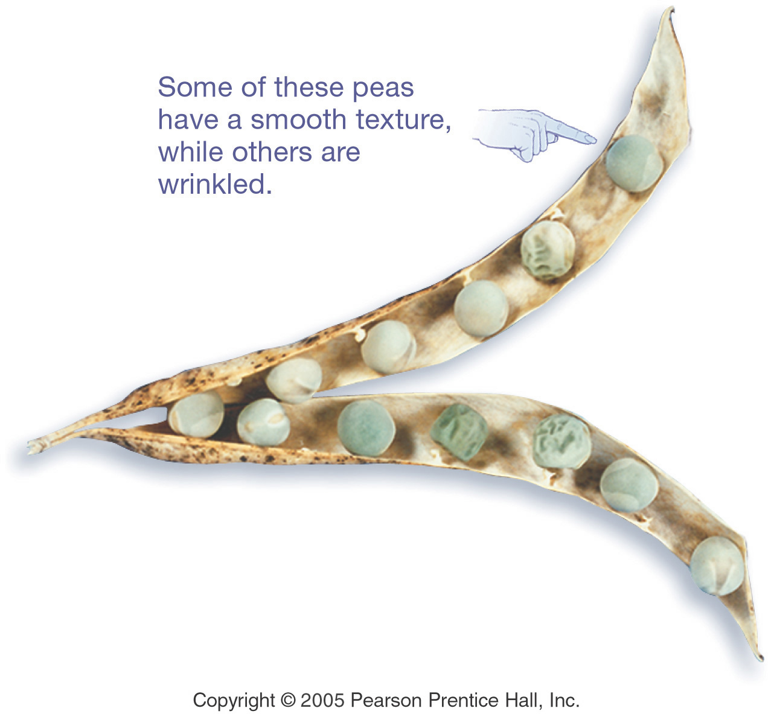
What Do the Peas Look Like?
‹#›
Notes:
Mendelian Genetics
*
‹#›

Slide 26
…And Now the Test Cross
Mendel then crossed a pure & a hybrid from his F₂ generation
This is known as an F₂ or test cross
There are two possible testcrosses: Homozygous dominant x Hybrid Homozygous recessive x Hybrid
‹#›
Notes:
Mendelian Genetics
*
‹#›

Slide 27
F₂ Monohybrid Cross (1st)
Trait: Seed Shape
Alleles: R – Round r – Wrinkled
Cross: Round seeds x Round seeds
RR x Rr
Genotype: RR, Rr
Phenotype: Round
Genotypic Ratio: 1:1
Phenotypic Ratio: All alike
R
r
R
RR
Rr
R
RR
Rr
‹#›
Notes:
Mendelian Genetics
*
‹#›

Slide 28
F₂ Monohybrid Cross (2nd)
Trait: Seed Shape
Alleles: R – Round r – Wrinkled
Cross: Wrinkled seeds x Round seeds
rr x Rr
R
r
Genotype: Rr, rr
Phenotype: Round & Wrinkled
G. Ratio: 1:1
P.Ratio: 1:1
r
Rr
rr
r
Rr
rr
‹#›
Notes:
Mendelian Genetics
*
‹#›

Slide 29
F₂ Monohybrid Cross Review
Homozygous x heterozygous(hybrid)
Offspring: 50% Homozygous RR or rr 50% Heterozygous Rr
Phenotypic Ratio is 1:1
Called Test Cross because the offspring have SAME genotype as parents
‹#›
Notes:
Mendelian Genetics
*
‹#›

Slide 30
Practice Your Crosses
Work the P₁, F₁, and both F₂ Crosses for each of the other Seven Pea Plant Traits
‹#›
Notes:
Mendelian Genetics
*
‹#›

Slide 31
Mendel’s Laws
‹#›
Notes:
Mendelian Genetics
*
‹#›

Slide 32
Results of Monohybrid Crosses
Inheritable factors or genes are responsible for all heritable characteristics
Phenotype is based on Genotype
Each trait is based on two genes, one from the mother and the other from the father
True-breeding individuals are homozygous ( both alleles) are the same
‹#›
Notes:
Mendelian Genetics
*
‹#›

Slide 33
Law of Dominance
In a cross of parents that are pure for contrasting traits, only one form of the trait will appear in the next generation.
All the offspring will be heterozygous and express only the dominant trait.
RR x rr yields all Rr (round seeds)
‹#›
Notes:
Mendelian Genetics
*
‹#›

Slide 34
Law of Dominance
‹#›
Notes:
Mendelian Genetics
*
‹#›

Slide 35
Law of Segregation
During the formation of gametes (eggs or sperm), the two alleles responsible for a trait separate from each other.
Alleles for a trait are then "recombined" at fertilization, producing the genotype for the traits of the offspring.
‹#›
Notes:
Mendelian Genetics
*
‹#›

Slide 36
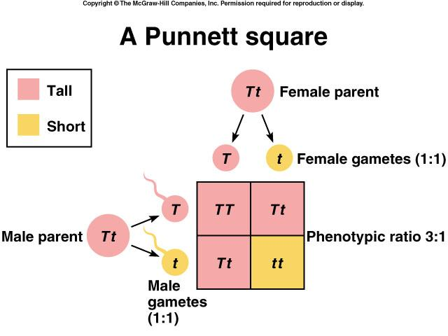
Applying the Law of Segregation
‹#›
Notes:
Mendelian Genetics
*
‹#›

Slide 37
Law of Independent Assortment
Alleles for different traits are distributed to sex cells (& offspring) independently of one another.
This law can be illustrated using dihybrid crosses.
‹#›
Notes:
Mendelian Genetics
*
‹#›

Slide 38
Dihybrid Cross
A breeding experiment that tracks the inheritance of two traits.
Mendel’s “Law of Independent Assortment”
a. Each pair of alleles segregates independently during gamete formation
b. Formula: 2^{n} (n = # of heterozygotes)
‹#›
Notes:
Mendelian Genetics
*
‹#›

Slide 39
Question: How many gametes will be produced for the following allele arrangements?
Remember: 2^{n} (n = # of heterozygotes)
1. RrYy
2. AaBbCCDd
3. MmNnOoPPQQRrssTtQq
‹#›
Notes:
Mendelian Genetics
*
‹#›

Slide 40
Answer:
1. RrYy: 2^{n} = 2² = 4 gametes
RY Ry rY ry
2. AaBbCCDd: 2^{n} = 2³ = 8 gametes
ABCD ABCd AbCD AbCd
aBCD aBCd abCD abCD
3. MmNnOoPPQQRrssTtQq: 2^{n} = 2⁶ = 64 gametes
‹#›
Notes:
Mendelian Genetics
*
‹#›

Slide 41
Dihybrid Cross
Traits: Seed shape & Seed color
Alleles: R round r wrinkled Y yellow y green
RrYy x RrYy
RY Ry rY ry
RY Ry rY ry
All possible gamete combinations
‹#›
Notes:
Mendelian Genetics
*
‹#›

Slide 42
Dihybrid Cross
RY
Ry
rY
ry
RY
Ry
rY
ry
‹#›
Notes:
Mendelian Genetics
*
‹#›

Slide 43
Dihybrid Cross
RY
Ry
rY
ry
RY
Round/Yellow: 9
Round/green: 3
wrinkled/Yellow: 3
wrinkled/green: 1
RRYY
RRYy
RrYY
RrYy
Ry
RRYy
RRyy
RrYy
Rryy
rY
RrYY
RrYy
rrYY
rrYy
ry
RrYy
Rryy
rrYy
rryy
9:3:3:1 phenotypic ratio
‹#›
Notes:
Mendelian Genetics
*
‹#›

Slide 44
Dihybrid Cross
Round/Yellow: 9 Round/green: 3 wrinkled/Yellow: 3 wrinkled/green: 1
9:3:3:1
‹#›
Notes:
Mendelian Genetics
*
‹#›

Slide 45
Test Cross
A mating between an individual of unknown genotype and a homozygous recessive individual.
Example: bbC__ x bbcc
BB = brown eyes
Bb = brown eyes
bb = blue eyes
CC = curly hair
Cc = curly hair
cc = straight hair
bC
b___
bc
‹#›
Notes:
Mendelian Genetics
*
‹#›

Slide 46
Test Cross
Possible results:
bC
b___
C
bC
b___
c
bc
bbCc
bbCc
or
bc
bbCc
bbcc
‹#›
Notes:
Mendelian Genetics
*
‹#›

Slide 47
Summary of Mendel’s laws
LAW
PARENT CROSS
OFFSPRING
DOMINANCE
TT x tt tall x short
100% Tt tall
SEGREGATION
Tt x Tt tall x tall
75% tall 25% short
INDEPENDENT ASSORTMENT
RrGg x RrGg round & green x round & green
9/16 round seeds & green pods 3/16 round seeds & yellow pods 3/16 wrinkled seeds & green pods 1/16 wrinkled seeds & yellow pods
‹#›
Notes:
Mendelian Genetics
*
‹#›

Slide 48
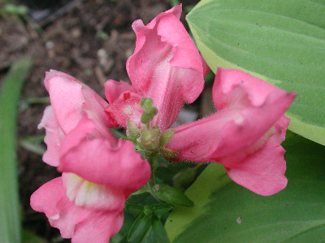
Incomplete Dominance and Codominance
‹#›
Notes:
Mendelian Genetics
*
‹#›

Slide 49
Incomplete Dominance
F1 hybrids have an appearance somewhat in between the phenotypes of the two parental varieties.
Example: snapdragons (flower)
red (RR) x white (rr)
RR = red flower
rr = white flower
r
r
R
R
‹#›
Notes:
Mendelian Genetics
*
‹#›

Slide 50
Incomplete Dominance
r
r
produces the
F₁ generation
R
Rr
Rr
R
Rr
Rr
All Rr = pink
(heterozygous pink)
‹#›
Notes:
Mendelian Genetics
*
‹#›

Slide 51
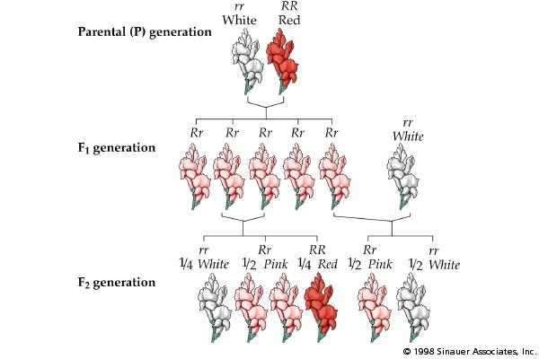
Incomplete Dominance
‹#›
Notes:
Mendelian Genetics
*
‹#›

Slide 52
Codominance
Two alleles are expressed (multiple alleles) in heterozygous individuals.
Example: blood type
1. type A = I^{A}I^{A} or I^{A}i
2. type B = I^{B}I^{B} or I^{B}i
3. type AB = I^{A}I^{B}
4. type O = ii
‹#›
Notes:
Mendelian Genetics
*
‹#›

Slide 53
Codominance Problem
Example: homozygous male Type B (I^{B}I^{B})
x heterozygous female Type A (I^{A}i)
I^{A}
i
I^{A}I^{B}
I^{B}i
I^{B}
1/2 = I^{A}I^{B}
1/2 = I^{B}i
I^{B}
I^{A}I^{B}
I^{B}i
‹#›
Notes:
Mendelian Genetics
*
‹#›

Slide 54
Another Codominance Problem
Example: male Type O (ii) x female type AB (I^{A}I^{B})
I^{A}
I^{B}
i
I^{A}i
I^{B}i
1/2 = I^{A}i
1/2 = I^{B}i
i
I^{A}i
I^{B}i
‹#›
Notes:
Mendelian Genetics
*
‹#›

Slide 55
Codominance
Question: If a boy has a blood type O and his sister has blood type AB, what are the genotypes and phenotypes of their parents?
boy - type O (ii) X girl - type AB (I^{A}I^{B})
‹#›
Notes:
Mendelian Genetics
*
‹#›

Slide 56
Codominance
Answer:
I^{A}
i
I^{B}
I^{A}I^{B}
Parents:
genotypes = I^{A}i and I^{B}i
phenotypes = A and B
i
ii
‹#›
Notes:
Mendelian Genetics
*
‹#›

Slide 57
Sex-linked Traits
Traits (genes) located on the sex chromosomes
Sex chromosomes are X and Y
XX genotype for females
XY genotype for males
Many sex-linked traits carried on X chromosome
‹#›
Notes:
Mendelian Genetics
*
‹#›

Slide 58
Sex-linked Traits
Example: Eye color in fruit flies
Sex Chromosomes
fruit fly
eye color
XX chromosome - female
Xy chromosome - male
‹#›
Notes:
Mendelian Genetics
*
‹#›

Slide 59
Sex-linked Trait Problem
Example: Eye color in fruit flies
(red-eyed male) x (white-eyed female) X^{R}Y x X^{r}X^{r}
Remember: the Y chromosome in males does not carry traits.
RR = red eyed
Rr = red eyed
rr = white eyed
XY = male
XX = female
X^{r}
X^{r}
X^{R}
Y
‹#›
Notes:
Mendelian Genetics
*
‹#›

Slide 60
Sex-linked Trait Solution:
X^{r}
X^{r}
50% red eyed female
50% white eyed male
X^{R}
X^{R} X^{r}
X^{R} X^{r}
Y
X^{r} Y
X^{r} Y
‹#›
Notes:
Mendelian Genetics
*
‹#›

Slide 61
Female Carriers
‹#›
Notes:
Mendelian Genetics
*
‹#›

Slide 62
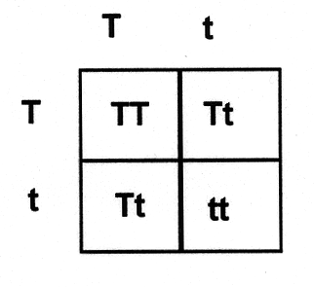
Genetic Practice Problems
‹#›
Notes:
Mendelian Genetics
*
‹#›

Slide 63
Breed the P₁ generation
tall (TT) x dwarf (tt) pea plants
t
t
T
T
‹#›
Notes:
Mendelian Genetics
*
‹#›

Slide 64
Solution:
tall (TT) vs. dwarf (tt) pea plants
t
t
Tt
produces the
F₁ generation
T
Tt
T
Tt
Tt
All Tt = tall
(heterozygous tall)
‹#›
Notes:
Mendelian Genetics
*
‹#›

Slide 65
Breed the F₁ generation
tall (Tt) vs. tall (Tt) pea plants
T
t
T
t
‹#›
Notes:
Mendelian Genetics
*
‹#›

Slide 66
Solution:
tall (Tt) x tall (Tt) pea plants
T
t
produces the
F₂ generation
TT
Tt
T
1/4 (25%) = TT
1/2 (50%) = Tt
1/4 (25%) = tt
t
Tt
tt
1:2:1 genotype
3:1 phenotype
‹#›
Notes:
Mendelian Genetics
*
‹#›

Slide 67
‹#›
Notes:
Mendelian Genetics
*
‹#›

