Slide 1
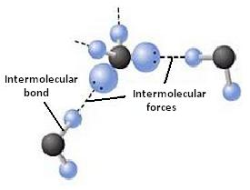
Unit #3
Intermolecular Forces and Properties

Slide 2
General Overview
3.1 Intermolecular Forces
3.2 Properties of Solids
3.3 Solids, Liquids, and Gases
3.4 Ideal Gas Law
3.5 Kinetic Molecular Theory
3.6 Deviation from Ideal Gas Law
3.7 Solutions and Mixtures
3.8 Representations of Solutions
3.9 Separation of Solutions and Mixtures - Chromatography
3.10 Solubility
3.11 Spectroscopy and the Electromagnetic Spectrum
3.12 Photoelectric Effect
3.13 Beer-Lambert Law

Slide 3
Quick Review - Polarity of Molecules

Slide 4
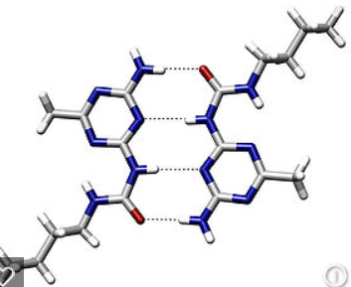
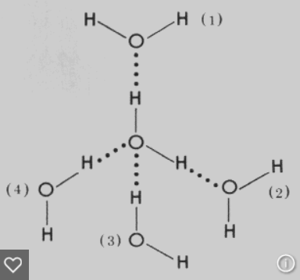
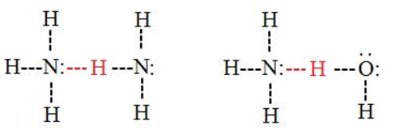
3.1 Intermolecular Forces
The Stronger the IMF the more energy required to break it, the Higher the Boiling Point,
the Lower the Vapor Pressure.
Intermolecular Forces Listed from weakest to strongest. Thus the boiling points and vapor pressure of
molecular substances can be ordered based on IMF strength:
London Dispersion forces (Induced Dipole-Induced Dipole): Caused by distortion of electron cloud (temporary dipoles). Dispersion forces increase with increasing contact area and increasing polarizability. The larger the electron cloud, and the more surface area, the more polarizable the cloud, the stronger the dispersion force. Polarizability is enhanced by pi bonding. Thus the boiling point trend in halogens is I₂ >Br₂>Cl₂> F₂ . All substances have dispersion forces, as all electron clouds distort. Nonpolar molecules and atoms have only dispersion forces, as they have no permanent dipoles. Remember with increased number of ELECTRONS a particle becomes more polarizable, not with increased mass! London dispersion forces are often the strongest net intermolecular force between large molecules.
Dipole- Induced Dipole: Present between a polar molecule (HCl) and a nonpolar molecule. (Cl₂) The nonpolar molecule’s cloud distorts when affected by a dipole. The strength of these forces increases with the magnitude of the dipole of the polar molecule and the with the polarizability of the nonpolar molecule.
Dipole-Dipole: Present between 2 polar molecules. (HCl-HCl). Strength depends on magnitudes of dipoles and orientation
Ion-dipole forces: Present between ions and polar molecules (like Na+ and H₂O). The higher the charge of the ion, the stronger the ion-dipole forces!
Hydrogen Bond: An extreme case of Dipole – Dipole. Occurs between molecules containing a H covalently bonded to F,O, or N. The “bond” occurs between the lone pair of F, O, or N, and the H which is attached to one of those elements.
Weaker IMF, Lower Boiling, Higher Vapor Pressure
Stronger IMF, Higher Boiling, Lower Vapor Pressure

Slide 5
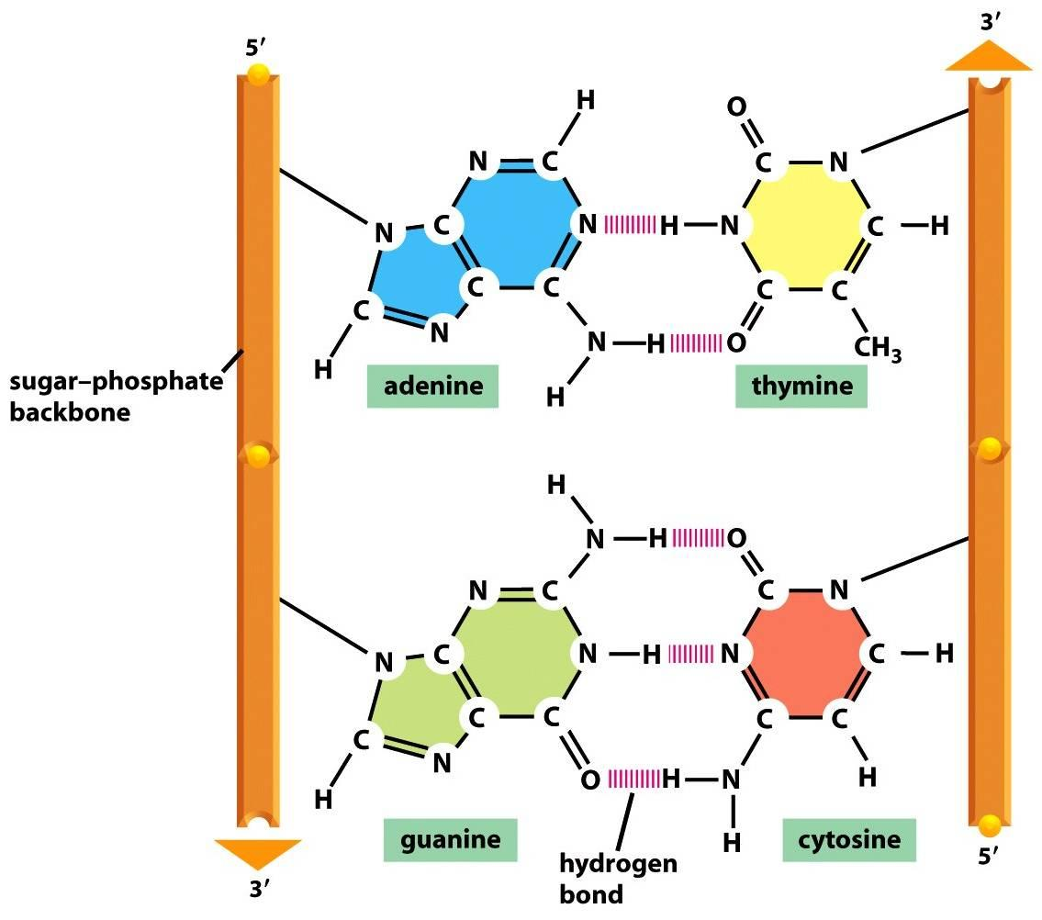
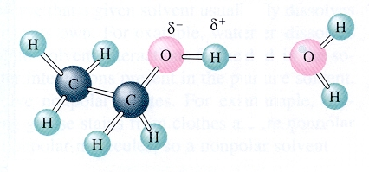
Hydrogen Bonding
Hydrogen bonding is seen in the following molecules: water, DNA, ammonia, HF, and alcohols. H-bonding is an attraction or force not a true intramolecular bond.
Hydrogen bonds are like a sandwich with N, O, and/or F as the bread. H will be in a intramolecular (same molecule) bond with one N, O, and/or F and have an intermolecular attraction (different molecule) with the other.
Remember this tip:
hydrogen bonds just wanna have FON

Slide 6
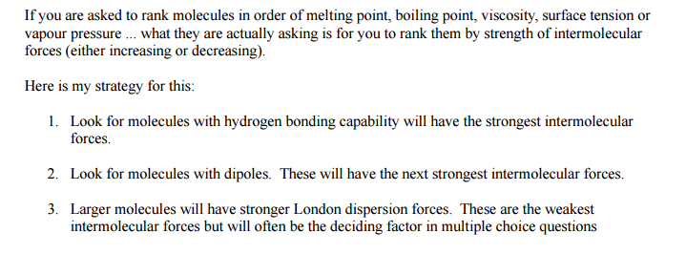
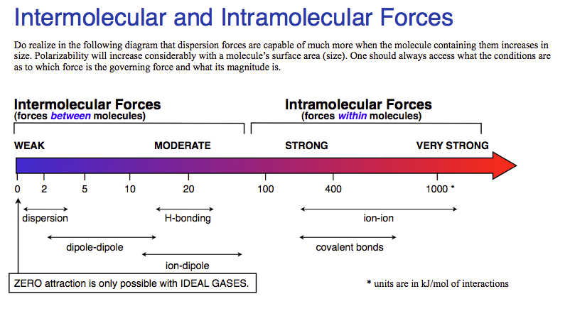
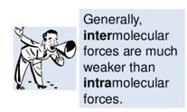
3.2 Properties & IMFs
Interstates- Between States
IMF- Between Molecules
Chemical vs. Physical Changes
A physical change doesn’t produce a new substance. Phase changes are the most common. It involves IMF changes.
A chemical change produces new substances. Bonds are broken and new bonds are formed! The Intra-molecular forces are changed.
Strong IMF= High BP, High MP, High viscosity, high surface tension, low vapor pressure!
REMEMBER: Intermolecular forces are broken during a phase change!!

Slide 7
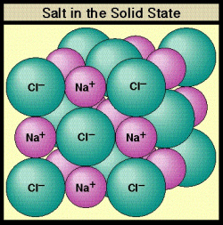
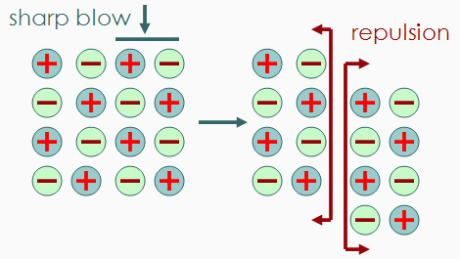
3.2 Ionic Substances and their Properties
Ionic compounds are brittle. As the crystal structure is struck, the ions become displaced. The displaced ions will repel like charges and fracture.
Ionic compounds DO NOT conduct as solids, but DO conduct as liquids or aqueous (when ions are mobile)

Slide 8
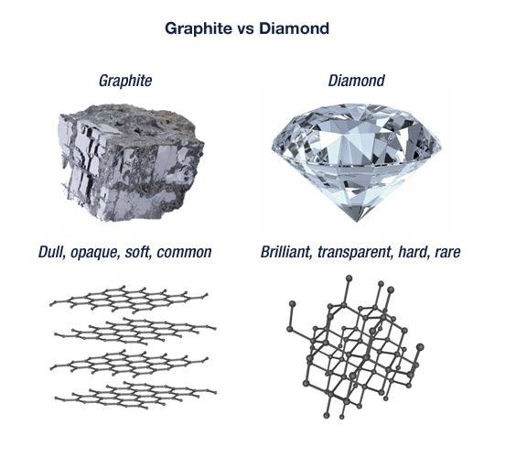
3.2 Covalent Network Solids
Covalent network solids: only C or Si!
Graphite are sheets of carbon atoms bonded together and stacked on top of one another. The interactions between sheets is weak, much like the substance itself.
Diamond’s carbon atoms are more connected in a three dimensional structure, adding strength to the network.

Slide 9
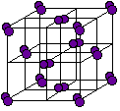
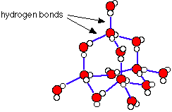
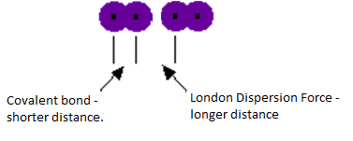
3.2 Molecular Solids
Water (H₂O)
Iodine (I₂)
Polar Covalent compounds align according to very strong dipole-dipole interactions.
Nonpolar Covalent compounds align according to LDF’s as a solid.

Slide 10
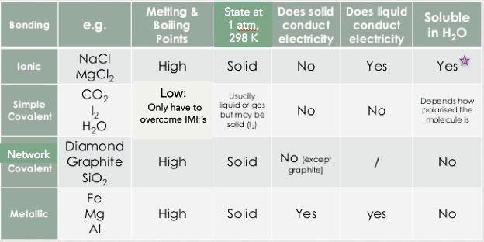
3.2 Properties of Solids
Molecular
Not all ionic compounds are soluble, but those containing ammonium, nitrate, alkali metals, and halogens (except bonded to Ag, Hg and Pb) are typically

Slide 11
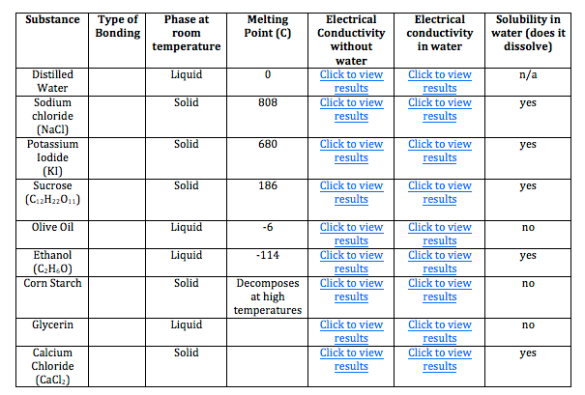
3.2 Ionic or Covalent? Bonding Tests
As the type of particles and forces of attraction in ionic and covalent compounds differ, their properties also differ!
Properties | Ionic Compounds | Covalent Compounds
Melting/Boiling Points | High | Low except for some giant covalent molecules
Electrical Conductivity | Conduct electricity in molten and in aqueous solution | Does not conduct electricity in any state when pure, may conduct in aqueous solution (i.e., acids)
Solubility in water and organic solvents | Soluble in water Insoluble in organic solvent | Insoluble in water, except for some simple molecule Soluble in organic solvent
Volatility | Not volatile | Highly volatile
Use properties of compounds to differentiate them from one another. Other tests may be performed to positively identify the compound, but are not necessary to observe types of bonds present.

Slide 12
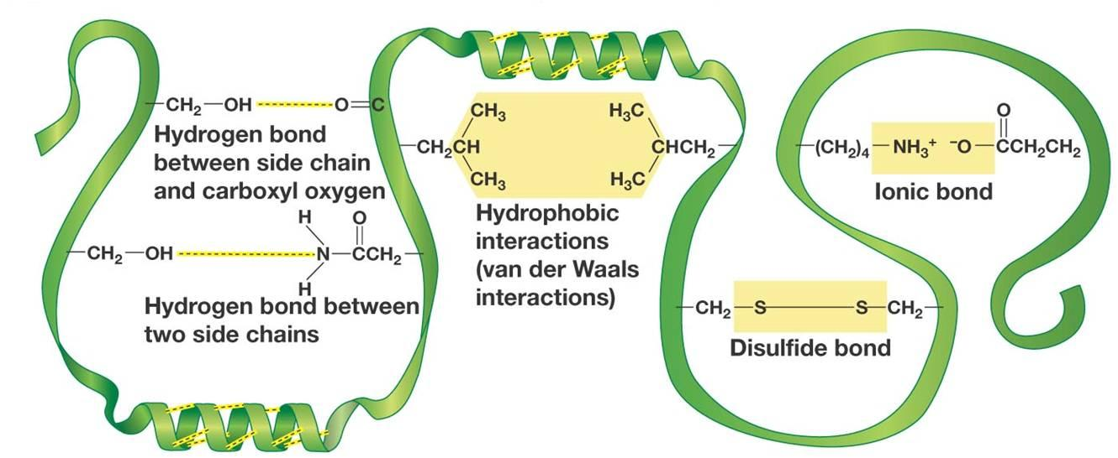
3.2 Biological/Large Molecules

Slide 13
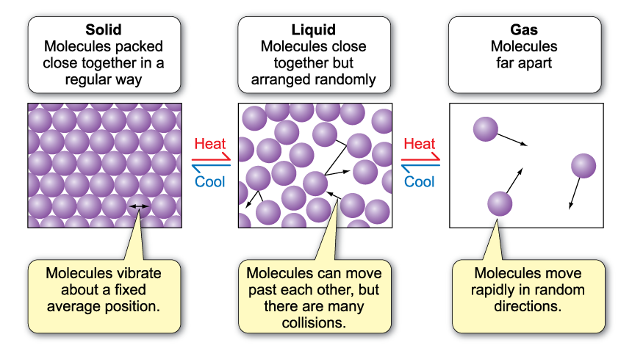
3.3 Behaviors of Solids, Liquids, and Gases
Solids can be crystalline or amorphous.
STRONG IMFS (particles are closer together) --------------------------------WEAK IMFS (particles far apart)

Slide 14
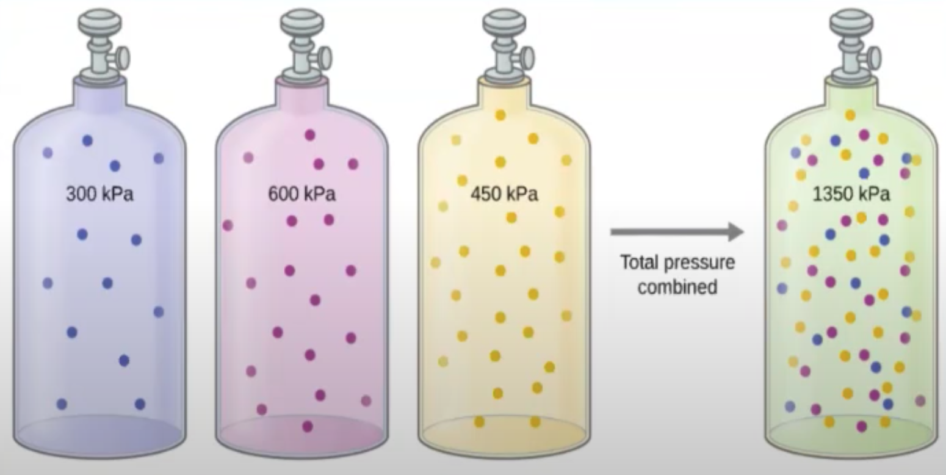
3.4 The Ideal Gas Law
Properties of gases can be calculated using the ideal gas law.
In a mixture of gases, the pressure exerted is independent of the other components. The total pressure of the sample is the sum of the partial pressures.
You can calculate the partial pressure using total pressure and mole fraction, X_{A}.

Slide 15
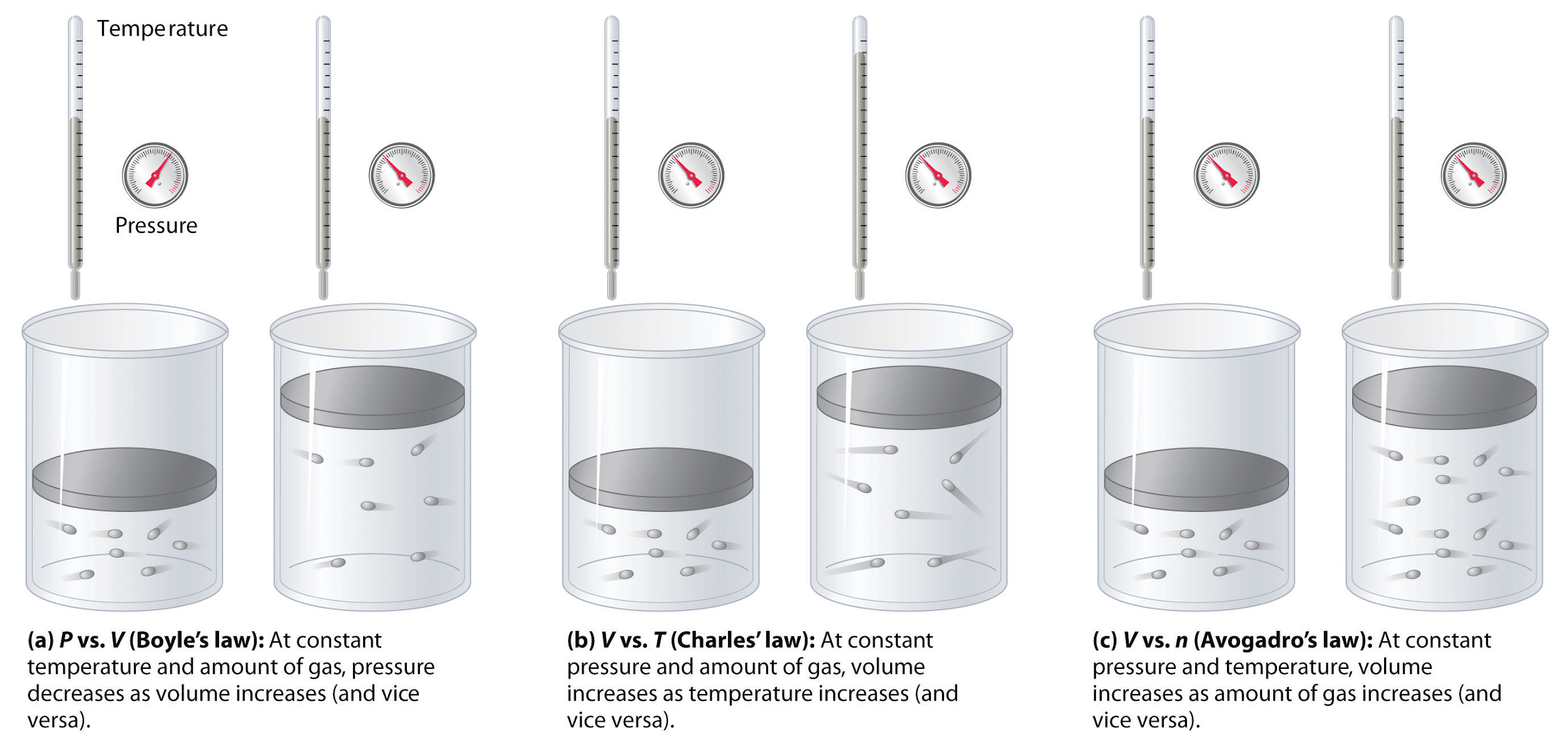
3.4 Properties of a Gas - Factors
Don’t worry about individual gas law names, but do worry about the effect of changing moles, pressure and temperature on a sample of gas

Slide 16
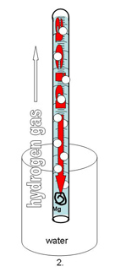
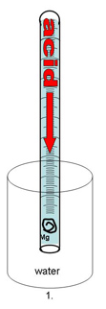
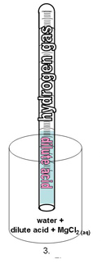
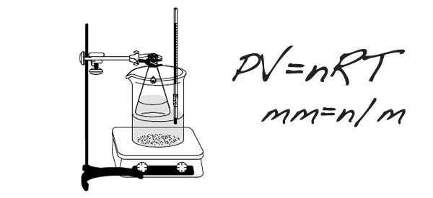
Gas Laws Labs
After rxn, eudiometer lowered into water until levels equal so pressure inside room and tube are same
Use Dalton’s Law to subtract P_{water}
Sources of error:
Mg left: moles of H₂ too low
Air bubble at start: volume of gas too high
Determination of Molar Mass of a Volatile Liquid
How It’s Done/Analysis:
Volatile liquid heated until completely vaporized
PV=nRT to solve for n:
Temperature of water bath=T
Small hole in stopper means Pressure = room pressure
Volume=volume of flask
Divide Mass of recondensed unknown by moles, compare to known molar mass to ID unknown
Assume vapor completely recondenses
🡪If lose vapor, then mass would be too low, and moles would be low
Determination of Molar Volume of a Gas
http://chemskills.com/?q=ideal_gas_law
Diffusion : Graham’s Law
Demo
How It’s Done/Analysis:
Ends of glass tube plugged with soaked cotton
White ring is NH₄Cl ppt
Ppt will not be exactly in middle…
Molar mass of NH₃ is lower than MM of HCl, so ring will be toward right side of tube
Graham’s Law can be used to establish ratios which can be applied to distances

Slide 17
3.5 Kinetic Molecular Theory (KMT)
IF the temperature is not changed, no matter what else is listed in the problem, the average kinetic energy of a gas does not change. That is the definition of temperature!
Kelvin temperature of a sample is proportional to the average kinetic energy!
All gases begin to act non-ideally (aka real) when they are at low temperatures and/or high pressures because these conditions increase particle interactions
Under the same conditions, the stronger the intermolecular attractions between gas particles, the LESS ideal the behavior of the gas

Slide 18
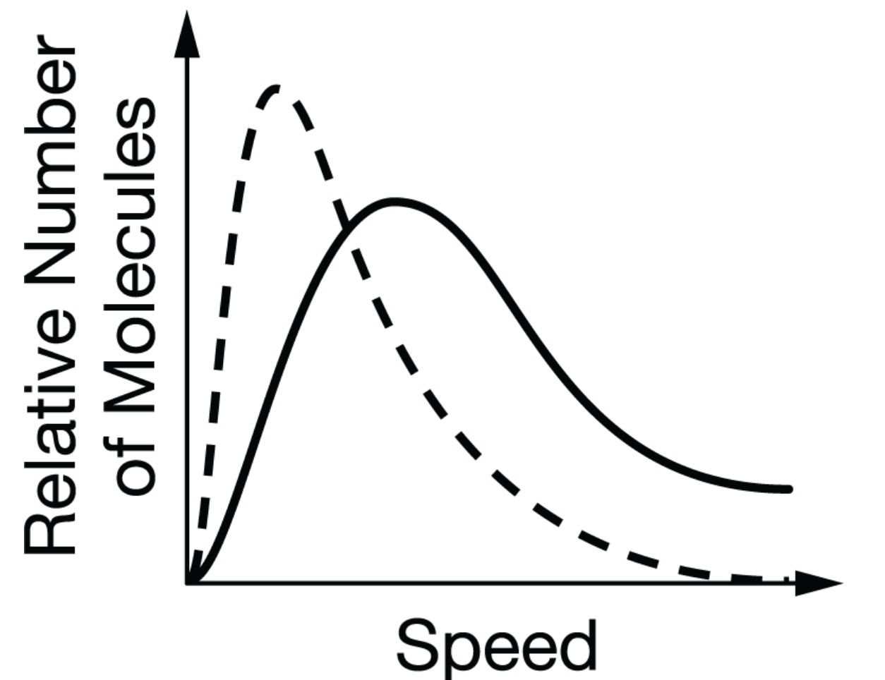
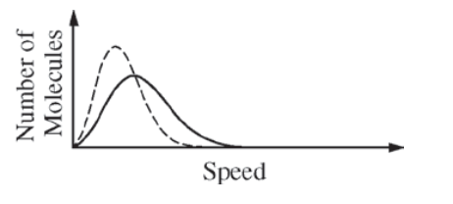
3.5 Kinetic Molecular Theory - Maxwell Boltzmann
The Maxwell-Boltzmann distribution describes the distribution of the kinetic energies of particles at a given temperature.
The Maxwell-Boltzmann distribution provides a graphical representation of the energies/velocities of particles at a given temperature.
This graph shows nitrogen gas (solid line) compared to oxygen gas (dashed line).
This graph shows a gas that is at a lower temperature (dashed line) compared to a gas at a higher temperature (solid line).

Slide 19
3.6 Deviations from Ideal Gas Behavior
With significant attraction, number of collisions decrease and actual pressure is
less than what is expected.
Once there is attraction, the gases now travel in pairs or trios.
As attraction increases, actual pressure is smaller than predicted.
At high temperatures, the gas molecules are moving so quickly that IMF become insignificant and gas behaves ideally.
At low temperatures, IMF become significant and gas is non-ideal.
With significant particle volume, number of collisions increase and actual pressure is more than what is expected.
When particles have volume, they don’t have as far to travel for a collision to occur.
As volume increases, actual pressure is larger than predicted.
At low pressures, the space between molecules is much greater than the volume of molecules themselves and the gas behaves ideally.
At high pressures, particle volume becomes significant and the gas is non-ideal.

Slide 20
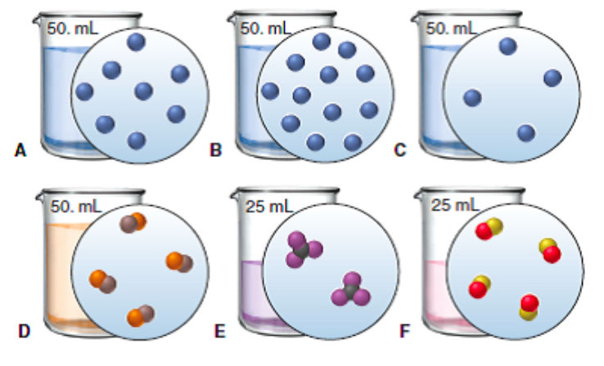
3.7 Molarity and Particle Views
Molarity:
M = mol/L
QUESTION: Rank the six solutions above in order of increasing molarity. Pay attention to volume, and some have equal concentration
C,D, and E (tied); A and F (tied); most concentrated is B

Slide 21
3.8 Dissolving/Dissociation: Solute and Solvent
When drawing solute ions:
pay attention to size (Na⁺ is smaller than Cl⁻)
Draw charges on ion, but not on water
draw at least 3 water molecules around each
the negative dipole (oxygen side) points toward cation and the positive dipoles (H side) points towards the anion

Slide 22
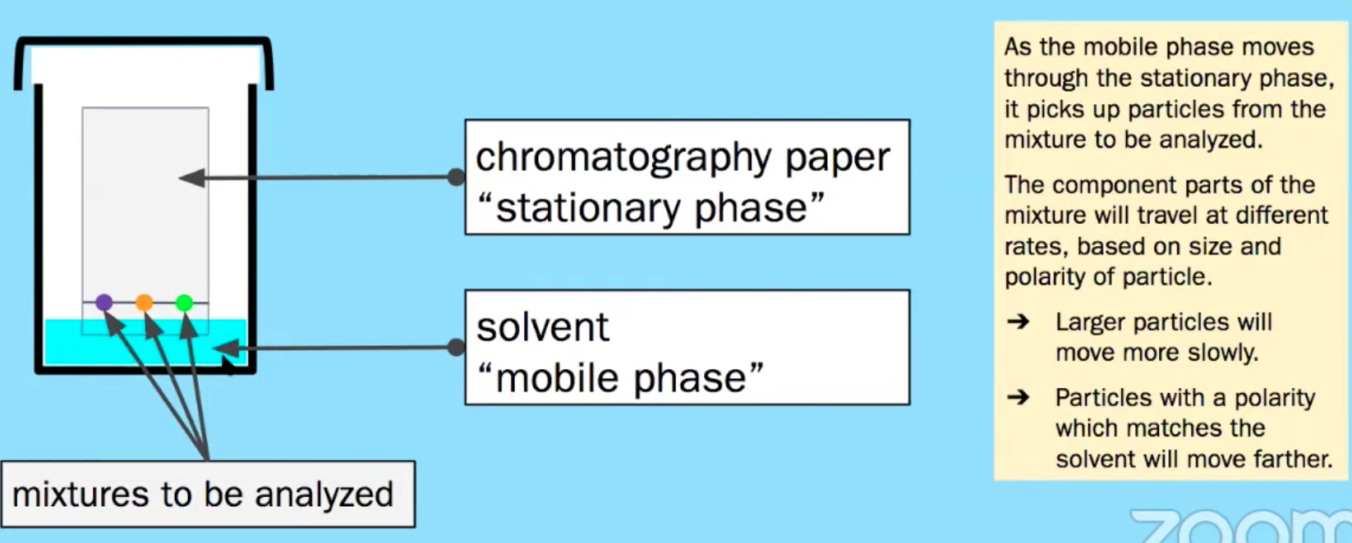
3.9 Chromatography
Components of a liquid cannot be separated by filtration. They are separated based on IMFs!
Chromatography (paper, thin-layer, and column) separates chemical species by taking advantage of the differential strength of intermolecular interactions between and among the components of the solution (the mobile phase) and with the surface components of the stationary phase.

Slide 23
3.9 Chromatography
Main Error:
Incomplete Separation
Can be caused by:
Inconsistent spotting
Overloading
Improper packing (column)
Poor solvent choice
Advantage: We can collect and use the fractions

Slide 24
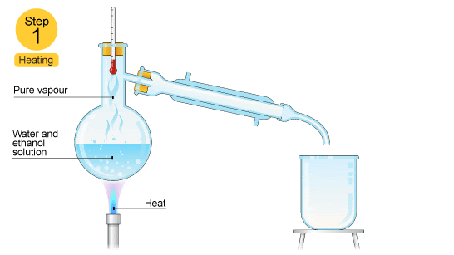
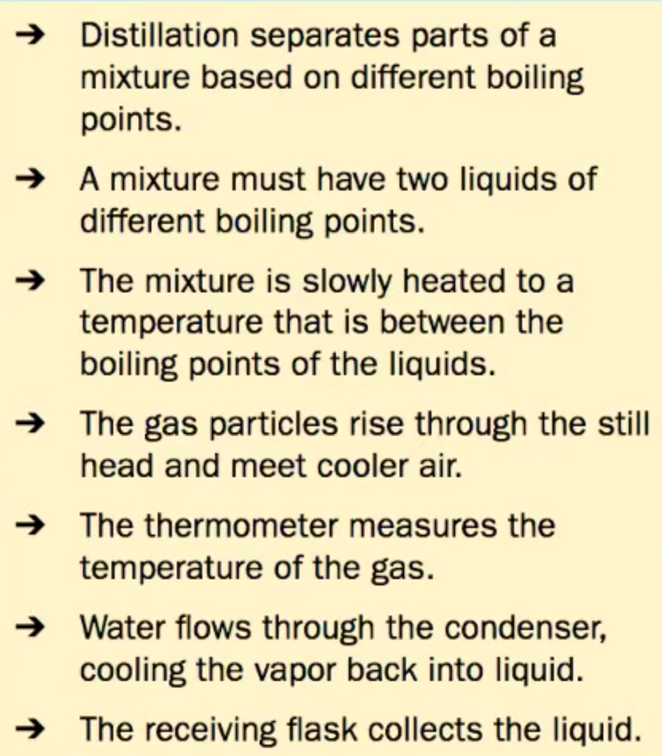
3.9 Distillation to Separate Solutions
Distillation separates chemical species by taking advantage of the strength of intermolecular interactions between and among the components and the effects these interactions have on the vapor pressures of the components in the mixture.
In the diagram above, ethanol has lower IMF’s and a resulting lower boiling point than water, so it can be heated, vaporized and condensed easily.
Ethanol hydrogen bonds as water does and is polar, but part of the ethanol has only weaker LDF’s because it’s nonpolar resulting in a lower boiling point

Slide 25
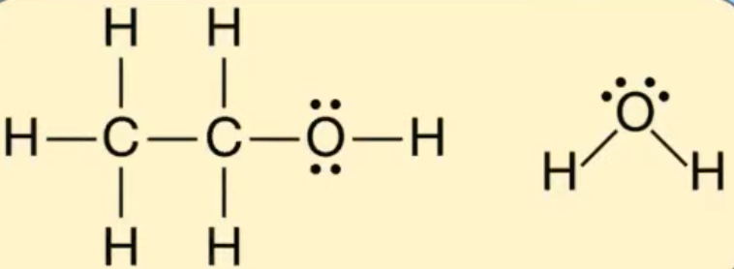
3.10 Coulomb’s Law and Solubility
Ionic compounds can dissolve in polar liquids like water because the ions are attracted to either the positive or negative part of the molecule.
There is a sort of tug-of-war involved with species dissolved in water. The water pulls individual ions away from the solid. The solid is pulling individual ions back out of the water. There exists an equilibrium based on how strongly the water attracts the ions, versus how strong the ionic solid attracts the ions.
We can predict the degree of solubility in water for different ionic compounds using Coulomb's law. The smaller the ions, the closer together they are, and the harder it is for the water molecules to pull the ions away from each other (lattice energy!). The greater the charge of the ions, the harder it is for the water to pull them away as well.
Substances with similar intermolecular interactions tend to be miscible or soluble in one another.

Slide 26
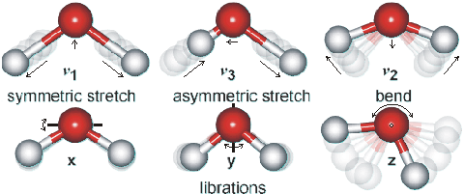
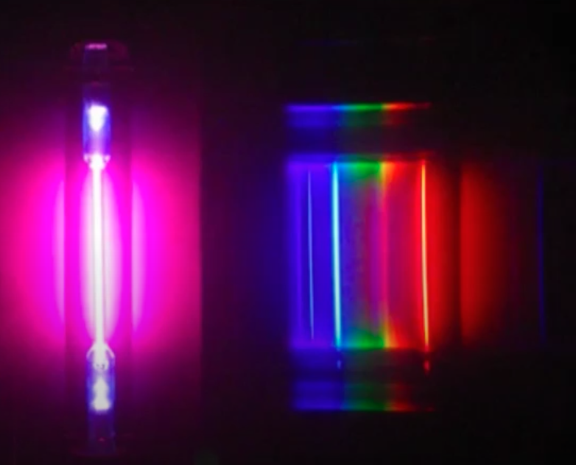
3.11 Spectroscopy - determines the structure and concentration in a mixture
Differences in absorption or emission of photons in different spectral regions are related to different types of molecular motion or electronic transition:
Microwave Radiation - associated with transitions in molecular rotational levels (bond rotation)
IR Radiation - detects different types of bonds by analyzing molecular vibrations
UV-Vis or X-Ray Radiation
Photoelectron Spectroscopy(PES)
Causes electron transitions
Transitions provides info on electron configurations

Slide 27
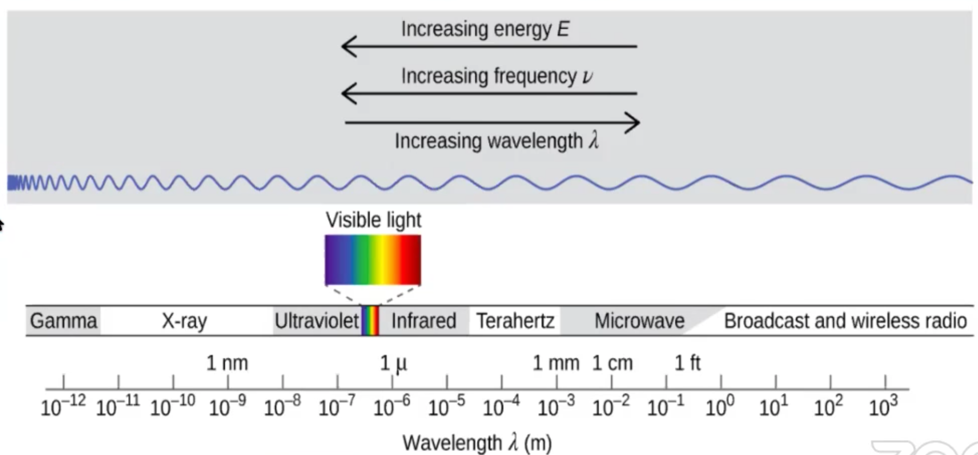
3.12 Photoelectric Effect
When a photon is absorbed (or emitted) by an atom or molecule, the energy
of the species is increased (or decreased) by an amount equal to the photon.
The wavelength of the electromagnetic wave is related to its frequency and the speed of light:
The energy of a photon is related to the frequency of the electromagnetic wave through Planck’s equation:

Slide 28
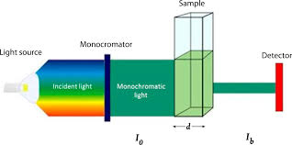
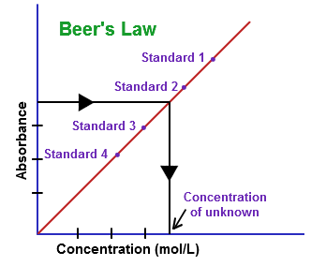
3.13 Beer-Lambert Law: used to measure the concentration of colored solutions
Relates absorption of light by a solution to three variables. In most experiments, the path length and wavelength of light are held constant. In such cases, the absorbance is proportional to the concentration of absorbing molecules or ions.
A = abc
A = absorbance
a = molar absorptivity (constant for material being tested)
b = path length (cuvette = 1 cm)
c = concentration
Taken at fixed wavelength

