Slide 1
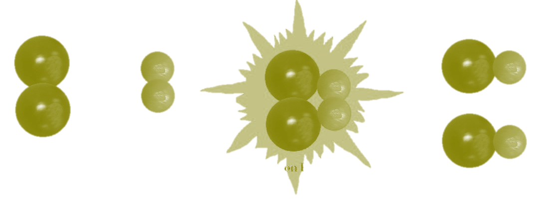
Unit 5
Kinetics

Slide 2
General Overview
5.1 Reaction Rates
5.2 Introduction to Rate Law
5.3 Concentration Changes Over Time
5.4 Elementary Reactions
5.5 Collision Model
5.6 Reaction Energy Profile
5.7 Introduction to Reaction Mechanisms
5.8 Reaction Mechanism and Rate Law
5.9 Steady-State Approximation
5.10 Multistep Reaction Energy Profile
5.11 Catalysis

Slide 3
5.1 Reaction Rates
Rate is the change in concentration over time
Δ[A] / t
Rates of change of reactant and product concentrations are determined by the stoichiometry in the balanced equation
Remember this is when we look at rate of appearance and rate of disappearance
Learning Objective: Explain the relationship between the rate of a chemical reaction and experimental parameters.

Slide 4
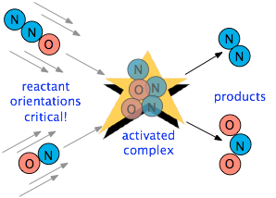
5.1 Factors Affecting Reaction Rate
Factors that Affect Reaction Rate
State of reactants
Rate increases as state changes from solid → gas as increased molecular movement allows for more opportunity for collision
Greater surface area of solids will increase rate as more reactant is exposed and able participate in collisions
Temperature - more kinetic energy leads to more successful collisions between molecules
Concentration – more reactants → more collisions
Use of a catalyst – affect the mechanism of reaction leading to faster rate (lowers the activation energy)
Collision theory states that reactants must collide in the correct orientation and with enough energy for the molecules to react; changing the number of collisions will affect the reaction rate
Anything that increases collisions will increase the rate of reaction!
Learning Objective: Explain the relationship between the rate of a chemical reaction and experimental parameters.

Slide 5
5.2 Introduction to Rate Law
Rate law for a reaction has the form: rate = k [A]^{m}[B]^{n}…
(only reactants are part of the rate law)
Exponents are determined from examining data - not coefficients:
for A + B → C
The overall rate expression for the reaction is rate = k [B]
k is the rate constant and is determined experimentally by plugging in data into the rate expression
Make sure to give units for the rate constant! They change based on the overall reaction order.
When [A] is doubled, the rate do not change, so the reaction is zero order with respect to A
Trial | Initial [A] (mol/L) | Initial [B] (mol/L) | Initial Rate (mol/(L•s)
1 | 0.100 | 0.100 | 0.002
2 | 0.200 | 0.100 | 0.002
3 | 0.200 | 0.200 | 0.004
When [B] is doubled, the rate doubles, so the reaction is first order with respect to B
Learning Objective: Represent experimental data with a consistent rate law expression.

Slide 6
5.3 Concentration Changes Over Time (Integrated Rate Law)
The order of a reaction can be determined from a graph of concentration of reactant versus time:
Plot to create a straight line graph:
Zeroth Order First Order Second Order
[A] / Time ln[A] / Time 1/[A] / time
The first and second order integrated rate laws can be found on the Kinetics section of the AP Equations Sheet
The slopes of the graphs can be used to determine the rate constant for the reaction. (Always make sure you have units for the rate constant!)
The graphs tell you the order, but always use concentration vs. time for the initial concentration (if asked).
Learning Objective: Identify the rate law expression of a chemical reaction using data that show how the concentrations of reaction species change over time.

Slide 7
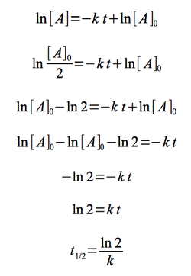
5.3 Half-life (First Order)
Time needed for the concentration of reactant to reach half its initial value
Time to reach half concentration is dependent on k, not initial concentration
Half-life remains constant in a first order reaction
Example: when t_{1/2}= 30 sec, the concentration is halved each 30 seconds
The first order half life equation is derived from the first order integrated rate law
Initial Conditions After 30 seconds After 60 seconds
(12 molecules) (6 molecules) (3 molecules)
Learning Objective: Identify the rate law expression of a chemical reaction using data that show how the concentrations of reaction species change over time.

Slide 8
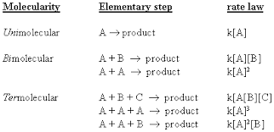
5.4 Elementary Steps
In a mechanism:
The rate law of any elementary reaction can be written from its stoichiometry.
Elementary steps involving the collision of three or more particles is very rare. This is highly unlikely because it is improbable that three molecules collide simultaneously with enough energy and in the proper orientation.
Molecularity: the number of molecules that come together to react in an elementary step of a reaction mechanism.
One species reacts
Two species reacts
Three species reacts
Learning Objective: Identify the rate law expression of a chemical reaction using data that show how the concentrations of reaction species change over time.

Slide 9
5.5 Collision Theory
Only a small fraction of collisions leads to a reaction. Remember, the more collisions, the faster the rate. For a successful collision:
Molecules have enough energy to overcome E_{a}.
Molecules collide with proper orientation to break/form a bond.
The larger the rate constant, the larger the percentage of molecules having successful collisions!
Learning Objective: Explain the relationship between the rate of an elementary reaction and the frequency, energy, and orientation of molecular collisions.

Slide 10
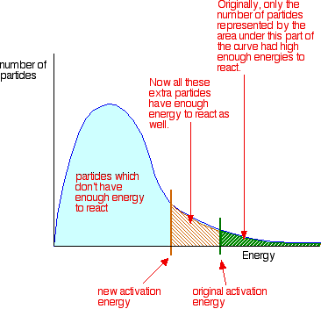
5.5 Collision Theory
The higher the activation energy, the higher the temperature must be to overcome it.
The Maxwell Boltzmann distribution curve shows the distribution of particle energies; this distribution can be used to gain a qualitative estimate of the fraction of collisions with sufficient energy to lead to a reaction, and also how tht fraction depends on temperature.
We are able to see the number of molecules with a specific speed/energy (remember they need enough energy to overcome E_{a})
Learning Objective: Explain the relationship between the rate of an elementary reaction and the frequency, energy, and orientation of molecular collisions.

Slide 11
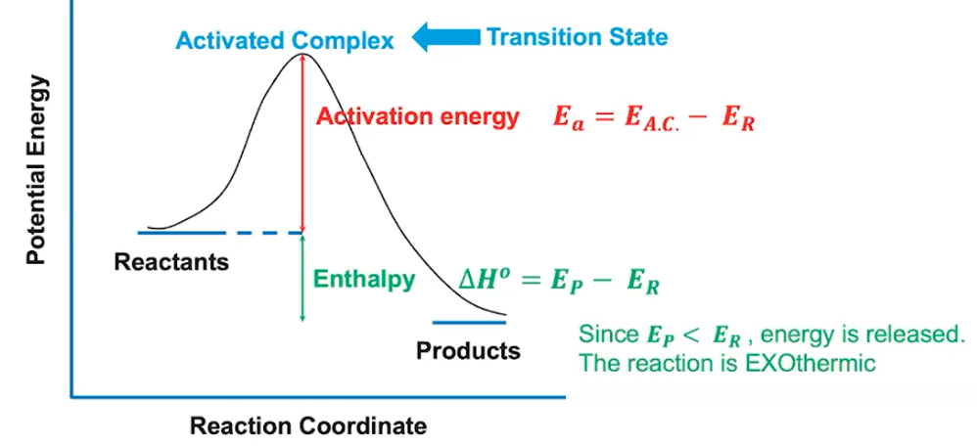
5.6 Reaction Energy Profile
Elementary reactions typically involve the breaking of some bonds and the forming of new ones.
The energy profile gives the energy along the reaction coordinate, which proceeds from reactants, through a transition state, to products. The energy difference between the reactants and the transition state is the activation energy for the forward reaction.
Notes:
Knowledge of the energetics of each elementary reaction in a mechanism allows for the construction of an energy profile for a multistep reaction.

Slide 12
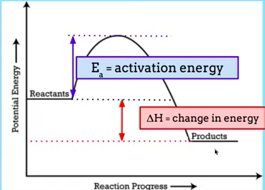
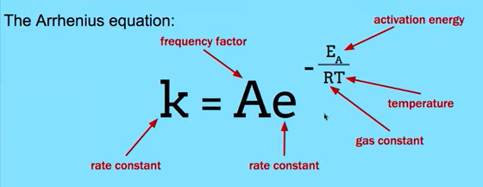
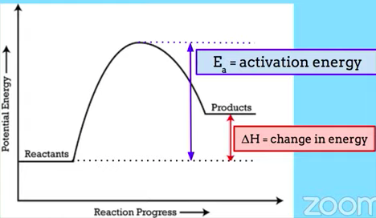
5.6 Reaction Energy Profile
The Arrhenius equation relates the temperature dependence of the rate of an elementary reaction to the activation energy needed by molecular collisions to reach the transition state.
The higher the temperature, the more energy the reactant molecules have and the more likely the reactants can overcome the activation energy.
Changing the temperature doesn’t change the activation energy, but it does increase the kinetic energy of the particles in the sample, giving more particles the energy needed to react.
Notes:
Knowledge of the energetics of each elementary reaction in a mechanism allows for the construction of an energy profile for a multistep reaction.

Slide 13
5.7 Reaction Mechanisms
A reaction mechanism consists of a series of steps, that occur in sequence. The components may include reactants, intermediates, products, and catalysts.
A reaction intermediate is produced by some elementary steps and consumed by others, such that it is present only while a reaction is occurring.
Tend to be extremely reactive and short-lived,
They represent a low concentration in a chemical reaction compared with the amount of reactants or products.
The elementary steps when combined should align with the overall balanced equation of a chemical reaction.
A catalyst is present at the beginning and end of the reaction (starts as a reactant and ends as a product), but it is not present in the overall reaction.
Intermediate: produced in one step and used up in the next
Catalyst: interacts with reactants but is not changed during the reaction
All steps should add up to the overall equation!
Learning Objective: Identify the components of a reaction mechanism.

Slide 14
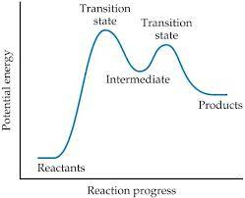
5.8/5.10 Rate Law & Reaction Mechanisms
When the entire mechanism of a reaction is given, the rate law can be written from the elementary steps.
In the case that the first step is the slow step, the rate law can be written based on that step only.
The slow step is the rate determining step and its rate law is what drives the reaction rate.
Learning Objective: Identify the rate law for a reaction from a mechanism in which the first step is rate limiting.

Slide 15
5.8 Rate Law & Reaction Mechanisms
X₂ + Y₂ → X₂Y₂ rate = k[X₂]
A reaction and its experimentally determined rate law are represented above. A chemist proposes two different possible mechanisms for the reaction, which are given below.
Mechanism 1 Mechanism 2
X₂ → 2X (slow) X₂ → 2X (slow)
X + Y₂ → XY₂ (fast) X + Y₂ → XY + Y (fast)
X + XY₂ → X₂Y₂ (fast) X + XY → X₂Y (fast)
X₂Y + Y → X₂Y₂ (fast)
Based on the information above, which of the mechanisms is/are consistent with the rate law? List the intermediates in each mechanism:
Answer: Both are consistent. In both mechanisms, the molecularity of the slow, rate determining step is consistent with the rate law. Furthermore, the sum of the elementary steps for both mechanisms gives the overall balanced equation for the reaction.
Intermediates in mechanism 1: X, XY2. Intermediates in mechanism 2: X, XY, Y, X2Y
Learning Objective: Identify the rate law for a reaction from a mechanism in which the first step is rate limiting.

Slide 16
5.9 Steady State Approximation
In the case that the second step is the slow step, it must be assumed that the first step (fast) attains equilibrium.
This means that the rate law cannot be simply written from the slow step (intermediates cannot be included in rate law)
Instead, a simple way to write the rate law for this type of mechanism is to substitute the reactants from the initial step in place of the intermediate in the slow step.
The rate law can then be written from this newly substituted reaction
No intermediates in the rate law!!
Learning Objective: Identify the rate law for a reaction from a mechanism in which the first step is not rate limiting.

Slide 17
5.7 - 5.9: Practice
The rate law for a reaction is found to be Rate = k[A]²[B]. What is the intermediate? Which of the following mechanisms gives this rate law?
I. A + B ⇄ E (fast)
E + B → C + D (slow)
II. A + B ⇄ E (fast)
E + A → C + D (slow)
III. A + A → E (slow)
E + B → C + D (fast)
A. I
B. II
C. III
D. Two of these
Answer: E is the intermediate. Only Mechanism II is consistent with the rate law. Whenever a fast equilibrium step producing an intermediate precedes the slow rate determining step and we want to remove the intermediate from the rate law, we can solve for the concentration of the intermediate by assuming that an equilibrium is established in the fast step. The concentration of the intermediate in the rate determining slow step can be replaced with an expression derived from the equilibrium constant [E] =K_{eq}[A][B]. This substitution gives us the desired rate law: rate = k’[A]²[B]

Slide 18
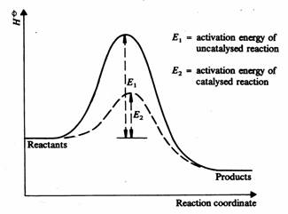
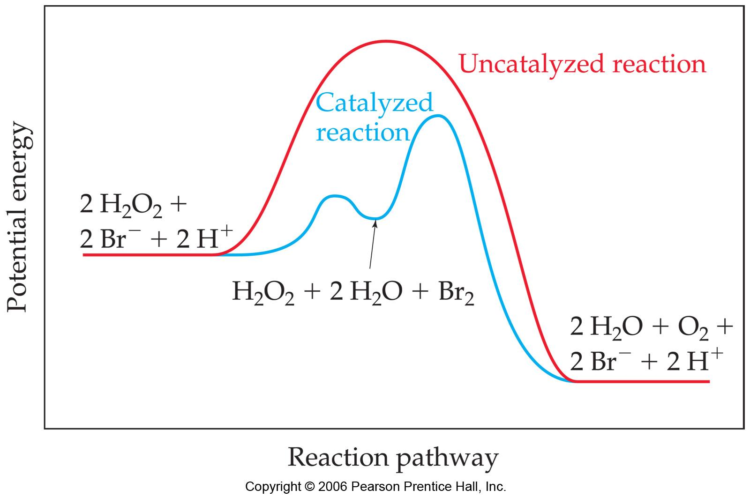
5.11 Catalysts
Catalysts increase the rate of the reaction by increasing the number of effective collisions or providing an alternative mechanisms with lower activation energy - CATALYSTS DO NOT ADD ENERGY
A catalyst can stabilize a transition state, lowering the activation energy.
A catalyst can participate in the formation of a new reaction intermediate,
providing a new reaction pathway.
**The concentration of a catalyst remains constant. It might be used and recreated, but the concentration will still remain constant.
Learning Objective: Explain the relationship between the effect of a catalyst on a reaction and changes in the reaction mechanism.

Slide 19
5.11 Catalysts
In acid-base catalysis, a reactant either gains or loses a proton, changing the rate of the reaction.
In surface catalysis, either a new reaction intermediate is formed or the probability of successful collisions is increased.
In Enzyme catalysis enzymes bind to reactants in a way that lowers the activation energy. Other enzymes react to form new reaction intermediates.
Learning Objective: Explain the relationship between the effect of a catalyst on a reaction and changes in the reaction mechanism.

Slide 20
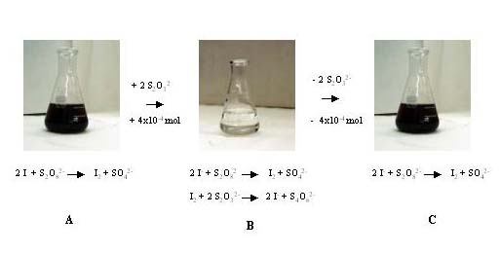
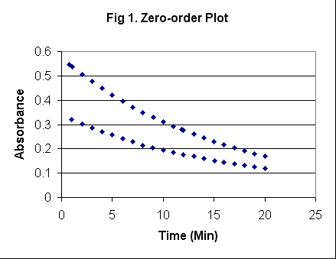
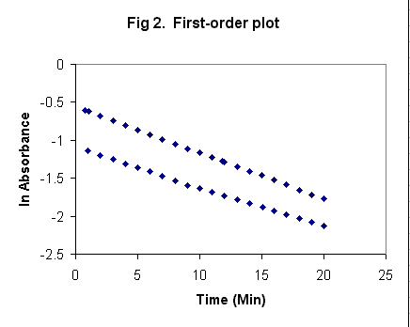
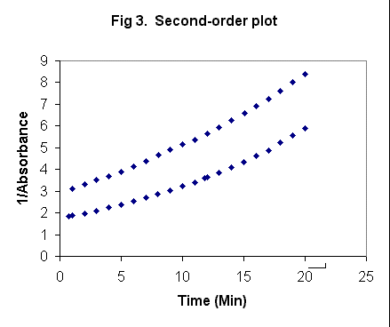
Labs: Kinetics; Collision Theory Factors
Using Spectrometry:
Data:
Analysis
rate law from straight-line graph
k from integrated rate law
E_{a} from Arrhenius Equation
Clock Reactions
Reactions that have a delayed physical change due to mechanism which only has a later step show color change
Concentration vs. time data can be gathered
It is important that there is a relatively low [S₂O₃⁻] so that the I₃⁻ will accumulate and show the color change
Time (s)
Zero Order Plot | 1st Order Plot | 2nd Order Plot
Blue in the presence of starch

