Slide 1
Unit 6
Thermodynamics

Slide 2
General Overview
6.1 Exothermic & Endothermic Processes
6.2 Energy Diagrams
6.3 Heat Transfer & Thermal Equilibrium
6.4 Calorimetry
6.5 Energy of Phase Changes
6.6 Introduction to Enthalpy of Reactions
6.7 Bond Enthalpies
6.8 Enthalpy of Formation
6.9 Hess’s Law

Slide 3
Thermodynamic vocabulary
System: The portion of the experiment on which we focus our attention. Normally consists of the reactants and the products
Surroundings: Everything else. The container, and everything outside.
When a solid is dissolved in water to form a solution, the thermometer used to record the temperature is part of the surroundings!
Endothermic: Heat flows to the system from the surroundings (surroundings temperature drops-i.e. beaker feels cold). Work is done ON THE SYSTEM.
Exothermic: Heat flows from the system to the surroundings. (surroundings temperature rises-i.e. beaker feels hot) Work is done BY THE SYSTEM (on the surroundings).
Energy: the capacity to do work or transfer heat
E = q+w

Slide 4
Some more vocabulary & info...
The First Law of Thermodynamics (aka The Law of Conservation of Energy): energy is conserved in chemical and physical processes. (energy changes from one form to another)
Heat: the transfer of energy that results from the difference in temperature between two objects
Specific Heat: the amount of energy needed to raise the temperature of one gram of a substance by 1ºC (1K)
Each substance has its own unique specific heat value
The larger the value of specific heat, the more energy that object can release or absorb before its temperature changes.
Water has a relatively large specific heat value while values for metals are generally small.
For objects with different values of C, the transfer of a given amount of thermal energy will not produce the same temperature change in equal masses of matter.

Slide 5
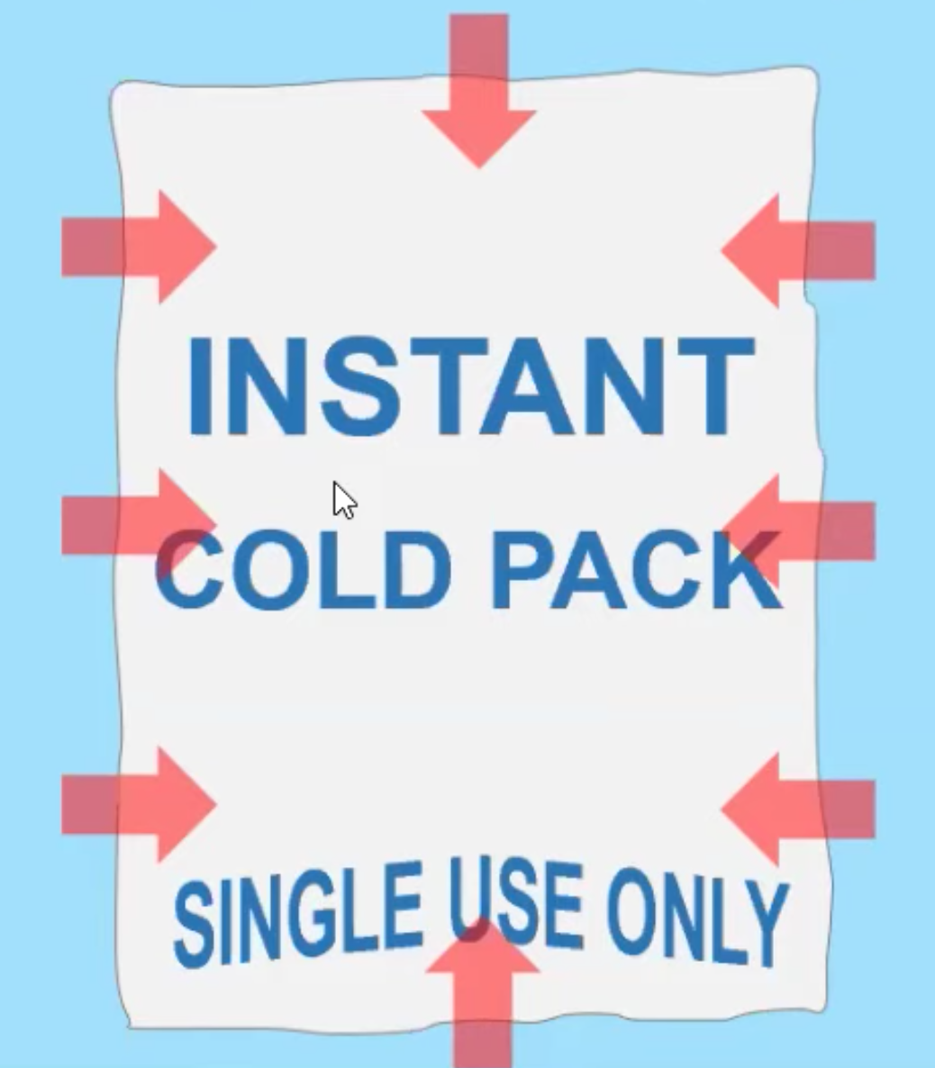
6.1 Endothermic & Exothermic Process
Endothermic process: Energy (in the form of heat) is transferred from the surroundings to the system. (INTO the system)
The cold pack feels cold when we touch it because our hand is part of the surroundings.
Exothermic process: Energy (in the form of heat) is transferred from the system to the surroundings (EXITS the system)
The hot pack feels warm when we touch it because our hand is part of the surroundings.
Learning Objective: Represent a chemical or physical transformation with an energy diagram.

Slide 6
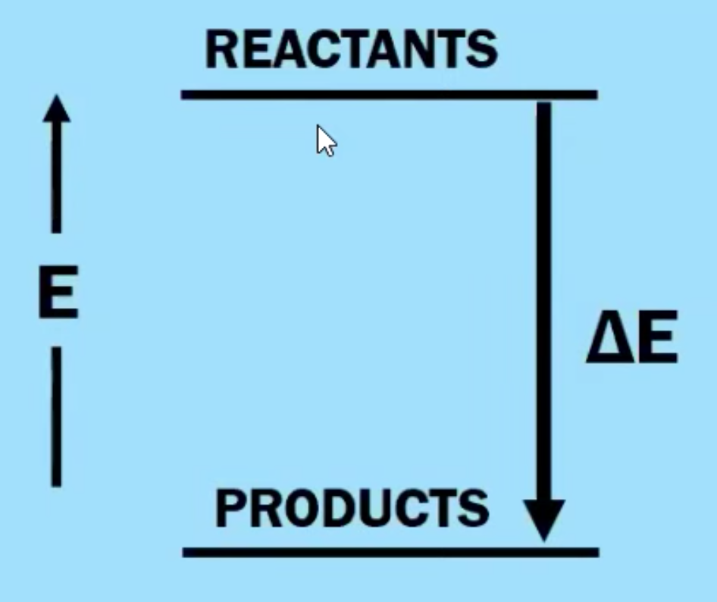
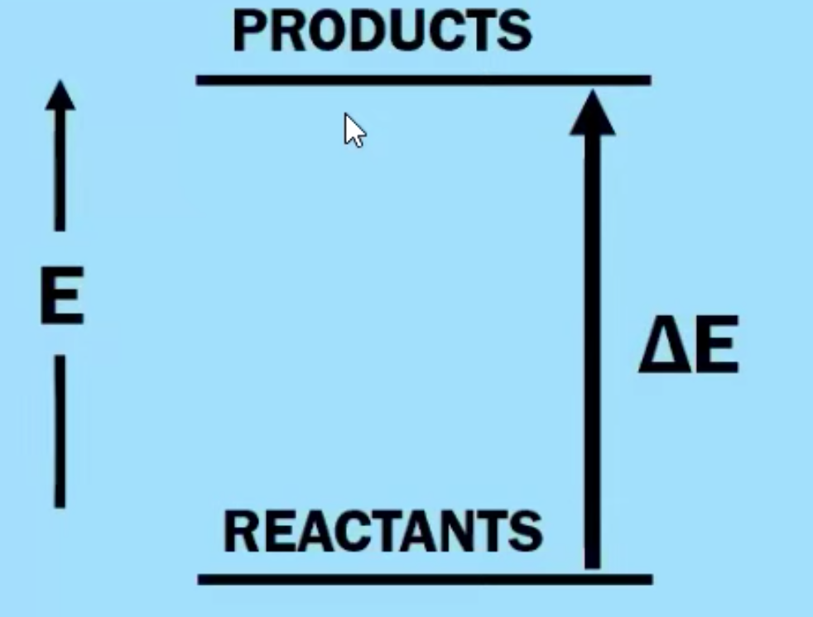
6.2 Energy Diagrams
Chemical reactions involve the formation of new products
Bonds between atoms or ions in the reactants must be BROKEN (the enthalpy of the system is increasing - ENDOTHERMIC process)
Bonds are then FORMED between atoms or ions to make the products of the reaction. (the enthalpy of the system is decreasing - EXOTHERMIC process)
Learning Objective: Represent a chemical or physical transformation with an energy diagram.

Slide 7
6.3 Heat Transfer & Thermal Equilibrium
As the temperature of a substance increases, the average kinetic energy of the particle in that substance also increases.
Heat transfer: Heat flows from particles of higher energy (hot) to those of lower energy (cold) when particles collide.
When two objects with different temperatures are in contact (and collide), heat will transfer between them until the average kinetic energy, and thus the temperature, of both objects is the same.
Heat flows from a warmer object to a colder one until thermal equilibrium is reached. (Both substances have same avg. KE!!)
This is known as thermal equilibrium
The amount of heat released by one object is equal to the amount of heat absorbed by the other object
Learning Objective: Explain the relationship between the transfer of thermal energy and molecular collisions.

Slide 8
6.3 Conservation of Energy when Mixing
Energy is transferred between systems in contact with one another
Energy lost by one system is gained by the other so that total energy is always conserved.
-Q lost by system = +Q gained by surroundings
For example :
When room temperature water T1 (system) is mixed with cold water T2 (surroundings), the final temperature T3 will be in-between.
Q1 + Q 2 = 0 and energy is conserved

Slide 9
6.4 Heat Capacity
The transfer of a given amount of thermal energy will not produce the same temperature change in equal masses of matter with differing specific heat capacities.
Although the heat transfer is equal (first law of thermo), not all particles will absorb or release the same amount of heat per gram.
Heating a system increases the energy of the system, while cooling a system decreases the energy of the system.
Specific Heat Capacity is a measure of the amount of heat energy in Joules that is absorbed to raise the temperature of 1 gram of a substance by 1 degree Kelvin.
The specific heat capacity of a substance and the molar heat capacity are both used in energy calculations.
Molar heat capacity is J/mol°C rather than J/g°C.
The lower the specific heat, the greater the temperature change.
Learning Objective: Calculate the heat q absorbed or released by a system undergoing heating/ cooling based on the amount of the substance, the heat capacity, and the change in temperature.

Slide 10
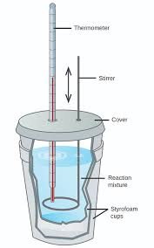
6.4 Calorimetry
The heating of a cool body by a warmer body is an important form of energy transfer between two systems. The amount of heat transferred between two bodies may be quantified by the heat transfer equation:
EQN: q = mcΔT
The process of measuring the heat released from or absorbed by a substance
For a simple “coffee cup calorimeter”, a coffee cup is filled with a solvent (generally water) and a substance is placed into the solvent.
The heat released from or absorbed by the object can then be measured using the temperature change of the water.
A lid is added to prevent heat exchange between the system and surroundings and a stirrer is used to keep the temperature even throughout the solvent.
Learning Objective: Calculate the heat q absorbed or released by a system undergoing heating/ cooling based on the amount of the substance, the heat capacity, and the change in temperature.

Slide 11
6.4 Calorimetry Equation
q = mcΔT
q = heat (measured in J or kJ)
m = mass (measured in g)
c = specific heat (generally measured in J/g ºC)
ΔT = temperature change (T_{f} - T_{i}) (generally measured in ºC)
The first law of thermodynamics states that energy is conserved in chemical and physical processes. If the heat lost by one object is gained by the other than -q = +q or…
-mCΔT = mCΔT
Learning Objective: Calculate the heat q absorbed or released by a system undergoing heating/ cooling based on the amount of the substance, the heat capacity, and the change in temperature.

Slide 12
Calorimetry: an experimental technique used to determine the heat transferred in a chemical system. System can be a chemical reaction or physical process.
Can use Calorimetry to solve for Heat Capacity of a calorimeter (C), specific heat of a substance (c), and ΔH_{vap}, ΔH_{fus}, ΔH_{rxn}.
The data handling and math:
Law of Conservation of Energy:
Q_{system} + Q_{surroundings} = 0
Q_{system} = - Q_{surroundings} where system = reaction
SO: Q_{rxn} = - Q_{calorimeter}
Heat Transfer due to Temperature Change in the Calorimeter:
Q= CΔT, or Q= mc ΔT where Q in J, C in J/K, m in g, c in J/g-K, ΔT in K
Q rxn = - Q calorimeter = - CΔT if the calorimeter Heat Capacity is Known, or can be determined.
Q rxn = - Q calorimeter = - mcΔT for reactions in solution.
When calculating ΔH, must take into account the mass of reactant that caused Q_{rxn}.

Slide 13
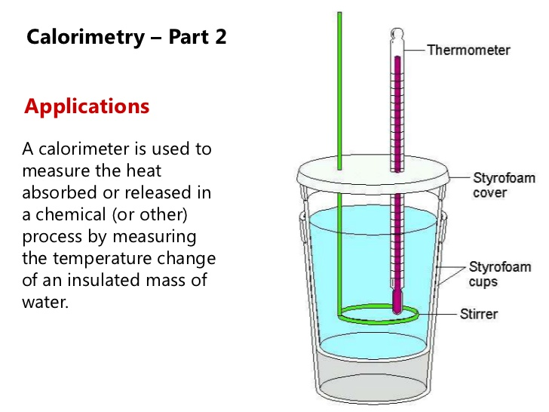
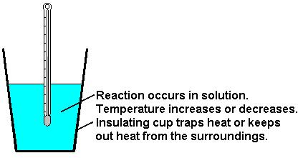
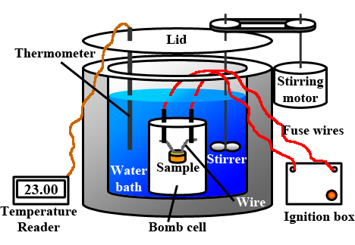
Calorimetry
Application of Law of Conservation of Energy: All heat produced/consumed during reaction (system) is exchanged with the surroundings.
Applications:
Coffee Cup Calorimeter
Assumption:
the calorimeter is isolated
so the surroundings are only the calorimeter setup, which includes the water
the calorimeter itself has a heat capacity, as it will absorb some heat.
So…
q_{surr} = -q_{rxn}
q_{surr} = q_{cal}+q_{H2O+sys}
q_{cal} = CcalΔT
Therefore:
-q_{rxn}= C_{cal}ΔT + m_{H2O+sys}cΔT
Then we can use q_{rxn} find ΔH_{rxn}:
ΔH_{rxn} =q_{rxn}/mol_{react}
Specific Heat of Material
Can be used to ID unknown
Heat of reaction
Energy content of food
This is usually done in a bomb calorimeter (constant V)
Constant P

Slide 14
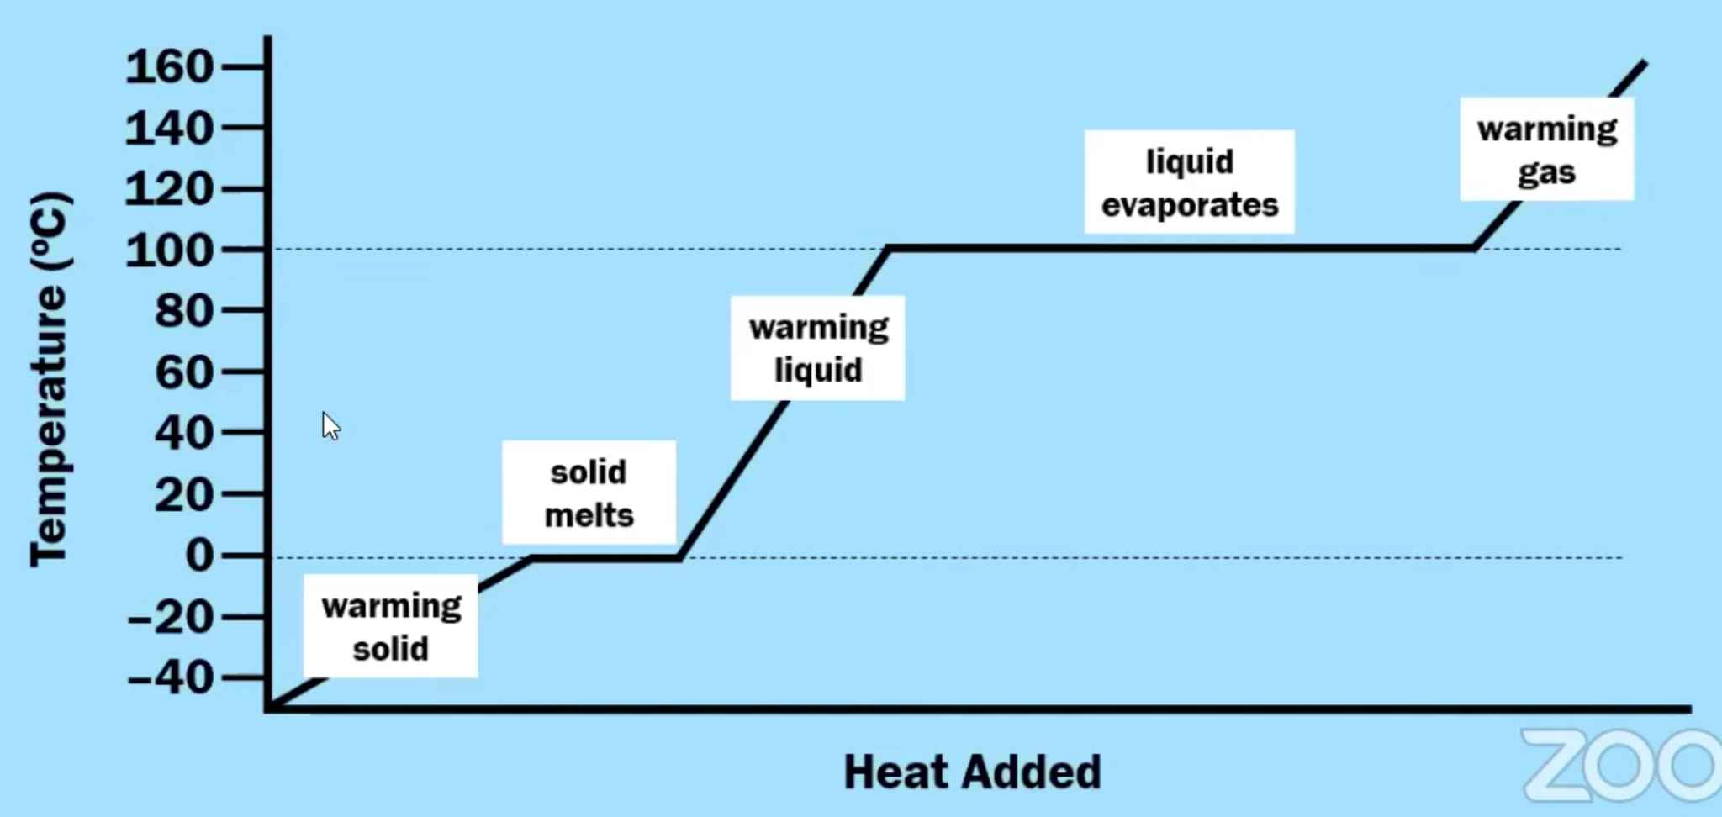
6.5 Energy of Phase Changes
In order for solids to transition to liquids (melting) or liquids to transition to gases (boiling) energy must be transferred to the system.
This energy is used to overcome IMFs between molecules
Endothermic processes (absorbs energy)
Sweating is a way to cool the body (evaporation of water). The sweat (water) is the system and the body is the surroundings.
In order for gases to transition to liquids (condensation) or liquids to transition to solids (freezing), energy must be released from a system.
Exothermic process (heat must be released for particles to slow)
The temperature of a substance remains constant during a phase change.
Learning Objective: Explain changes in the heat q absorbed or released by a system undergoing a phase transition based on the amount of the substance in moles and the molar enthalpy of the phase transition.

Slide 15
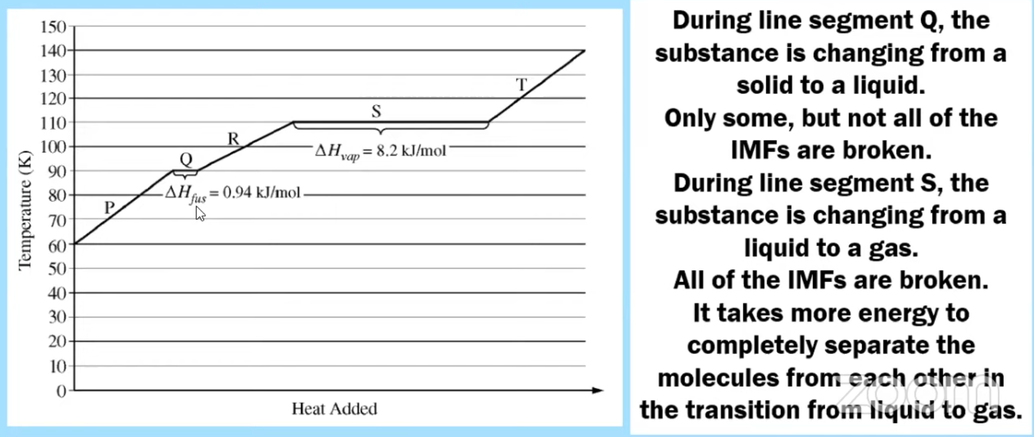
6.5 Energy of Phase Changes - Tying in IMFs
Learning Objective: Explain changes in the heat q absorbed or released by a system undergoing a phase transition based on the amount of the substance in moles and the molar enthalpy of the phase transition.

Slide 16
6.5 Chemical Systems undergo 3 main processes that change their energy: heating/cooling, phase transitions, and chemical reactions.
1. Heat Transfer due to Temperature Change: (kJ)
Q= mcΔT
m= mass (g), c= specific heat capacity (J/g-°C), ΔT= Temp. change in °C
Q is + for Heating, - for cooling
2. Heat Transfer due to Phase Change: (kJ/mol )
Q= mΔH_{phase change}
Q phase change = + for ΔH fusion, ΔH vaporizing, ΔH subliming, - for ΔH freezing, ΔH condensing, ΔH deposition
3. Q for a chemical reaction at constant pressure: ΔH_{rxn}
When calculating ΔH_{rxn} from Q, remember ΔH_{rxn} must agree with the stoichiometric coefficients in the reaction. Units of ΔH rxn are kJ/mol_{rxn}.
Learning Objective: Explain changes in the heat q absorbed or released by a system undergoing a phase transition based on the amount of the substance in moles and the molar enthalpy of the phase transition.

Slide 17
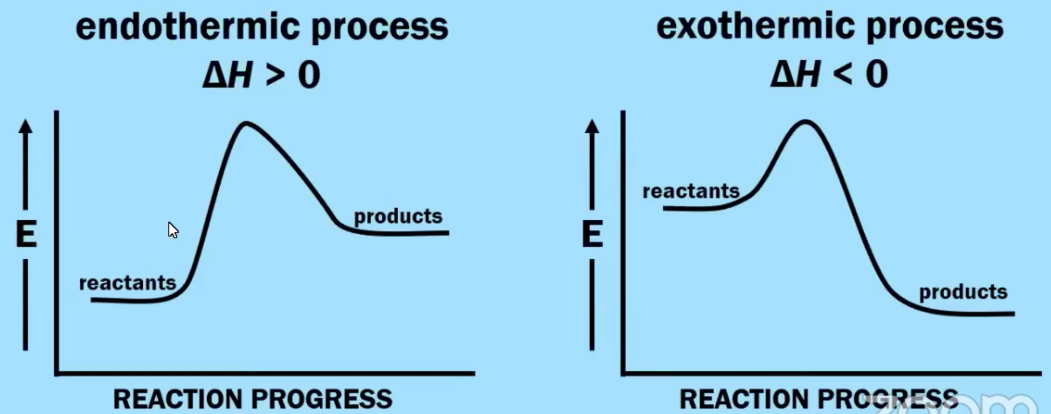
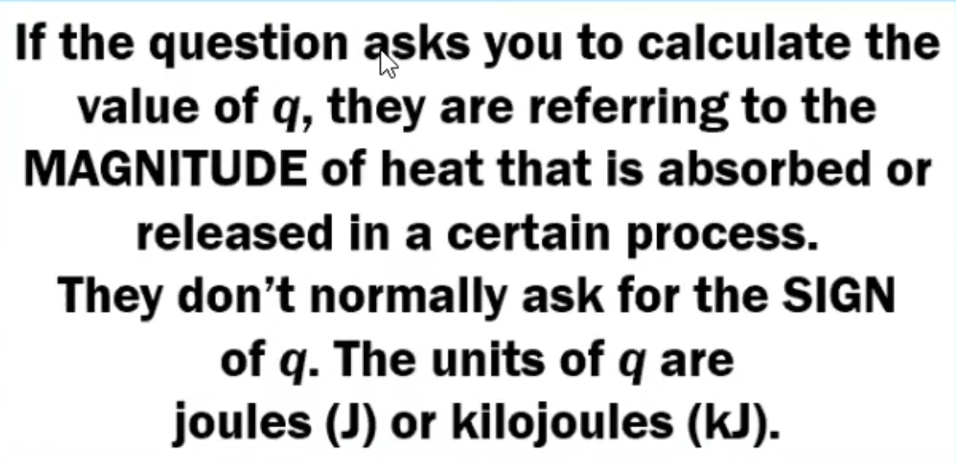
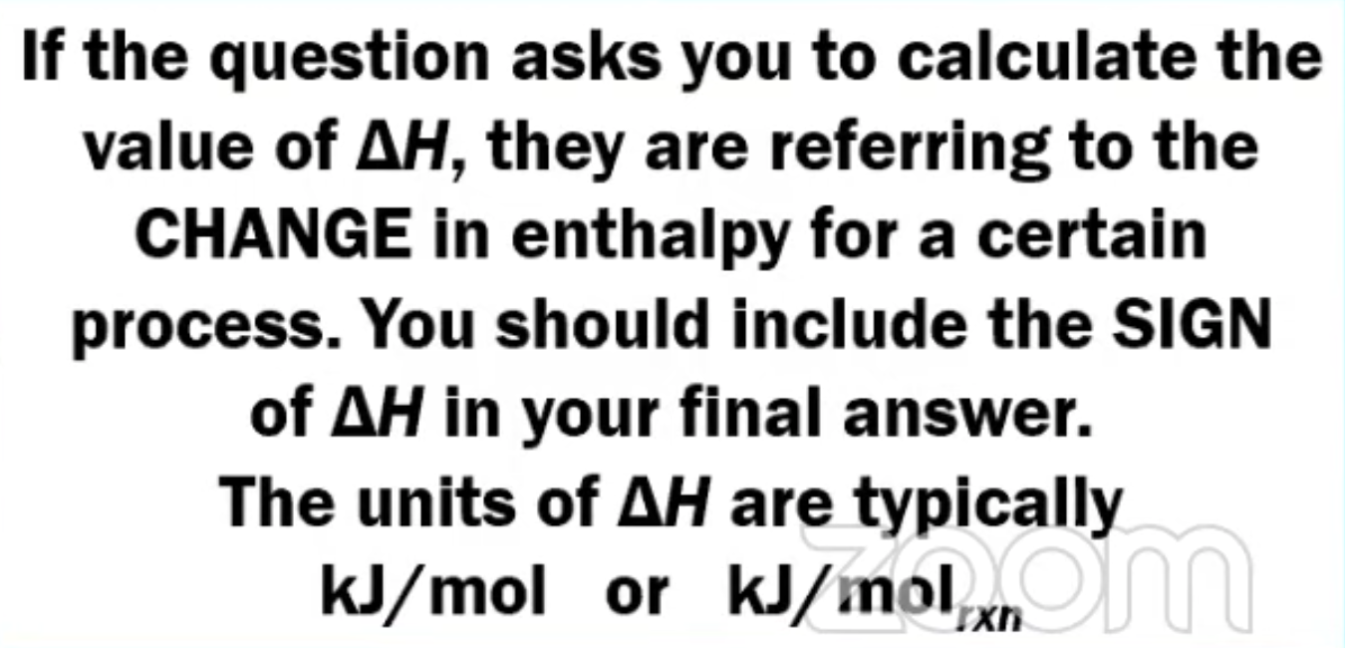
6.6 Introduction to Enthalpy of Reactions

Slide 18
6.6 Introduction to Enthalpy of Reactions
The enthalpy change of a reaction gives the amount of heat energy released (for negative values) or absorbed (for positive values) by a chemical reaction at constant pressure.
We can look at the thermochemical equation and use stoichiometry!
It is very important to pay attention to two things when calculating enthalpy values for this topic:
The number of moles of a substance based on the balanced equation
Limiting Reactants
Learning Objective: Calculate the heat q absorbed or released by a system undergoing a chemical reaction in relationship to the amount of the reacting substance in moles and the molar enthalpy of reaction.

Slide 19
6.7 Bond Enthalpy
Bond enthalpy: the energy required to break a bond or energy released when a bond is formed
Breaking bonds is ENDOTHERMIC
Forming bonds is EXOTHERMIC.
If the energy released when bonds are formed is greater than the energy required to break bonds, the reaction is exothermic.
If the energy required to break bonds is greater than the energy released when bonds are formed, the reaction is endothermic.
Bond strength is determined by the distance between the atoms in a molecule and bond order (single, double, or triple bond). Multiple bonds shorten the distance & increase the force of attraction between atoms in a molecule.
Lowest PE =Bond Energy
Learning Objective: Calculate the enthalpy change of a reaction based on the average bond energies of bonds broken and formed in the reaction.

Slide 20
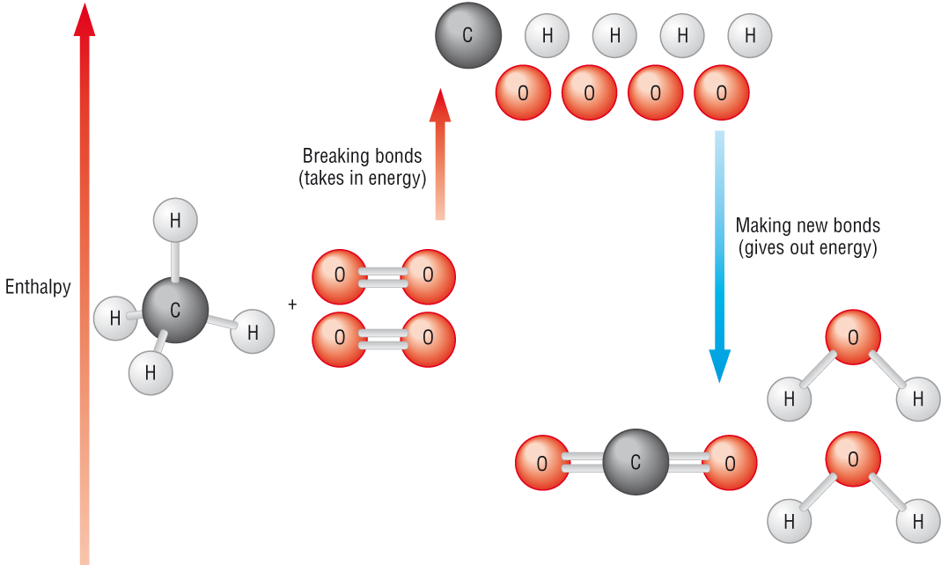
6.7 Bond Enthalpy

Slide 21
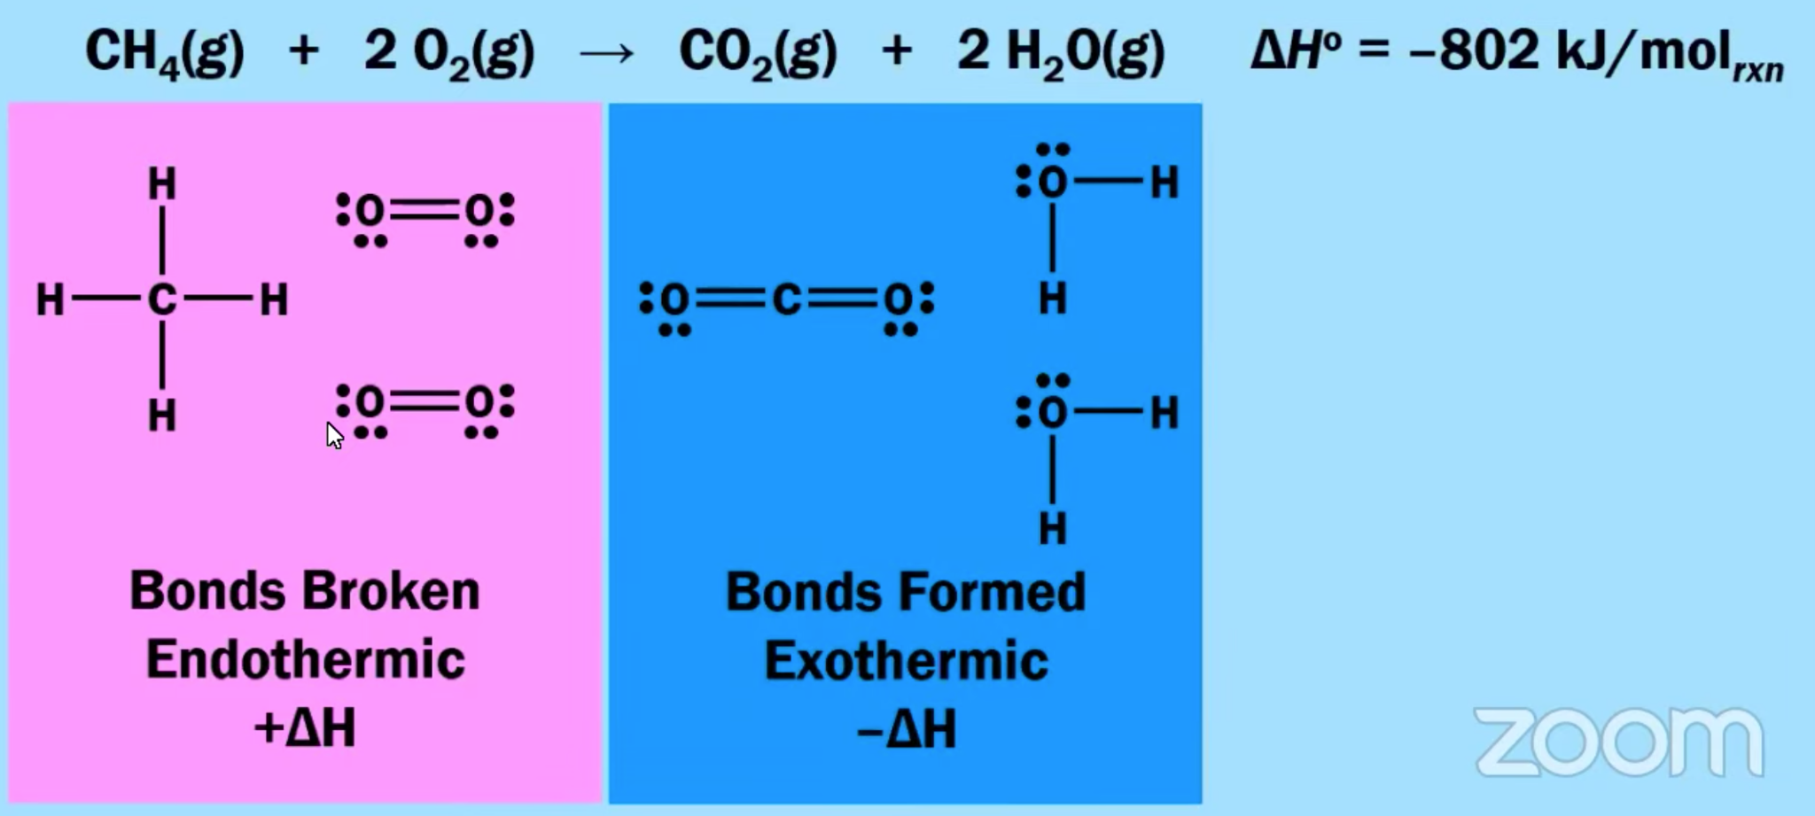
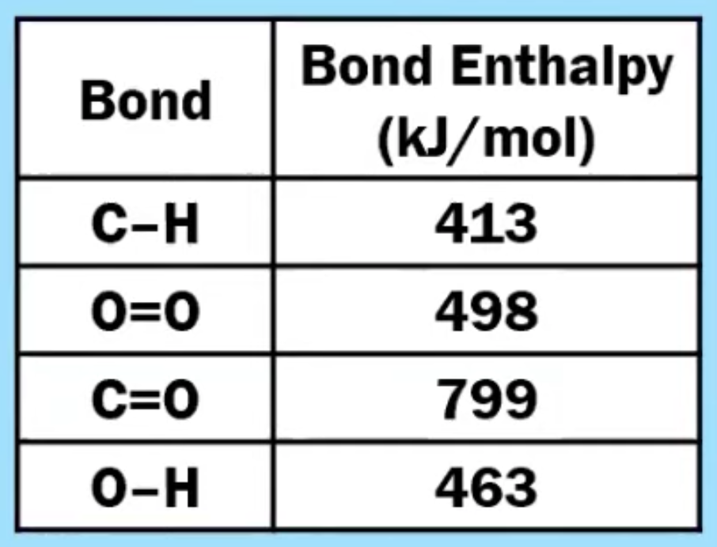
6.7 Bond Enthalpy
Learning Objective: Calculate the enthalpy change of a reaction based on the average bond energies of bonds broken and formed in the reaction.

Slide 22
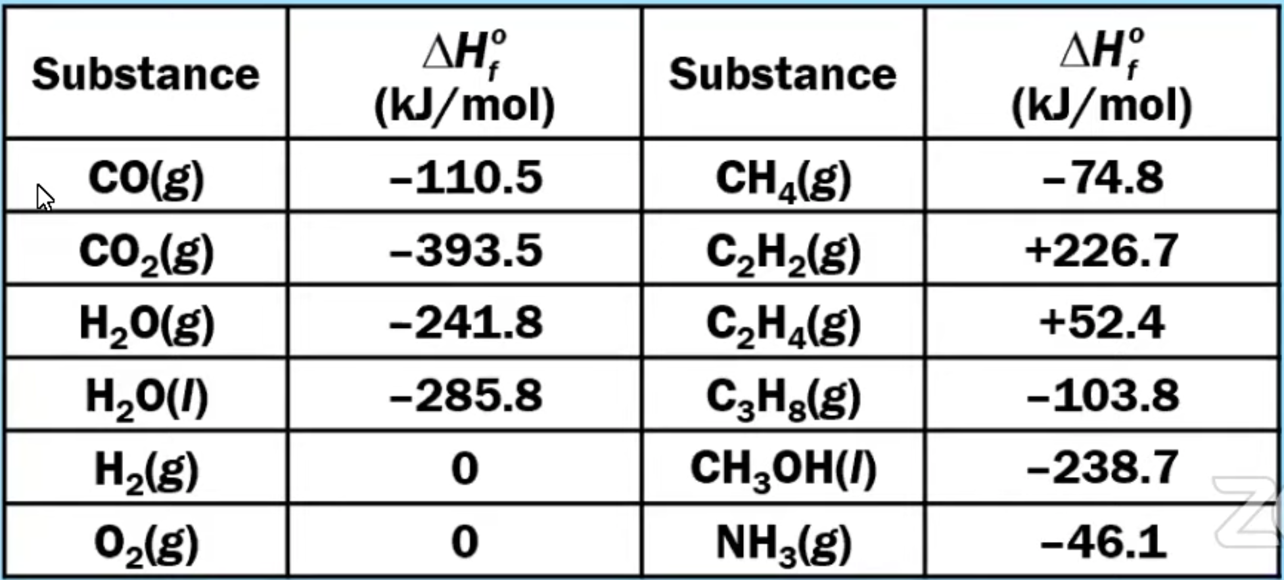
6.8 Enthalpy of Formation
The standard enthalpy of formation is the change of enthalpy during the formation of 1 mole of a substance from its constituent elements under standard conditions.
Pay attention to states of matter!!
Elements in their standard states do not have enthalpy of formation values as they do not have to “form”.
Ex: O₂(g) or Fe (s)
ΔH°_{reaction} = ΣΔH_{f} °_{products} − ΣΔH_{f} °_{reactants}
Learning Objective: Calculate the enthalpy change for a chemical or physical process based on the standard enthalpies of formation.

Slide 23
Summary of Enthalpies
Any bond that can be formed can be broken. These processes are in opposition. (their enthalpy changes are equal in magnitude, opposite sign)
ΔH bonds breaking: ENDOTHERMIC (+)
ΔH bonds forming: EXOTHERMIC (-)
To find ΔH_{rxn}
ΔH_{rxn} = ΣΔH_{bonds broken}- ΣΔH_{bonds formed}
To calculate or estimate ΔHrxn from Bond Energy:
Draw the Lewis Structure. Don’t forget about double and triple bonds!
Add up ΔH bonds breaking
Add up ΔH bonds forming.
Subtract broken - formed. Units are kJ/mol_{rxn}.
To calculate ΔH°_{rxn} from a table of standard enthalpies of formation:
ΔH°_{rxn} = ΣΔH°_{f} products - ΣΔH°_{f} reactants
If a reaction is EXOTHERMIC, there is a net release in energy, since weaker bonds break and stronger bonds form. Product has higher kinetic energy and lower potential energy than reactant.
If a reaction is ENDOTHERMIC, there is a net absorption of energy, since stronger bonds break, and weaker bonds form. Product has lower kinetic energy, and higher potential energy than reactant.

Slide 24
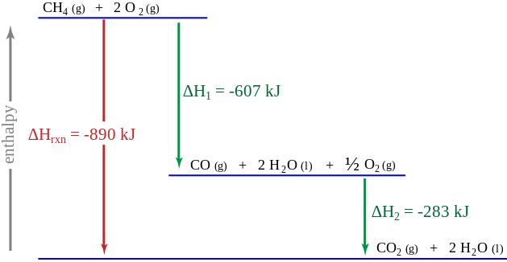
6.9 Hess’s Law
If you add two or more reactions together, the value of ΔH for the overall reaction is equal to the SUM of the ΔH values for the individual reactions.
Review of rules associated with changing thermochemical equations:
If an equation is reversed, change the sign of ΔH.
If an equation is multiplied by a number, multiply the value of ΔH by the number.
If equations are added together, add up the total of the ΔH values.
Learning Objective: Represent a chemical or physical process as a sequence of steps. Explain the relationship between the enthalpy of a chemical or physical process and the sum of the enthalpies of the individual steps.

