Slide 1
VSEPR
and hybridization
Ashlynn Brown, Jordyn Kelly, Lauren Saiter, Malane Qi

Slide 2
Valence Shell Electron-Pair Repulsion (VSepr) Theory
Uses Coulombic forces between electrons to predict the arrangement of electron pairs around a central atom (shape of molecules)

Slide 3
Linear
Two atoms bonded to the central atom
Zero Lone pairs
Bond angle of 180°

Slide 4
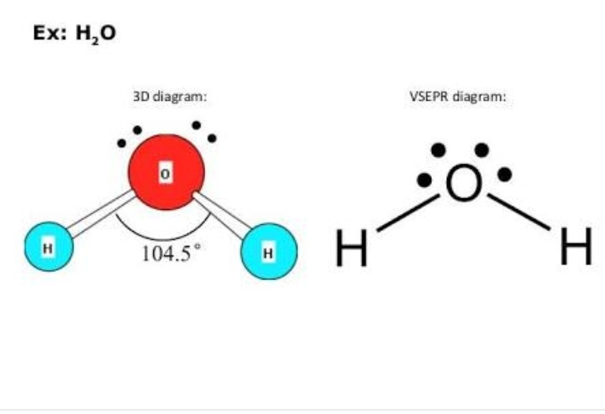
Bent
Two atoms bonded to the central atom
At least one lone pair
The lone pair(s) repel the electrons of the bonding atoms, causing a bend in the molecule
Bond angle slightly less than 120° (less if more lone pairs)

Slide 5
Trigonal Planar
Three atoms bonded to the central atom
Zero lone pairs
Equal bond angles of 120°

Slide 6
Trigonal Pyramidal
Three Atoms bonded to the central atom
One lone pair
The three bonding atoms are repelled by the lone pair of the central atom
Equal bond angles of 107.5°

Slide 7
Tetrahedral
Four atoms bonded to the central atom
Zero lone pairs
Equal bond angles of 109.5°

Slide 8
Trigonal Bipyramidal
Five atoms bonded to the central atom
Zero lone pairs
Bond angles of 120° and 90°

Slide 9
Octahedral
Six atoms bonded to the central atom
Zero lone pairs
Equal bond angles of 90°

Slide 10
VSEPR Notation (AXE)
When asked to determine the molecular geometry of an unknown species, said species may be referred to in VSEPR notation.
This provides the central atom, number bonding atoms, and number of lone pairs.
A=central atom
X=bonding atoms
E=lone pairs
For example: species AX₂E has a central atom with one lone pair and 2 bonding atoms, and would therefore have a bent molecular shape.

Slide 11
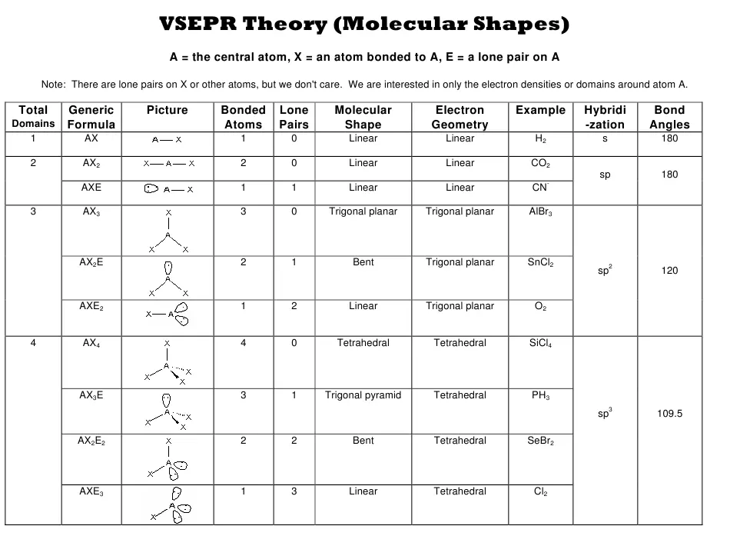
H y b r I d I z a t I o n

Slide 12
Hybridization
Hybridization occurs when a molecule has incomplete p orbitals
within these orbitals, an electron from an s orbital will lend itself over to the incomplete p orbital to make it balanced.
When this occurs, it creates a new type of orbital called an sp orbital.
Depending on the amount of full electron pairs in p, it can be called sp3, sp2, or sp.

Slide 13
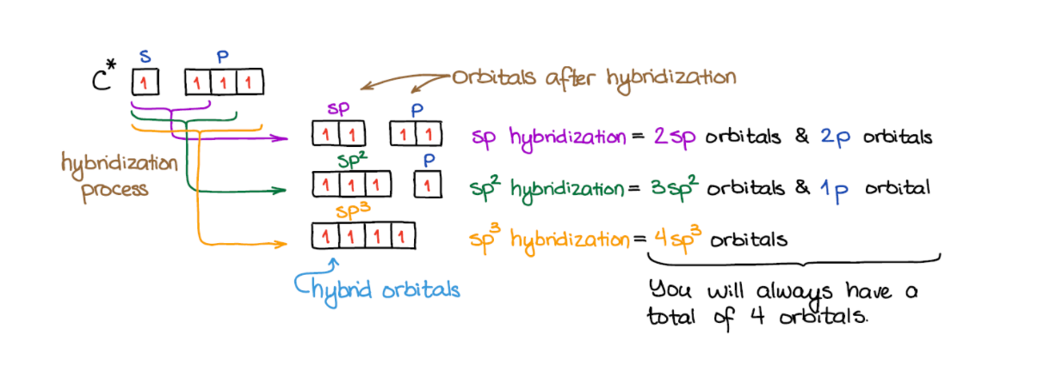
Hybridization graphic to help :)

Slide 14
What are Sigma and Pi Bonds?
When atomic orbitals of different atoms overlap to form covalent bonds, they approach each other in two different ways: Head on or from the side
Because s orbitals are spherical, they can only overlap head to head
P Orbitals may approach each other from either direction
When orbitals approach each other in a head to head fashion, they create sigma bonds
When they approach one another from the side, they create pi bonds
This means that s orbital bonds are always sigma bonds, while p orbital bonds can be either sigma or pi bonds

Slide 15
Examples of sigma Bonding
The bond between two hydrogen atoms
The carbon-hydrogen bonds in methane

Slide 16
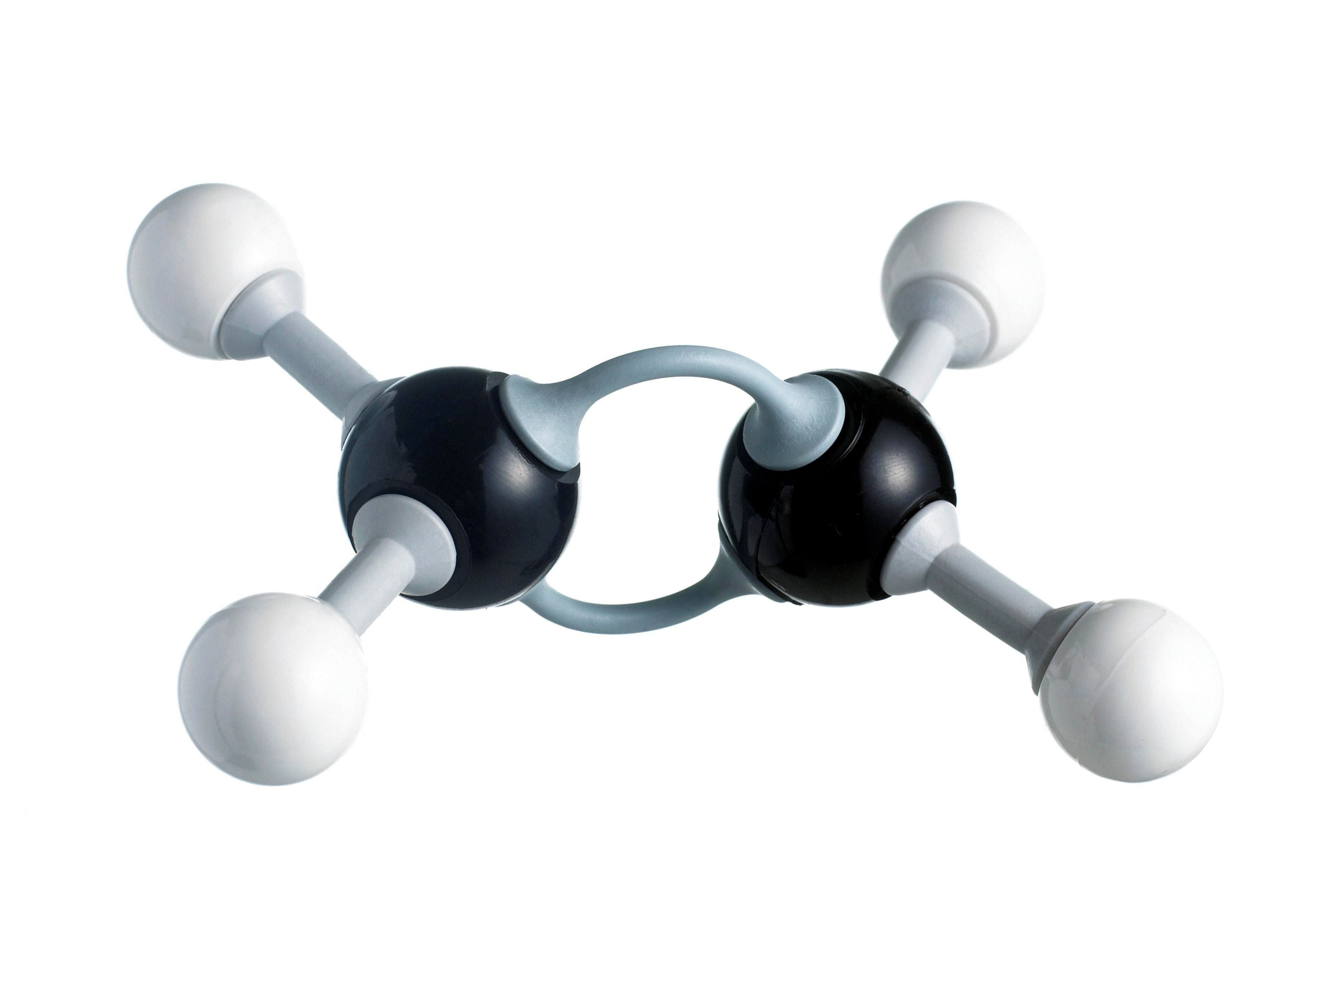
Examples of Pi Bonding
Ethene is an example of both pi and sigma bonding
The hydrogen-carbon bonds are sigma bonds
The carbon-carbon bond is a pi bond

Slide 17
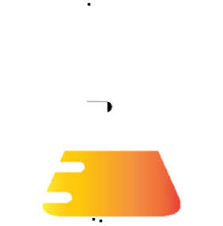
Homework
We apologize for the inconvenience

Slide 18
Activity!

Slide 19
References
linear vs. bent
hibridization
Sigma Bonds
Pi Bonds
WHY are Pi Bonds?
Counting Sigma and Pi Bonds

